Slide 1
World War II
DO NOW
What happened to Germany at the end of WW I?
What was the foreign policy of the US after WW I?

Slide 2
What happened to Germany at the end of WW I?
Treaty of Versailles
War Guilt Clause: Germany had to take responsibility for starting the war and pay huge amounts of money in reparations to the allies.
Demilitarization: Size of army limited
Troops not allowed in the Rhineland
Loss of territory

Slide 3
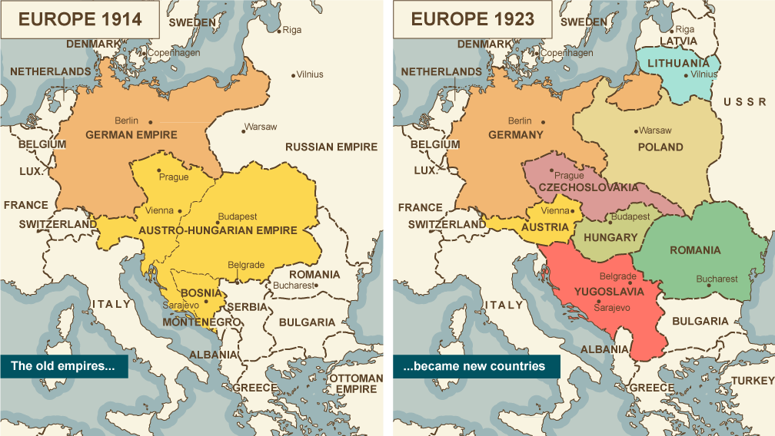
What happened to Germany at the end of WW I? Loss of territory.

Slide 4
___Essential Vocabulary___
Instability unreliability, uncertainty, unpredictability, insecurity, riskiness.
Dictator a ruler with total power over a country, typically one who has obtained power by force.
Nationalism a feeling that people have of being loyal to and proud of their country often with the belief that it is better and more important than other countries.
Fascism political philosophy in which total power is given to a dictator and individual freedoms are denied and nationalism and, often, racism are emphasized.
Inflation a continual increase in the price of goods and services.
Neutral not favoring either side in a quarrel, contest, or war.
Annex to add (an area or region) to a country, state, etc. : to take control of (a territory or place)

Slide 5
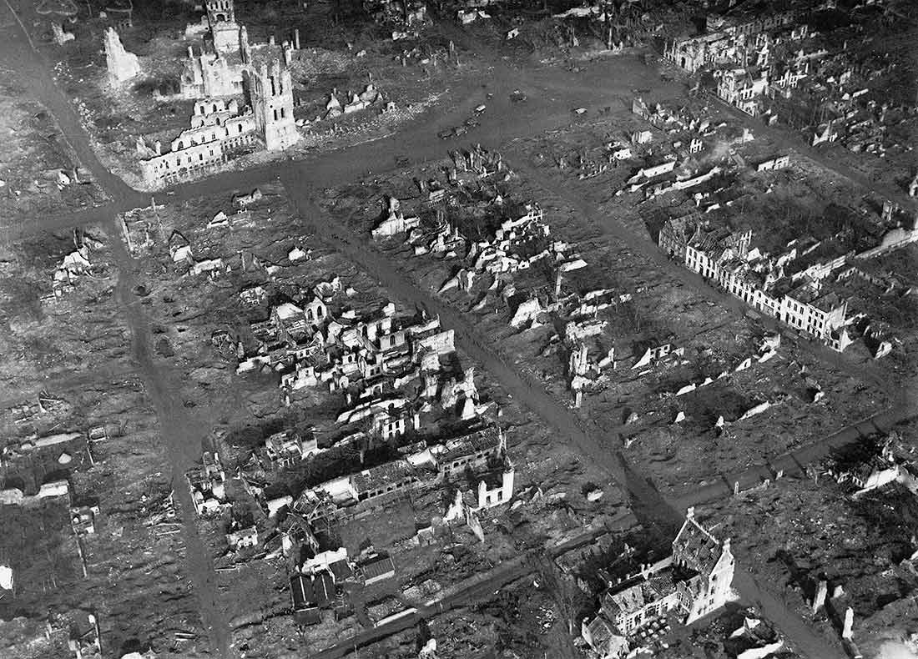
The Causes of World War II
Political instability and economic devastation in Europe resulting from World War I helped bring about WW II.

Slide 6
Causes video link

Slide 7
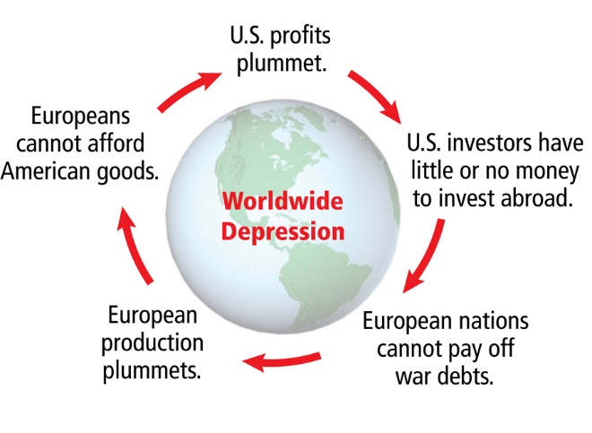
1. Worldwide depression
Especially in Germany, where the country had to pay large amounts to European Countries for World War I.

Slide 8
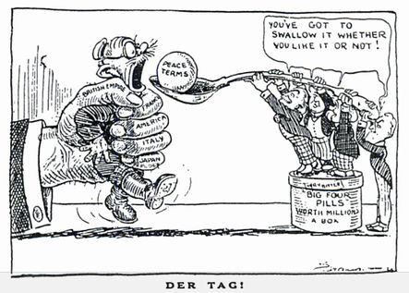
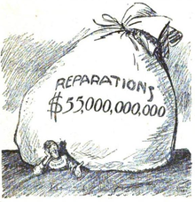
2. High war debt owed by Germany
(Treaty of Versailles)
Made Germany resentful of the other countries in Europe. They blamed their poverty on the Treaty of Versailles.

Slide 9
September 28,2010
Germany's Final Payment

Slide 10
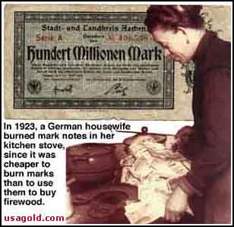
3. High inflation (increased price of goods)
German food and other goods were very expensive but their money was worth very little.

Slide 11
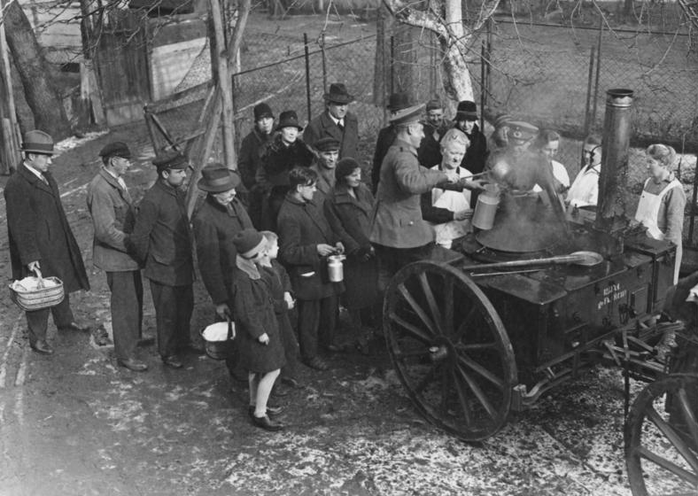
4. Massive unemployment
German people could not find jobs due to the depression. They blamed the treaty of Versailles, inflation, and the rest of Europe for this problem.

Slide 12
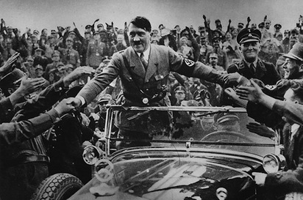
5. Rise of fascism (dictatorships)
Fascist dictators promised hope and change to Europeans who were desperate because of the depression, inflation, and unemployment that plagued Europe.

Slide 13
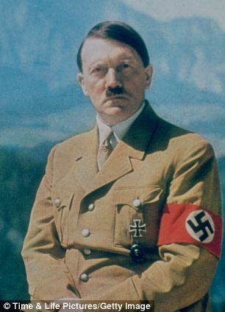
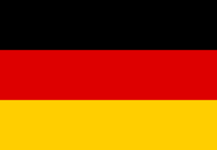
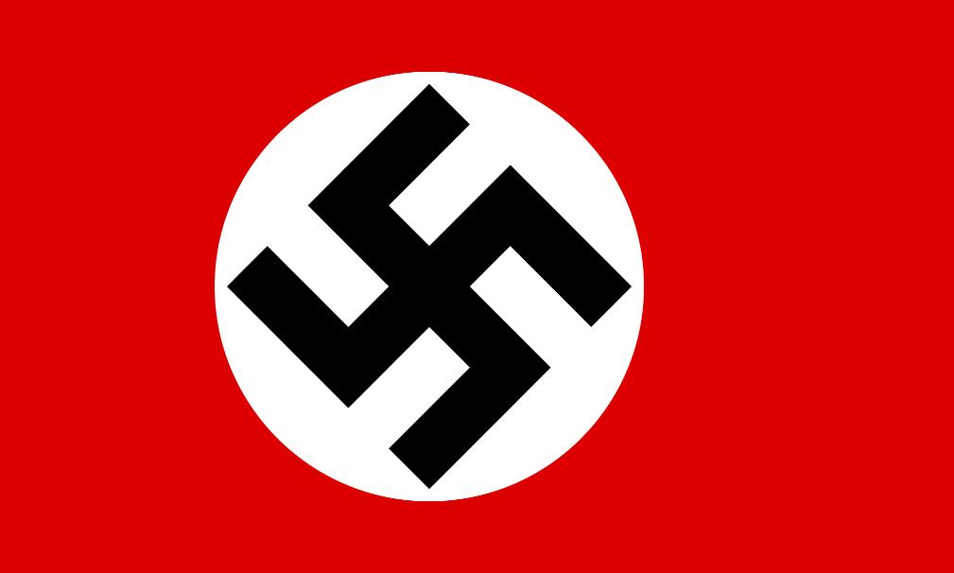
Three Fascist Dictators became the Axis Powers
1. Germany
Adolf Hitler
Came to power in 1933
Führer - Leader

Slide 14
Three Fascist Dictators became the Axis Powers
2. Italy
Benito Mussolini
~Became dictator in 1925
~Il Duce – The Leader

Slide 15
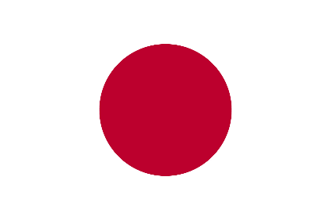
Three Fascist Dictators became the Axis Powers
3. Japan
Hideki Tojo
~ Hideki Tojo was not a dictator.
He served as Premier and war minister of Japan and had great power.
~Kamisori - the razor

Slide 16
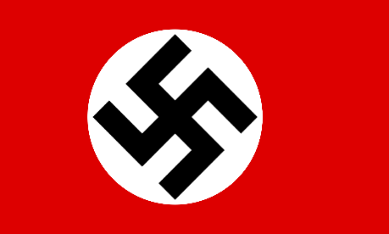
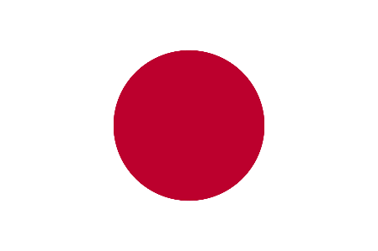
_The Axis Powers_
Germany – Adolf Hitler
Italy – Benito Mussolini
Japan – Hideki Tojo

Slide 17
Major Allied Powers
Great Britain
USA
Canada
Soviet Union (USSR)
Prime Minister: Winston Churchill
President: Franklin Roosevelt
Harry Truman - 1945
Leader of the Communist Party: Joseph Stalin

