Slide 1
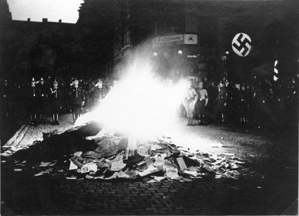
DO NOW
Why might a government want to silence people who disagree with it?
Why would a government want to burn and/or ban some books?

Slide 2
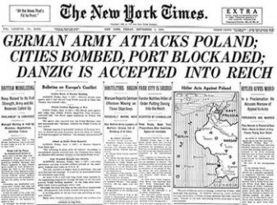
WW II Begins Sept. 1939
Germany invaded Poland September 1, 1939.

Slide 3
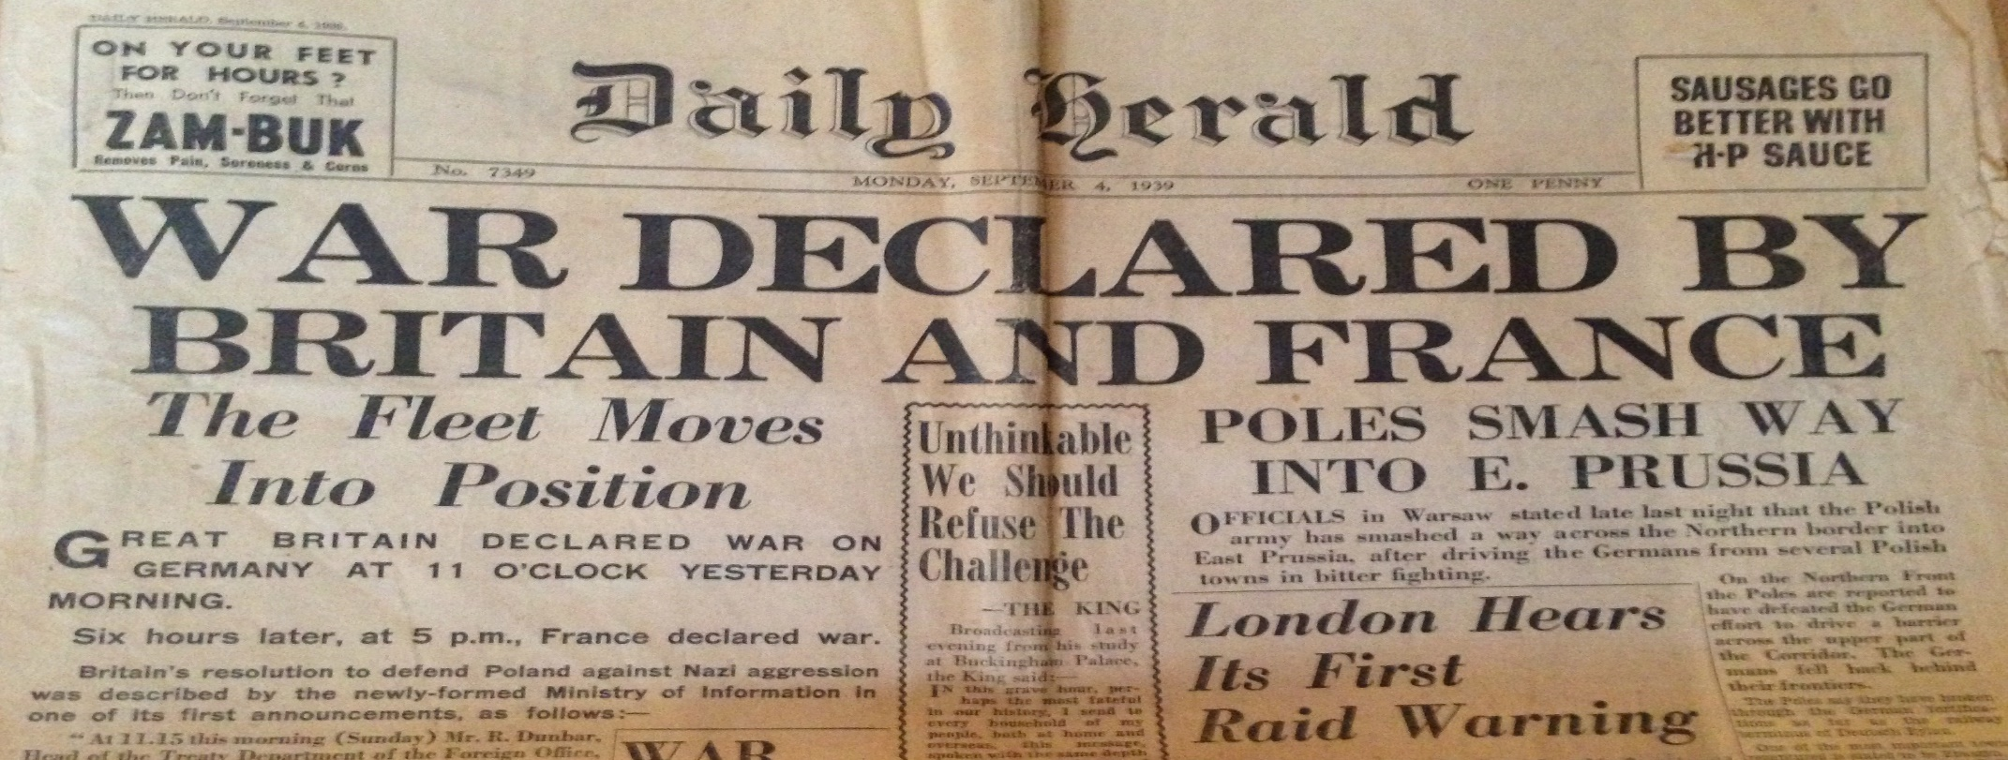
WW II Begins Sept. 1939
September 2, 1939 - Britain and France demanded that Germany withdraw by September 3 or face war.
At 11 p.m. on September 3, the British ultimatum expired, and Britain was at war with Germany.
France declared war on Germany.

Slide 4
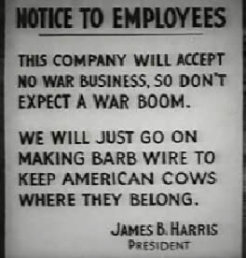
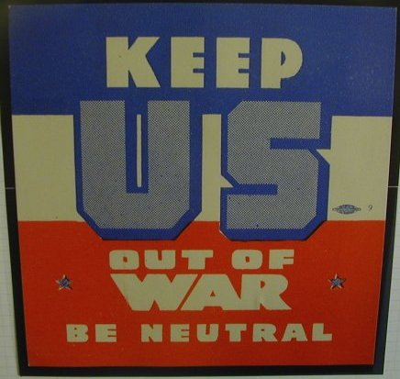
WW II Begins Sept. 1939
September 5, 1939 - United States proclaims its neutrality

Slide 5
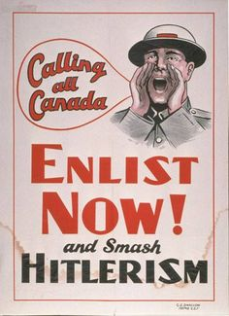
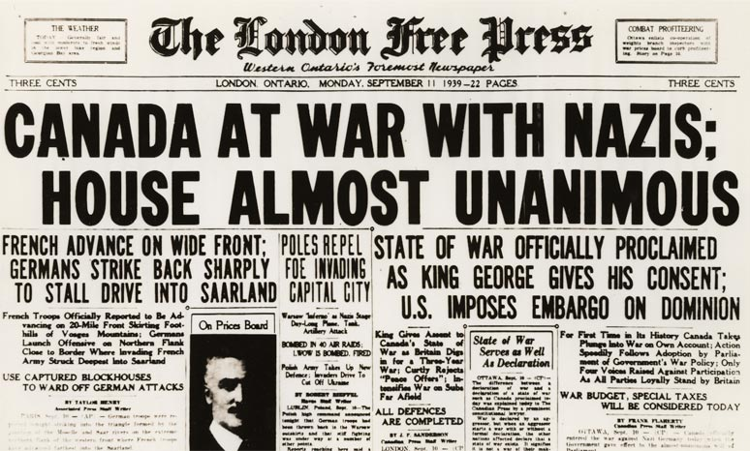
WW II Begins Sept. 1939
September 10, 1939 - Canada declares war on Germany

Slide 6
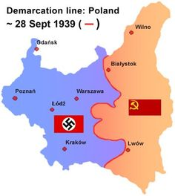
WW II Begins Sept. 1939
September 17, 1939 - Soviets invade Poland.
September 29, 1939 - Nazis and Soviets divide up Poland

Slide 7
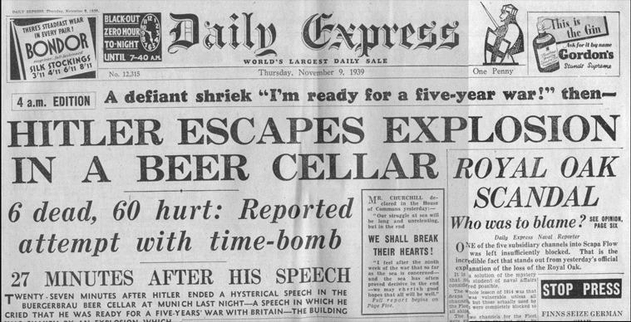
November 8, 1939
Assassination attempt on Hitler fails.
There were many attempts to assassinate Adolf Hitler:
http://www.assassinationinfo.com/Attempted/Adolf_Hitler/timeline.htm

