Slide 1
DO NOW
1. What event set off WW2?
2. Which countries were the major Axis Powers and who were the leaders of each country?
3. Which countries were the major Allied Powers and who were the leaders of these countries?

Slide 2
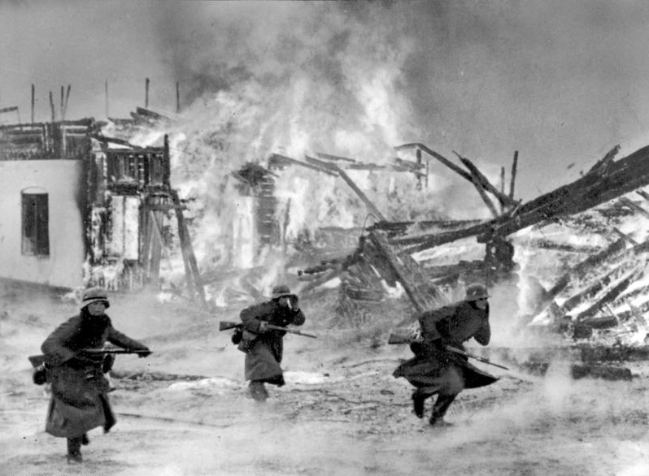
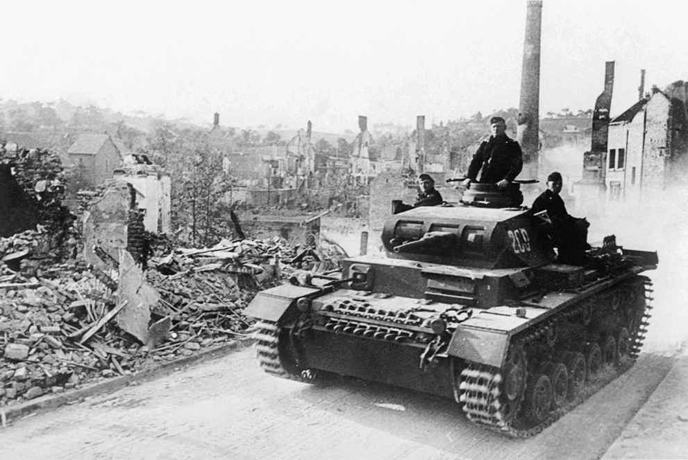
THE WAR CONTINUES
April 9, 1940 - Nazis invade Denmark and Norway.
May 10, 1940 - Nazis invade France, Belgium, Luxembourg and the Netherlands; Winston Churchill becomes British Prime Minister.

Slide 3
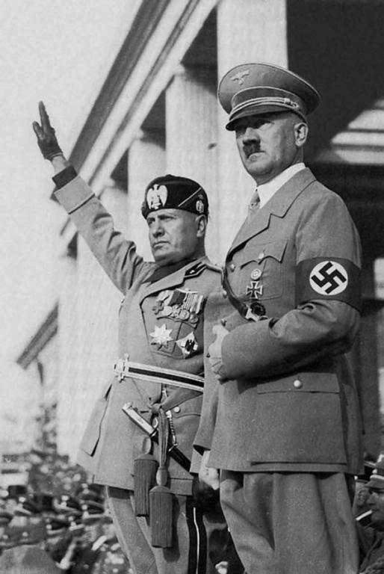
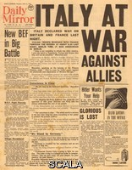
THE WAR CONTINUES
June 10, 1940 - Italy declares war on Britain and France.

Slide 4
June 22, 1940 - France Surrenders
Armistice is signed in the exact place where WW 1 ended:
A reporter’s account of the events:
“Also in the centre is a great granite block which stands some three feet above the ground. Hitler, followed by the others, walks slowly over to it, steps up, and reads the inscription engraved in great high letters on that block. It says:”
HERE ON THE ELEVENTH OF NOVEMBER 1918 SUCCUMBED THE CRIMINAL PRIDE OF THE GERMAN EMPIRE... VANQUISHED BY THE FREE PEOPLES WHICH IT TRIED TO ENSLAVE."

Slide 5
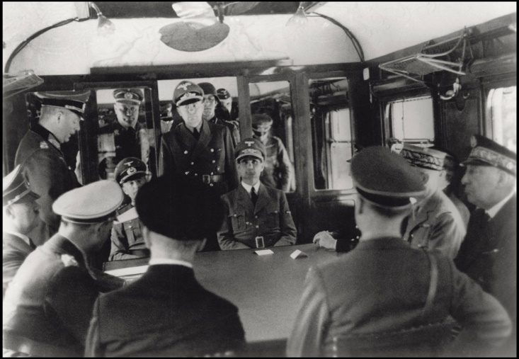
June 22, 1940 - France Surrenders ~ Signing the armistice.

Slide 6
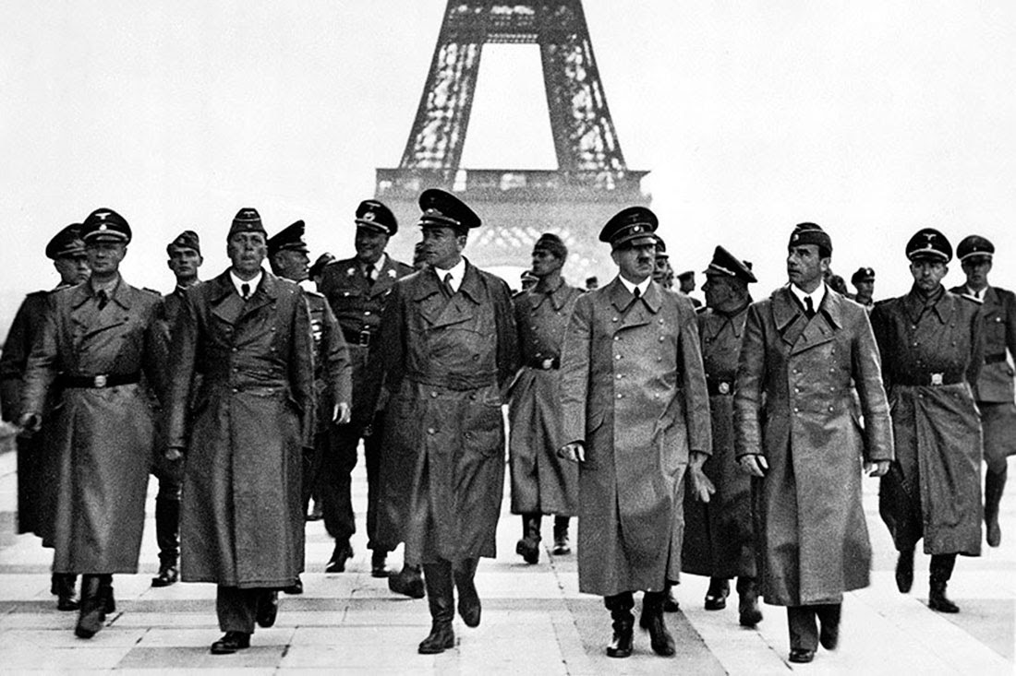
Hitler tours Paris

Slide 7
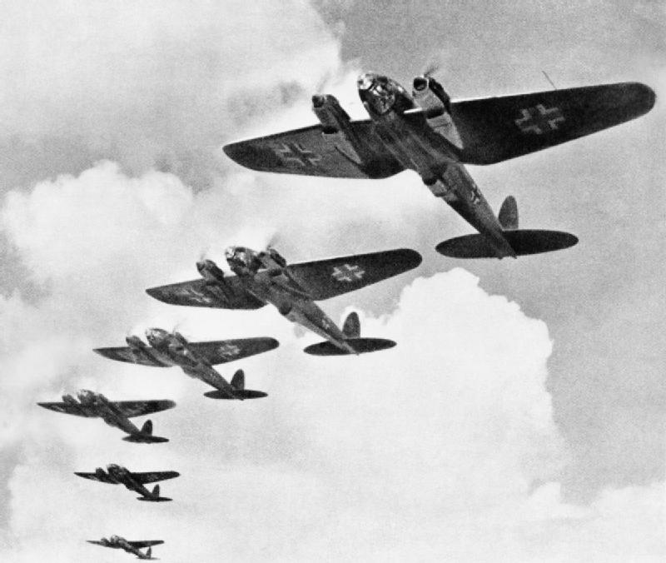
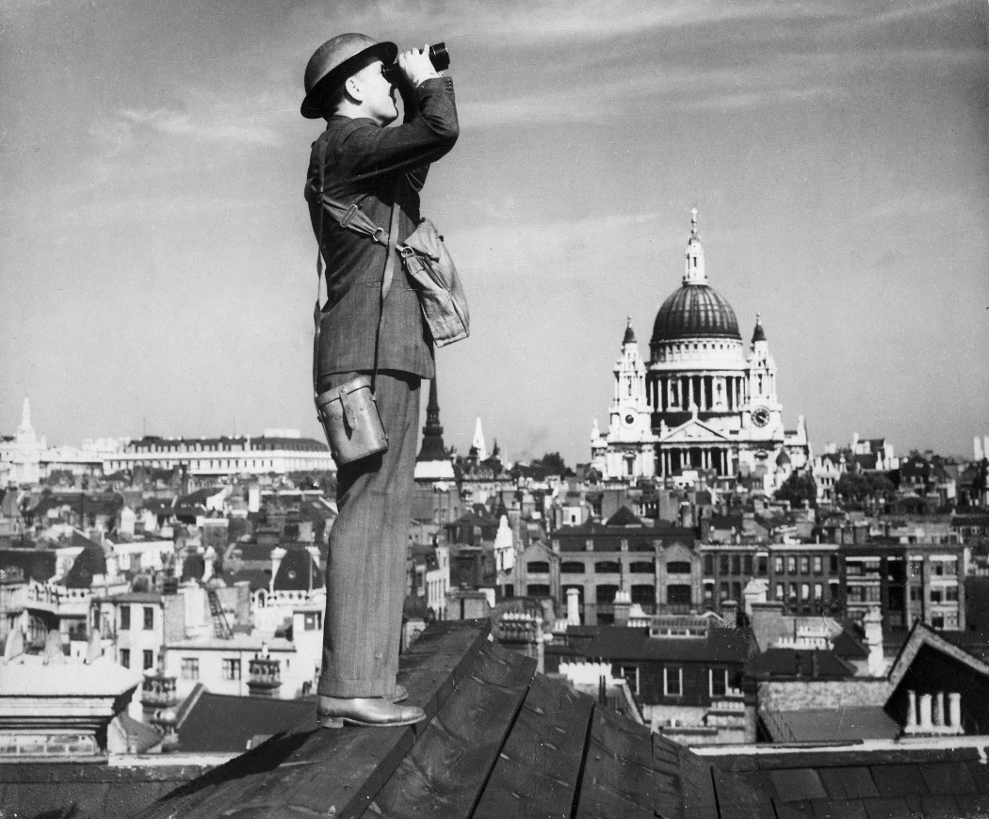
Germany Begins Bombing Britain
July 10, 1940 – The Battle of Britain Begins

Slide 8
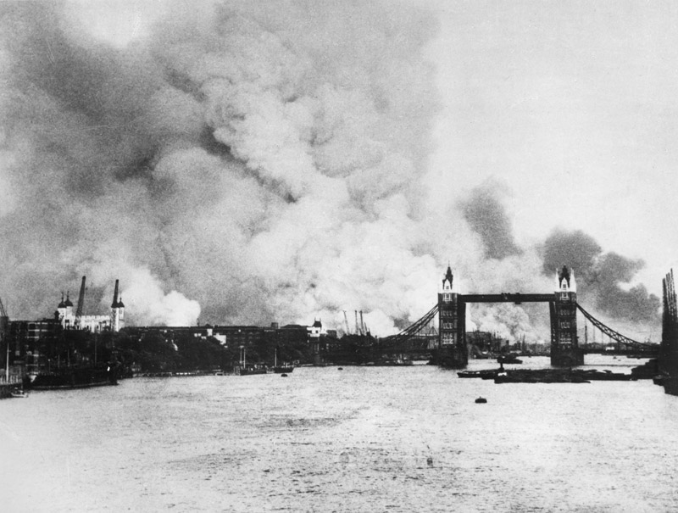

Slide 9
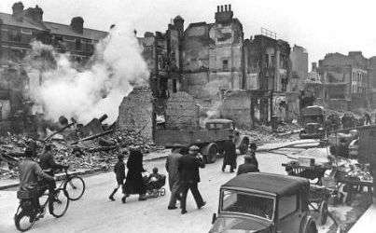

Slide 10
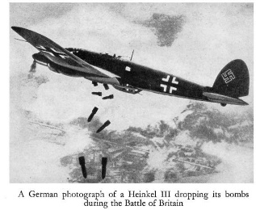
Germany Begins Bombing Britian

Slide 11
September 27, 1940 - Tripartite (Axis) Pact signed by Japan, Germany, and Italy.
Tojo Hitler Mussolini

Slide 12
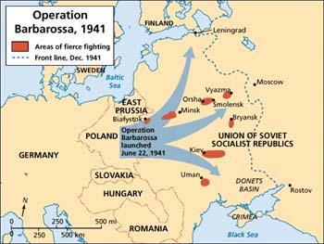
June 1941, Germany broke the Nazi-Soviet pact and invaded the USSR.
Known as Operation Barbarossa

Slide 13
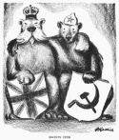
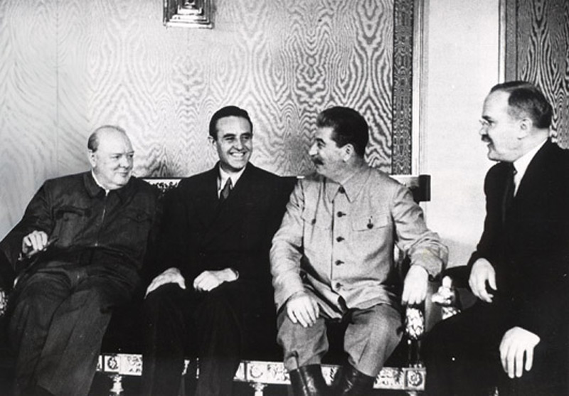
July 12, 1941 -Mutual Assistance agreement between British and Soviets.

Slide 14
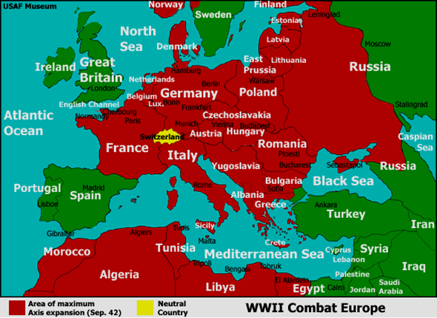

Slide 15
Make a WW II PPT
INCLUDE:
5 causes of WW II
2 Ways Germany violated the Treaty of Versailles
The event that started WW II
Allied Powers and Leaders
Axis Powers and Leaders
Use pictures and make it look good!!!

