Slide 1
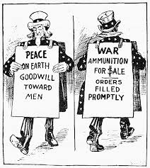
THE U.S. & WW II
There was a gradual change in American policy from neutrality to direct involvement.

Slide 2
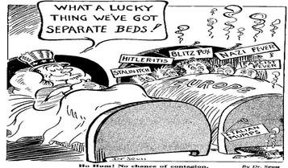
THE U.S. & WW II
1. US policy was Isolationism because of the Great Depression and legacy of World War I.
The Neutrality Acts were laws passed in 1935, 1936, 1937, and 1939 to limit U.S. involvement in future wars. They were based on the belief that the United States had been drawn into the WW I through loans and trade with the Allies.

Slide 3
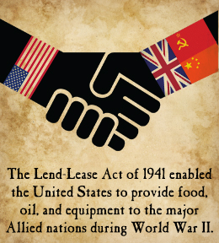
THE U.S. & WW II
2. Economic aid to Allies
Lend-Lease Act
Authorized the president to transfer arms or any other defense materials to “the government of any country whose defense the President deems vital to the defense of the United States.”

Slide 4
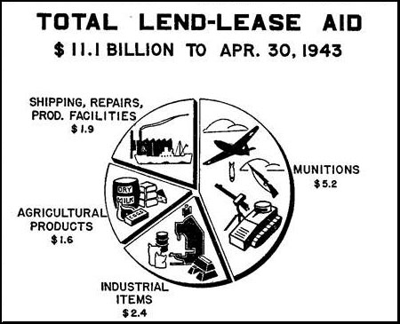

Slide 5
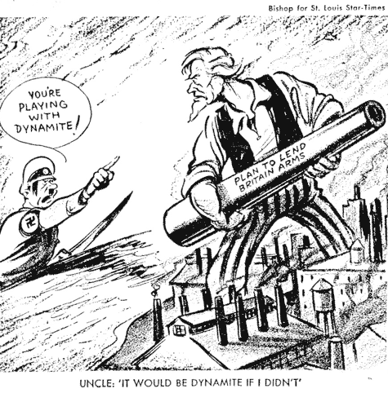

Slide 7
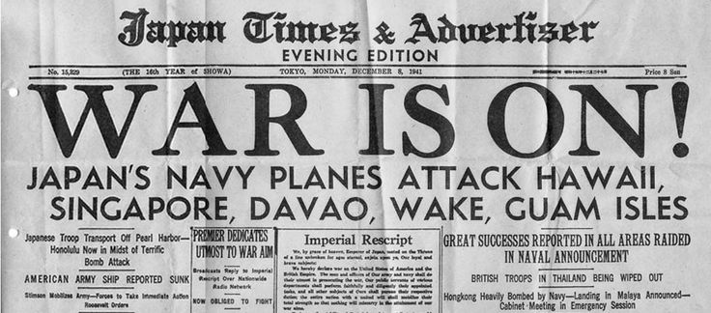
THE U.S. & WW II
3. Direct involvement in the war
Rising tension developed between the United States and Japan because of Japanese aggression in East Asia.
On December 7, 1941, Japan attacked the United States at Pearl Harbor without warning.

Slide 8
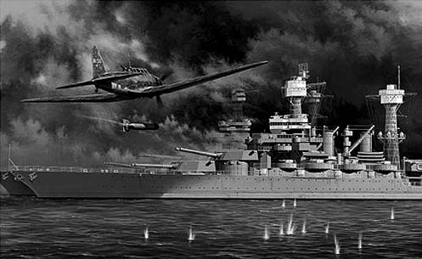
Pearl Harbor

Slide 9
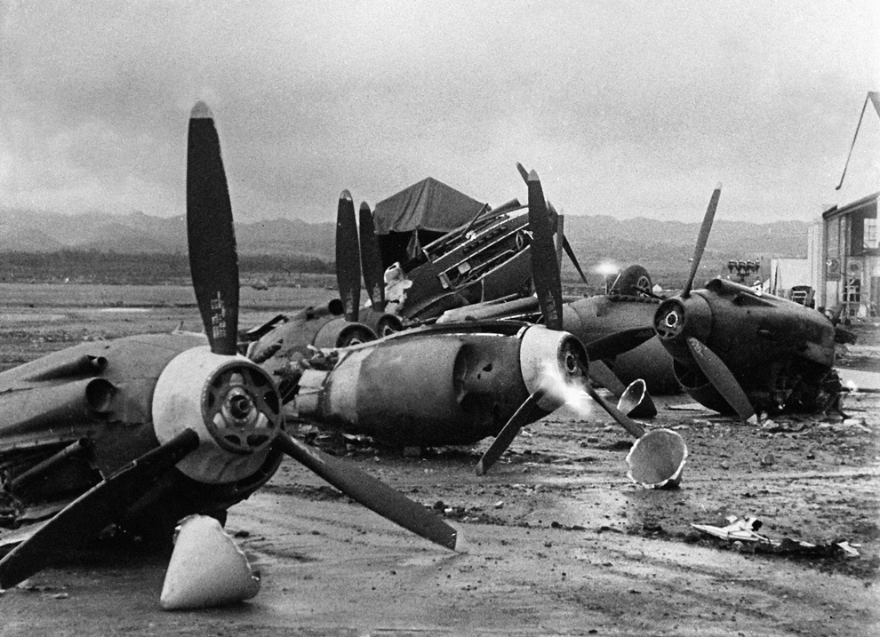
Pearl Harbor

Slide 10
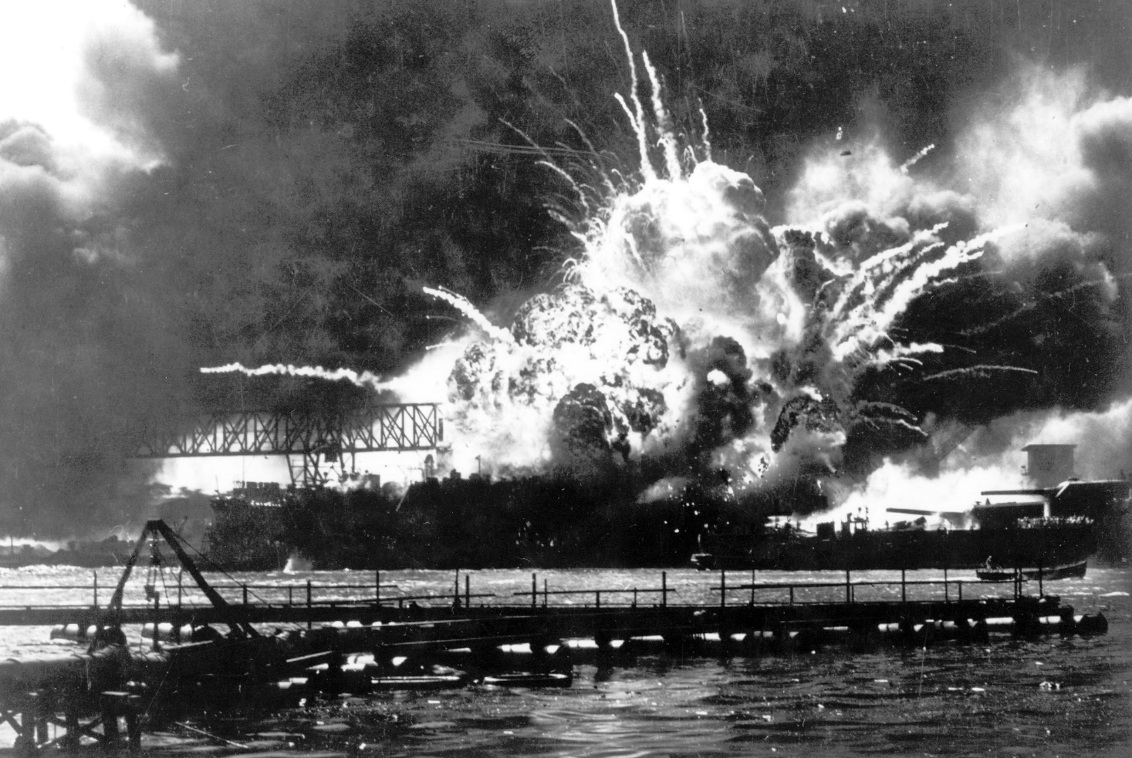
Pearl Harbor

Slide 11
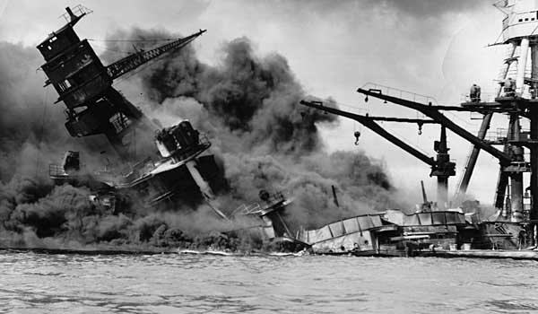
Pearl Harbor

Slide 12
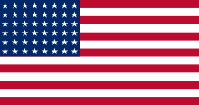
Losses at Pearl Harbor
United States:
2,403 people killed (68 civilians)
19 U.S. Navy ships destroyed or damaged

Slide 13
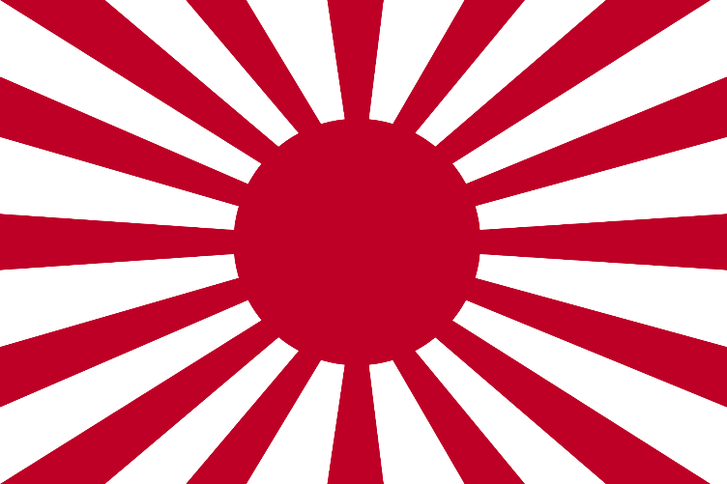
Losses at Pearl Harbor
Japanese:
29 aircraft
5 midget submarines
One Japanese soldier was taken prisoner
129 Japanese soldiers were killed

Slide 14
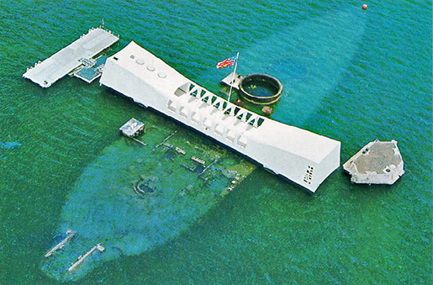
The battleship USS Arizona remains sunken in Pearl Harbor with its crew onboard. Half of the dead at Pearl Harbor were on the Arizona.

Slide 15
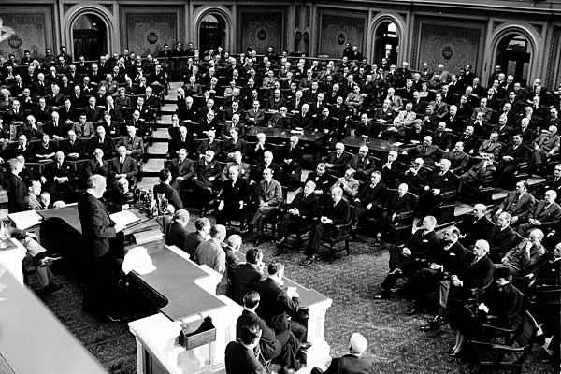
December 8, 1941 - United States and Britain
declare war on Japan.
Franklin D. Roosevelt addresses Congress and the country over the radio.

Slide 16
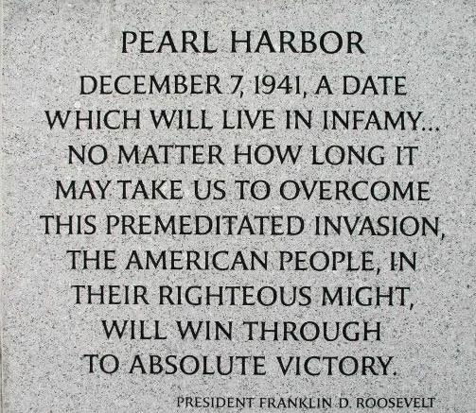

Slide 17
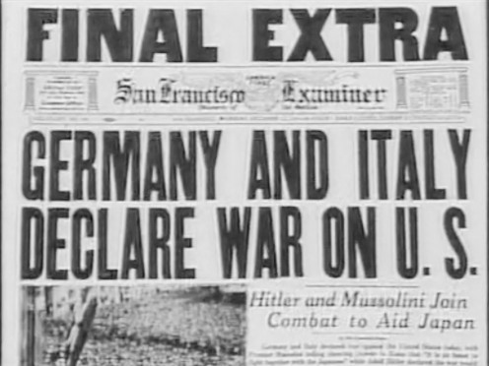
December 11, 1941 - Hitler & Mussolini declare war on the United States.

Slide 18
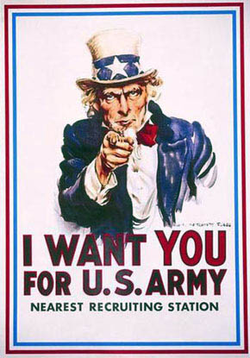
You’ve been drafted!
~And you’re going to world War 2!
Write a letter home to your parents telling them you’re off to war.
____Be sure to include:____
The causes of WW2 (5)
What countries you will be fighting against (3)
What countries you will be fighting with (3)
Why the USA is joining the war. (1)

