Slide 1
Do Now
What three inventions of the 20’s might’ve improved the lives of people living in rural areas?
How did labor saving products help people in their homes?

Slide 2
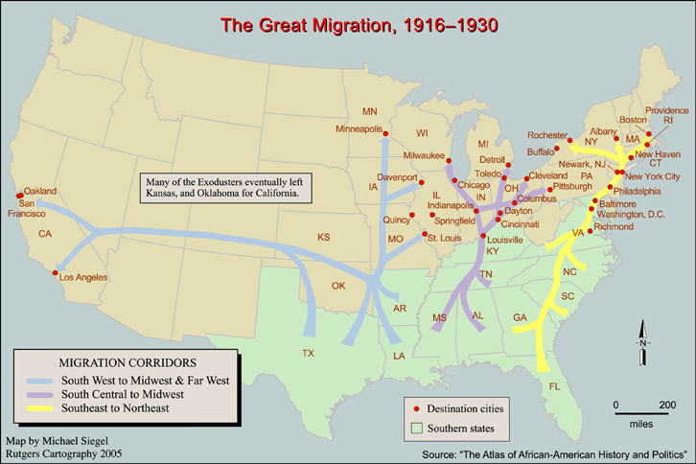
DO NOW
African American
3.Where are people migrating according to this map? 4. Why do you think they left the south?

Slide 3
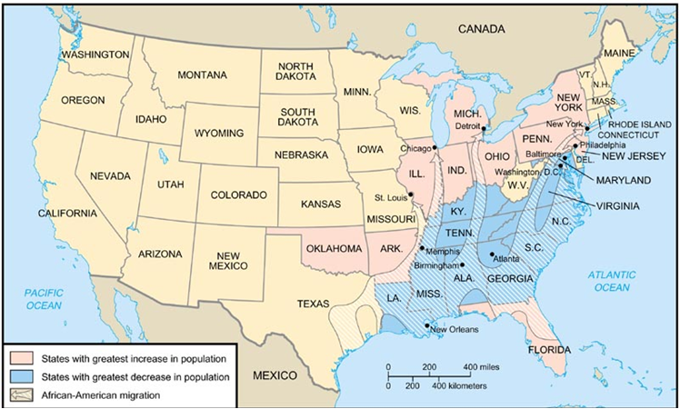
Poor Economic conditions and segregation in the South led to the migration of African-American people to the North and West.

Slide 4
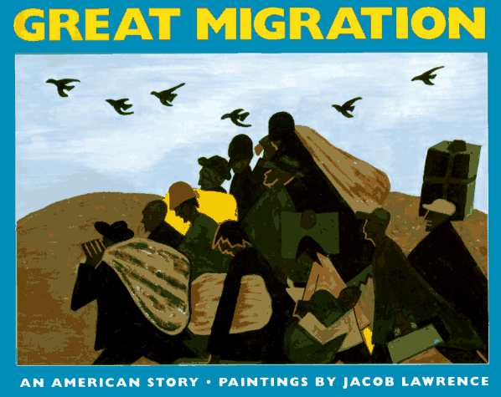
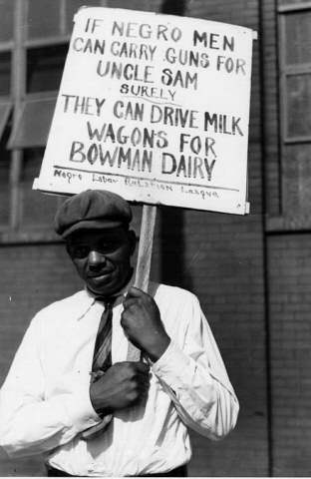
The Great Migration took place during and after WWI.

Slide 5
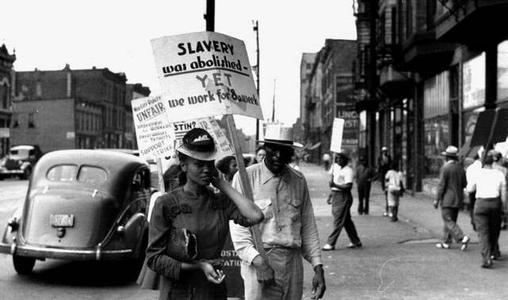
Because Jobs for African Americans in the south were scarce and low paying

Slide 6
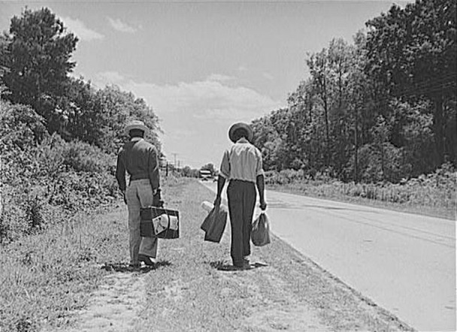
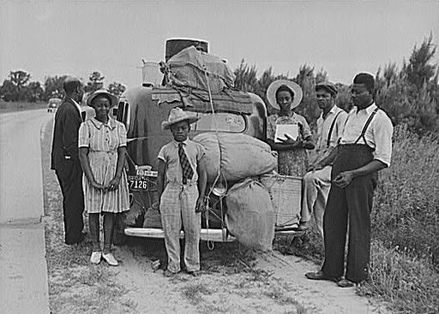
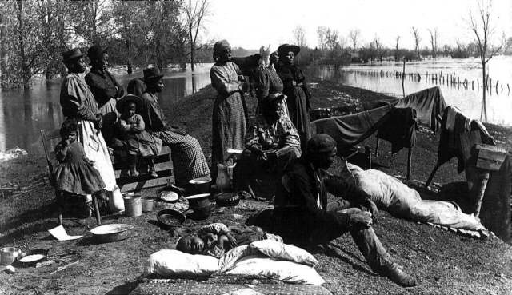
Between 1-2 million African Americans moved from the South to Northern Cities in search of better employment opportunities.

Slide 7
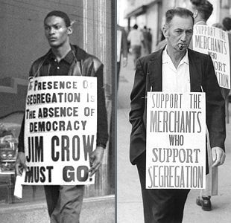
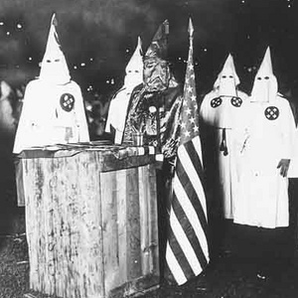
Also to avoid discrimination and violence in the South.

Slide 8
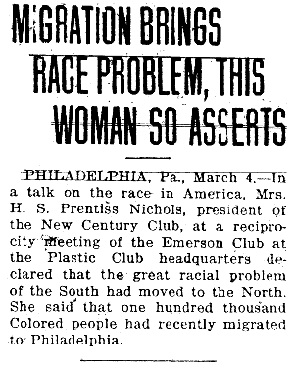
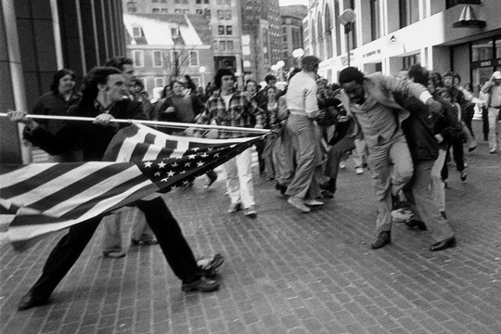
****However African Americans also faces discrimination and violence in the North and Midwest.****

Slide 9
Push factors – negative things that make one want to leave a place
Pull factors – positive things about a place that make you want to go there

