Slide 1
DO NOW
What were Black Codes?
What is the capital of the United States?
What was the term used by Southerners to describe Northerners who moved South during Reconstruction?

Slide 2
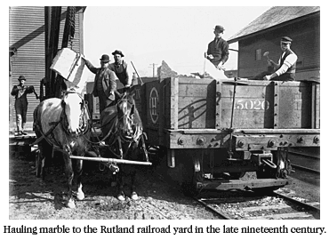
Reasons for growth of industry
1. Access to raw materials and energy
(natural resources)

Slide 3
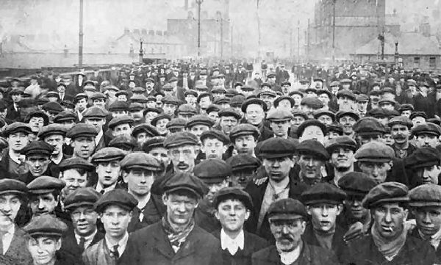
Reasons for growth of industry
2. Availability of work force due to immigration (labor resources)

Slide 4
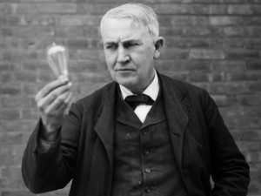
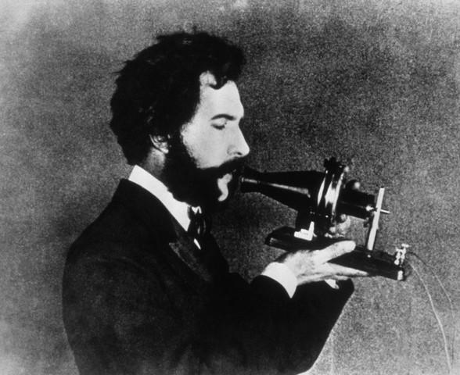
Reasons for growth of industry
3. Inventions and ideas (mind resources)

Slide 5
Reasons for growth of industry
4. Financial resources

Slide 6
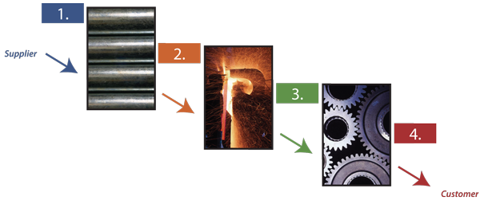
Reasons for growth of industry
5. Transportation Resources

Slide 7
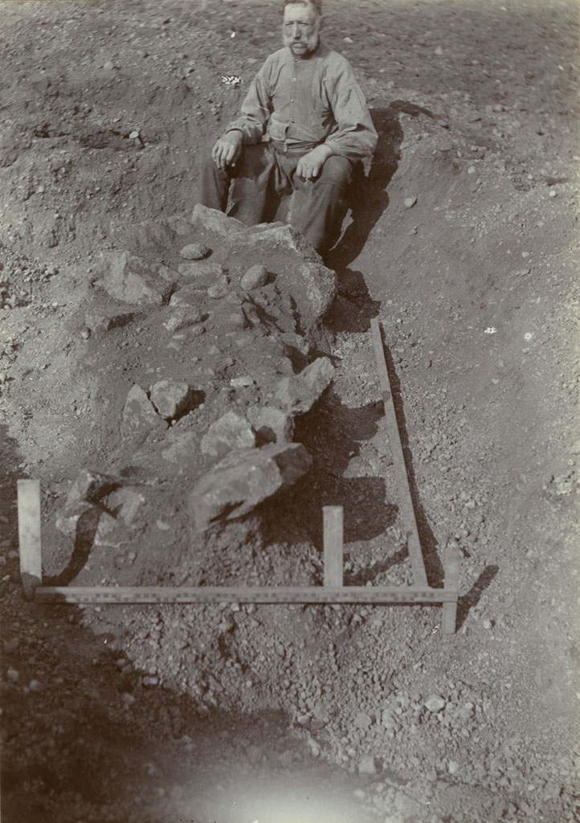
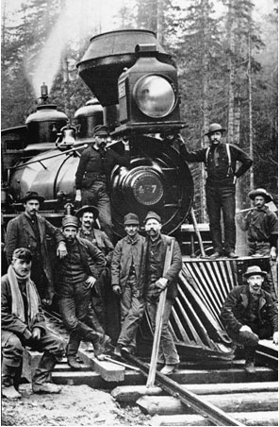
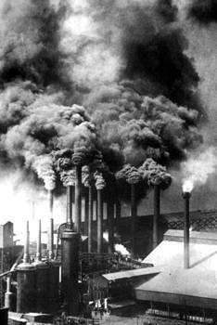
Transportation resources
Moving natural resources (e.g., copper, lead) to eastern factories.

Slide 8
Transportation resources
Moving iron ore deposits to sites of steel mills (e.g., Pittsburgh).

Slide 9
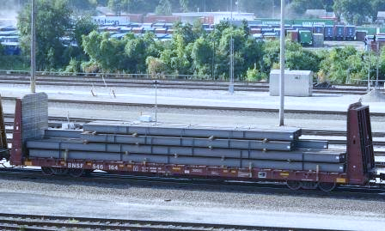
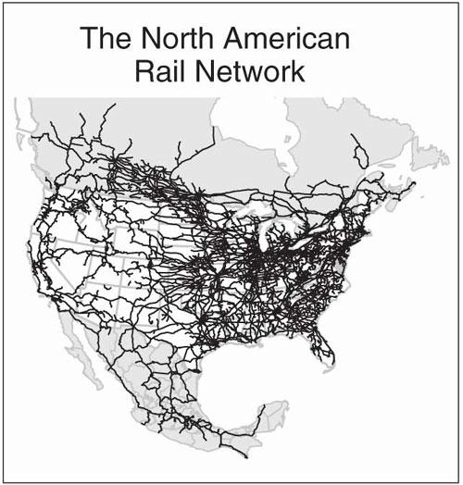
Transportation resources
Transporting finished products to national markets

