Slide 1
Do Now
What did Booker T. Washington believe?
What did WEB Dubois want?
Why did African Americans leave the South? What was this called?

Slide 2
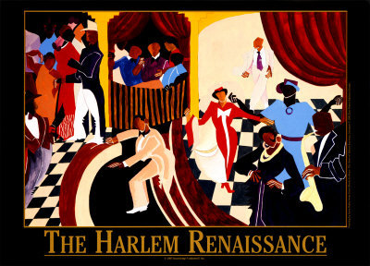
The Harlem Renaissance was when African American artists, writers, and musicians based in Harlem revealed the freshness and variety of African American culture.

Slide 3
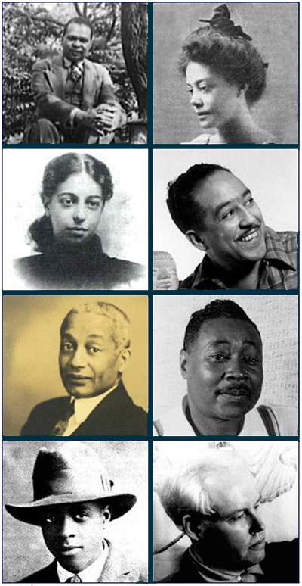
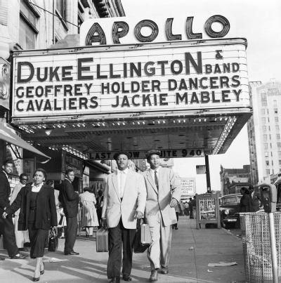
The popularity of these artists spread to the rest of society.

Slide 4
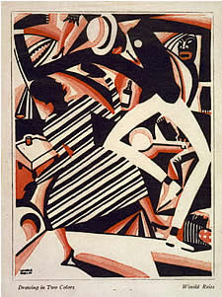
The Harlem Renaissance was a result of the Great Migration.

Slide 5
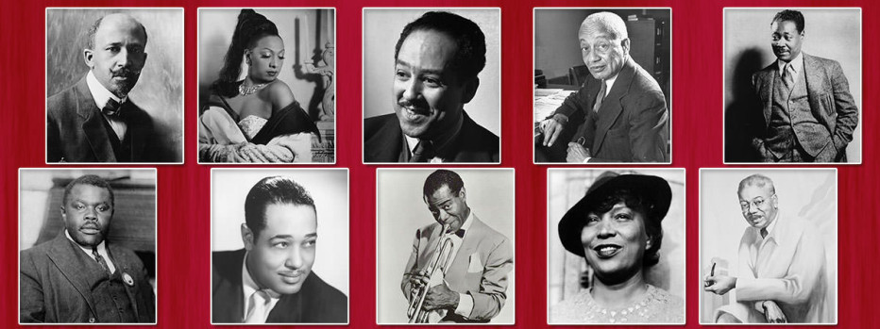
The leaders of the Harlem Renaissance drew upon the heritage of African American culture to establish themselves as powerful forces for cultural change.

Slide 6
People to know
of the Harlem Renaissance…

Slide 7
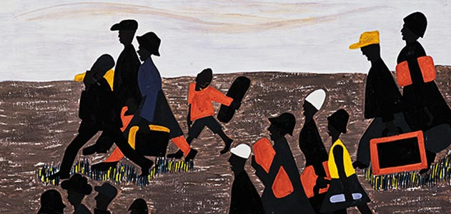
Jacob Lawrence (Art), a painter who chronicled the experiences of the Great Migration North through art.

Slide 8
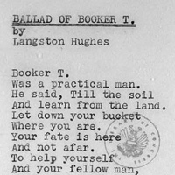
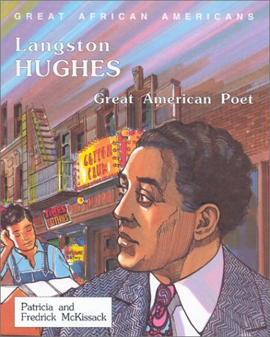
Langston Hughes (Literature), a poet who combined the experiences of African and American cultural roots

Slide 9
The South by Langston Hughes The lazy, laughing South With blood on its mouth. The sunny-faced South, Beast-strong, Idiot-brained. The child-minded South Scratching in the dead fire's ashes For a Negro's bones. Cotton and the moon, Warmth, earth, warmth, The sky, the sun, the stars, The magnolia-scented South. Beautiful, like a woman, Seductive as a dark-eyed woman, Passionate, cruel, Honey-lipped, syphilitic— That is the South. And I, who am black, would love her But she spits in my face. And I, who am black, Would give her many rare gifts But she turns her back upon me. So now I seek the North— The cold-faced North, For she, they say, Is a kinder mistress, And in her house my children May escape the spell of the South.
1.What is the metaphor in this poem?
2. What does the poem reveal about life in the South?
3What does the poem suggest is the solution to life in the South?
4.What does the poem reveal about life in the North?

Slide 10
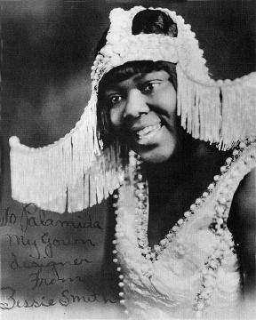
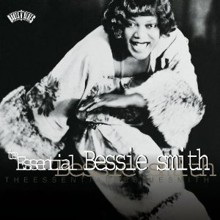
Bessie Smith (Music) Blues singer

Slide 11
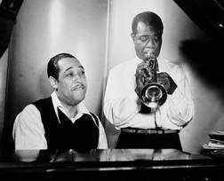
Duke Ellington and Louis Armstrong(Music), jazz musicians;

Slide 12
Other Cultural Artists

Slide 13
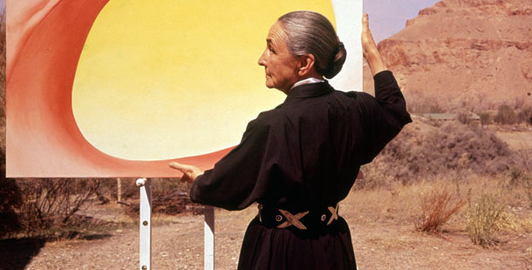
Georgia O’Keeffe(Art) an artist known for urban scenes and, later, paintings of the Southwest

Slide 14
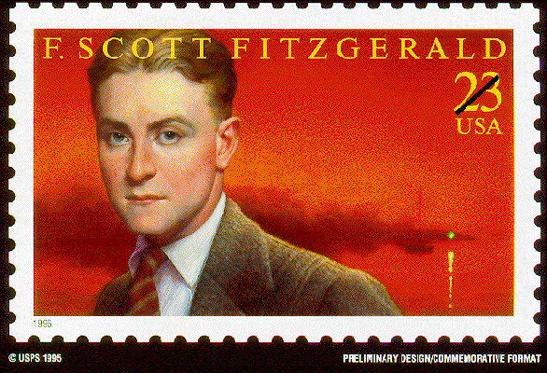
F. Scott Fitzgerald(Literature), a writer who wrote about the Jazz Age of the 1920s;

Slide 15
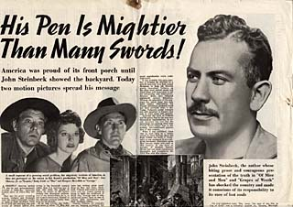
John Steinbeck(Literature), a novelist who portrayed the strength and struggles of poor migrant farm workers during the 1930s

Slide 16
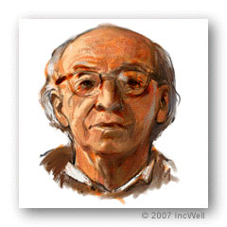
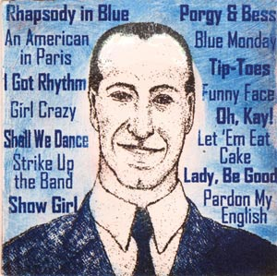
Aaron Copland and George Gershwin(Music), composers who wrote uniquely American music.

