Slide 1
Do Now
1. What is prejudice?
2. What is discrimination?
3. What is segregation?

Slide 2
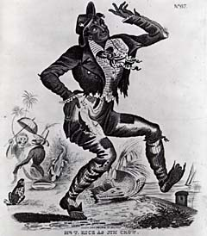
Who was Jim Crow?
"Come listen all you galls and boys, I'm going to sing a little song, My name is Jim Crow. Weel about and turn about and do jis so, Eb'ry time I weel about I jump Jim Crow."
These words are from the song, "Jim Crow," as it appeared in sheet music written by Thomas Dartmouth "Daddy" Rice. Rice, a struggling "actor" (he did short solo skits between play scenes) at the Park Theater in New York, happened upon a Black person singing the above song -- some accounts say it was an old Black slave who walked with difficulty, others say it was a ragged Black stable boy. Whether modeled on an old man or a young boy we will never know, however, it is clear that in 1828 Rice appeared on stage as "Jim Crow" -- an exaggerated, highly stereotypical Black character.

Slide 3
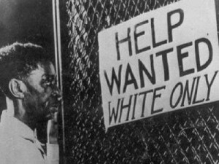
Discrimination against African Americans continued after Reconstruction. “Jim Crow
laws institutionalized (made into custom) a system of legal segregation.

Slide 4
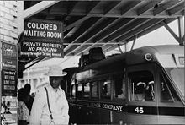
Jim Crow Laws
“Jim Crow” laws were passed to discriminate against African Americans.

Slide 5
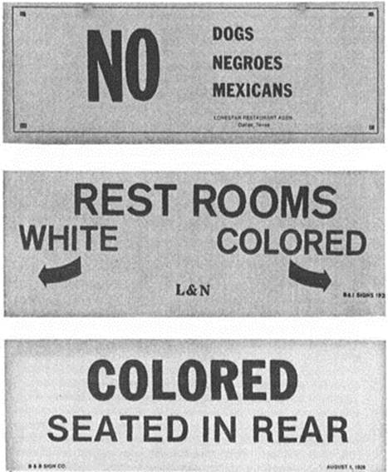
Jim Crow Laws
Made discrimination practices legal in many SOUTHERN communities and states.

Slide 6
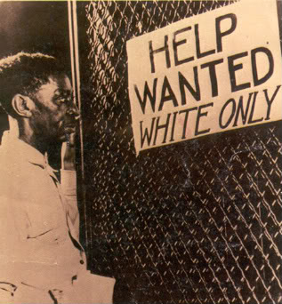
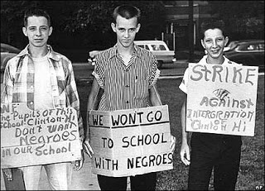
Jim Crow Laws
Were characterized by unequal opportunities in housing, work, education, government.

Slide 7
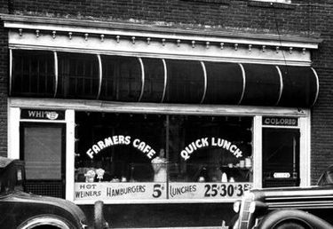
Racial Segregation
Based upon race

Slide 8
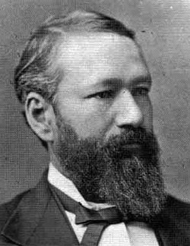
•The Plessy v. Ferguson case (which said the facilities could be “Separate but Equal.”-1896

Slide 9
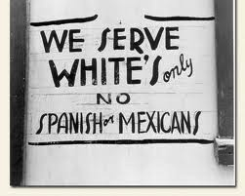
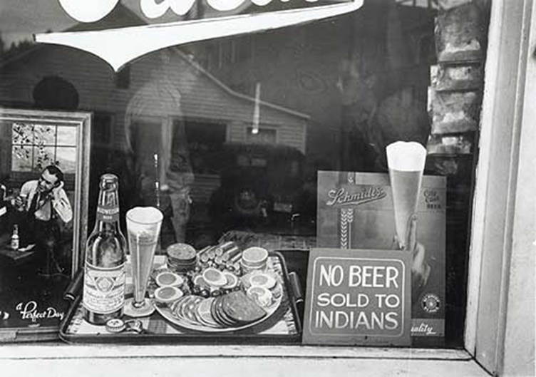
Segregation
Directed primarily against African Americans, but other groups also were kept segregated.

Slide 10
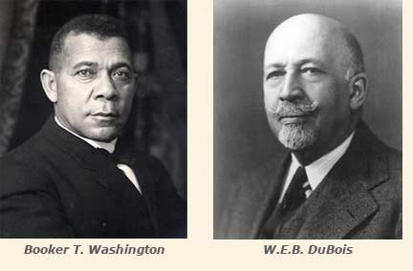
Jim crow & Segregation
African Americans differed in their responses to discrimination and “Jim Crow.”

Slide 11
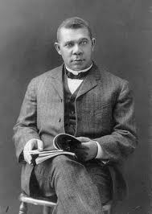
Booker T. Washington
Believed equality could be achieved through vocational (job-related) education; accepted social separation.

Slide 12
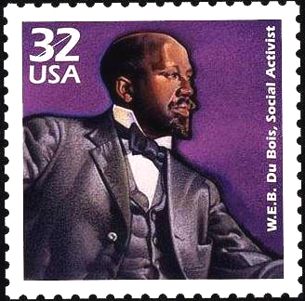
W.E.B. Dubois
Believed in full political, civil, and social rights for African Americans and co-founder of the NAACP in 1909.

Slide 13
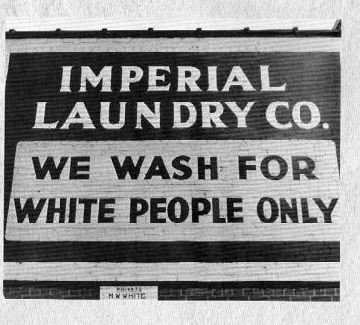
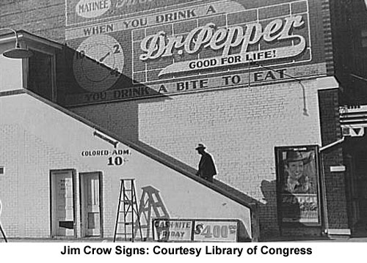

Slide 14
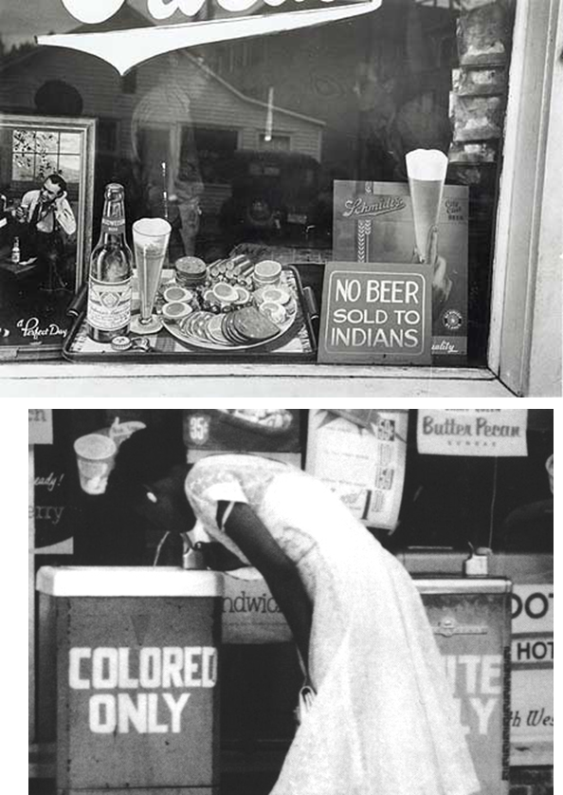
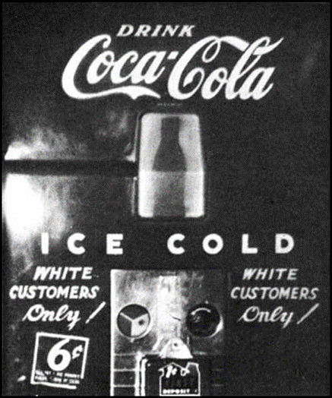
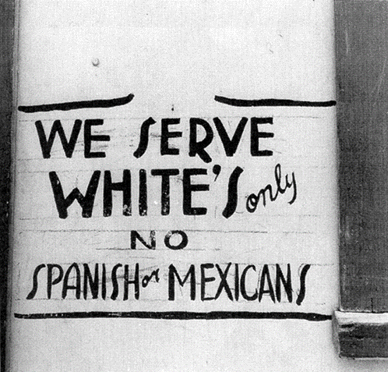

Slide 15
Members [of the Ohio House of Representatives] will be astonished when I tell them that I have traveled in this free country for twenty hours without anything to eat; not because I had no money to pay for it, but because I was colored. Other passengers of a lighter hue had breakfast, dinner and supper. In traveling we are thrown in "Jim Crow" cars, denied the privilege of buying a berth in the sleeping coach. This monster caste stands at the doors of the theatres and skating rinks, locks the doors of the pews in our fashionable churches, closes the mouths of some of the ministers in their pulpits which prevents the man of color from breaking the bread of life to his fellowmen. This foe of my race stands at the school house door and separates the children, by reason of color, and denies to those who have a visible admixture of African blood in them the blessings of a graded school and equal privileges...We call upon all friends of Equal Rights to assist us in this struggle to secure the blessings of untrammeled liberty for ourselves and prosperity.

Slide 16
EDUCATION
Florida: The schools for white children and the schools for negro children shall be conducted separately.
Kentucky: The children of white and colored races committed to reform schools shall be kept entirely separate from each other.

Slide 17
Entertainment
Alabama: It shall be unlawful for a negro and white person to play together or in company with each other at any game of pool or billiards.
Alabama: Every employer of white or negro males shall provide for such white or negro males reasonably accessible and separate toilet facilities.

Slide 18
HEALTH CARE
Alabama: No person or corporation shall require any white female nurse to nurse in wards or rooms in hospitals, either public or private, in which negro men are placed.
Louisiana: The board of trustees shall maintain a separate building, on separate grounds, for the admission, care, instruction, and support of all blind persons of the colored or black race.

Slide 19
HOUSING
Louisiana: Any person...who shall rent any part of any such building to a negro person or a negro family when such building is already in whole or in part in occupancy by a white person or white family shall be guilty of a misdemeanor.
Mississippi: The prison warden shall see that the white convicts shall have separate apartments for both eating and sleeping from the negro convicts.

Slide 20
TRANSPORTATION
Alabama: All passenger stations in this state operated by any motor transportation company shall have separate waiting rooms or space and separate ticket windows for the white and colored races.
Alabama: The conductor of each passenger train is authorized and required to assign each passenger to the car or the division of the car, when it is divided by a partition, designated for the race to which such passenger belongs. Maryland: All railroad companies are hereby required to provide separate cars or coaches for the travel and transportation of the white and colored passengers.

Slide 21
LIBRARIES
Texas: Negroes are to be served through a separate branch or branches of the county free library, which shall be administered by a custodian of the negro race under the supervision of the county librarian.
North Carolina: The state librarian is directed to fit up and maintain a separate place for the use of the colored people who may come to the library for the purpose of reading books or periodicals.

Slide 22
MARRIAGE
Arizona: The marriage of a person of Caucasian blood with a Negro shall be null and void.
Florida: All marriages between a white person and a negro, or between a white person and a person of negro descent to the fourth generation inclusive, are hereby forever prohibited

Slide 23
SERVICES
Georgia: No colored barber shall serve as a barber to white women or girls.
Georgia: The officer in charge shall not bury, or allow to be buried, any colored persons upon ground set apart or used for the burial of white persons.

Slide 24
DO NOW
What were Jim Crow Laws Based on?
Who did Jim Crow Laws segregate?
What two leaders fought against Jim Crow Laws?

Slide 25
What is a Jim Crow Law?
Why did Jim Crow laws exist?
What is an example of a Jim Crow Law?

