Slide 1
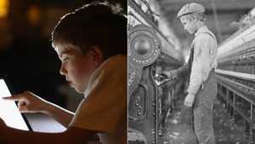
Kids and Machines: Then and Now
From Labor to Leisure
Pics and text from→ http://gassit5.rssing.com/chan-3657084/all_p14.html

Slide 2
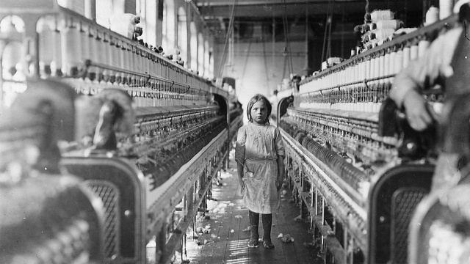
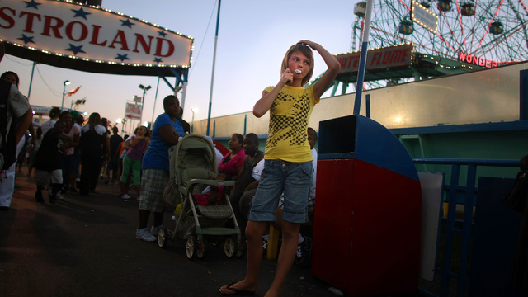
Like many other children working in this mill in 1908, this child just turned up to help her sister.
After a day spent riding roller coasters at Coney Island, this girl chats on her cell phone while cracking a big hunk of bubble gum.

Slide 3
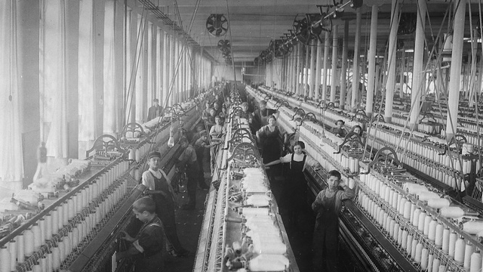
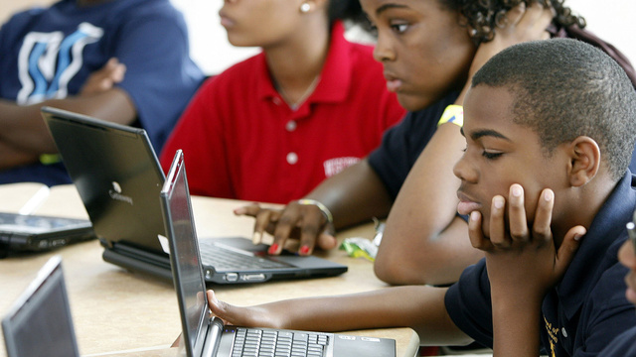
These young boys and girls worked day in and day out at Cornell Mill in Fall River, Massachusetts in the winter of 1912.
About 100 years later, in Philadelphia's School of the Future, Microsoft provided laptops to each freshman in a class of 170.

Slide 4
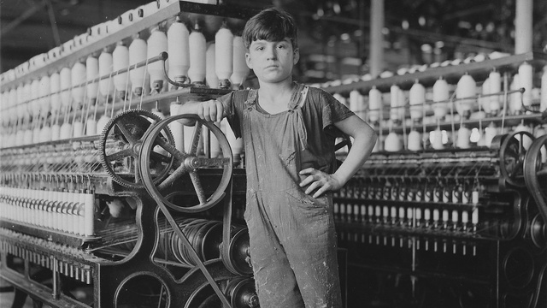
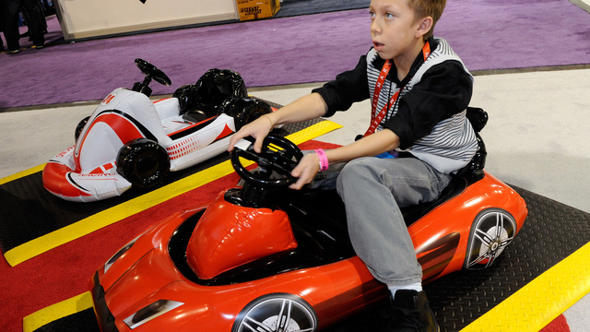
By 1911, Stanislaus Beauvais had already worked in this Massachusetts factory for two years.
At CES in Las Vegas, in 2012, Christopher Jacobs demonstrates an inflatable toy car for the Wii.

Slide 5
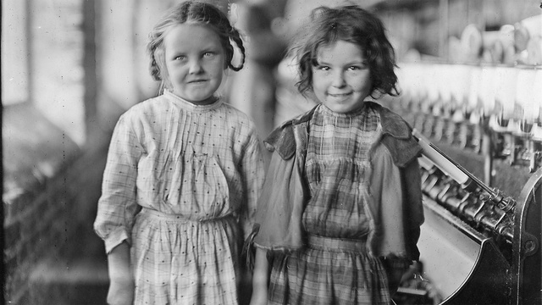
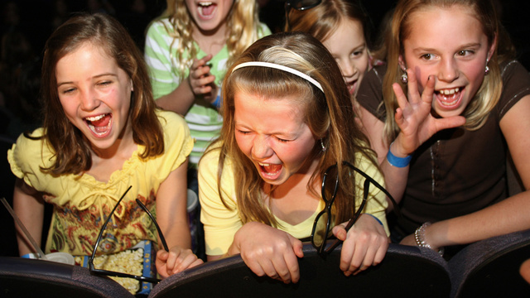
One hundred years later, in an Atlanta movie theater, a gaggle of 10-year-old girls scream and laugh after a surprise appearance by the Jonas Brothers.
Two little girls smile sweetly as they take a break from their jobs in a cotton mill in Tifton, Georgia, in 1909.

Slide 6
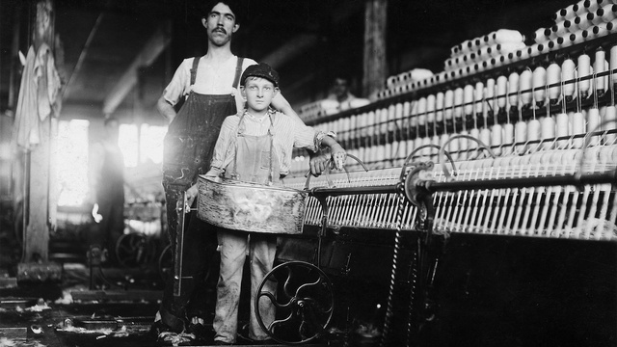
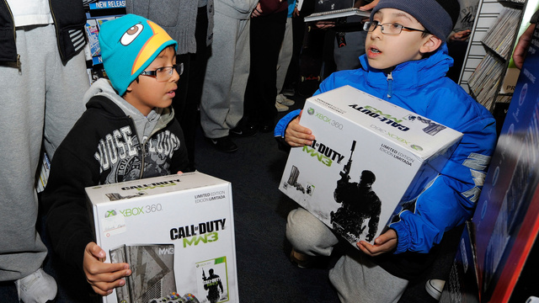
Street Bretzau, with a bandaged finger, was injured while working in the mule room of this Tennessee factory in 1910.
In November 2011, 10-year-old cousins Angel and Isaiah Alvarez clutch their Xboxes as they wait in line at a Game Stop for the launch of Call of Duty: Modern Warfare 3.

Slide 7
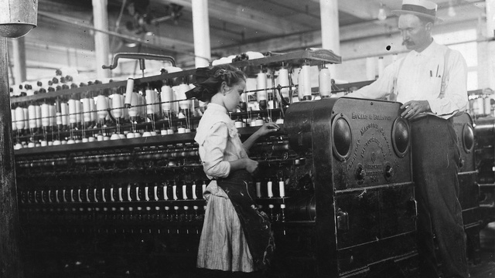
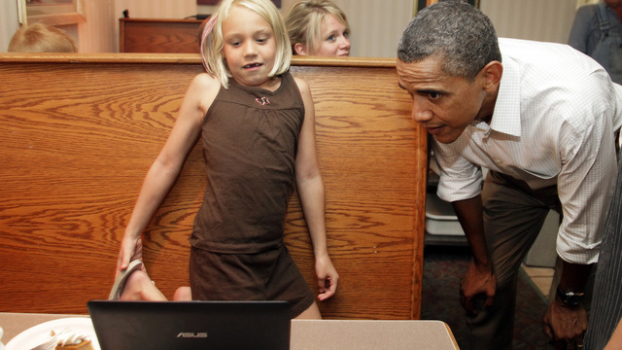
A hundred years earlier, in 1911, a young child in Yazoo City, Mississippi, works a spinner.
President Obama looked over a girl's work on her laptop in a coffee shop in Minnesota this past August

Slide 8
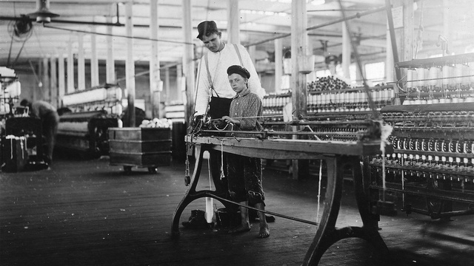
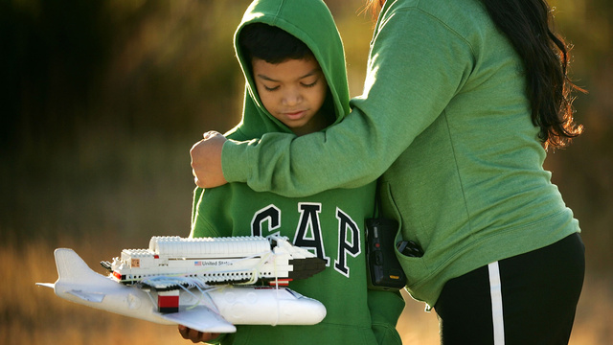
This little boy, looking fatigued in 1911, works barefooted on a factory floor.
Young Carlos Cerrillos holds a Lego model of the Space Shuttle Discovery as he waits for the real deal to blast off from Kennedy Space Center in 2005.

Slide 9
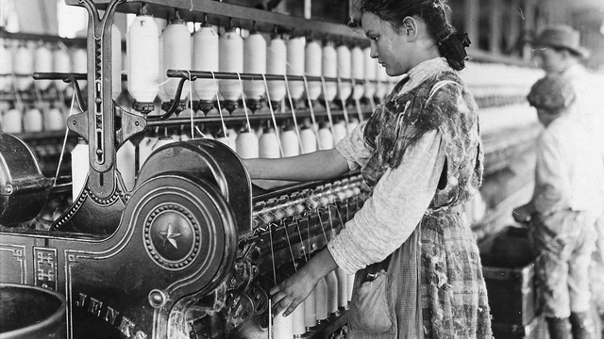
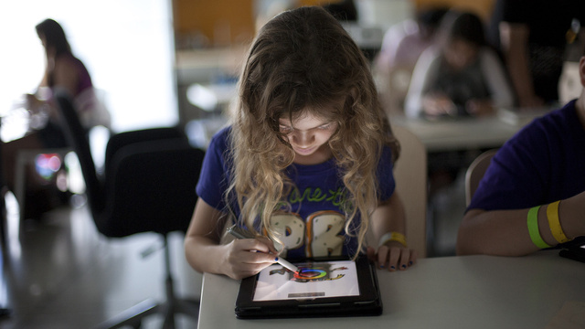
A child works as a spinner, a job she's had for two years. You have to wonder how long she kept at it.
This child, who spent her summer at Young at Art Museum summer camp in Davie, Florida, used an iPad to draw cartoons.

Slide 10
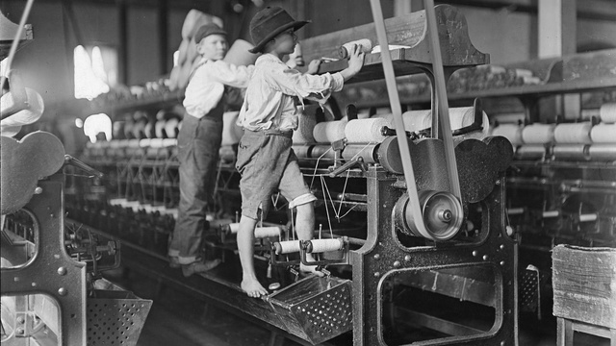
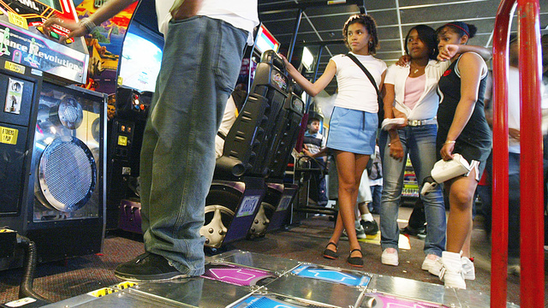
Some of the kids in this Macon, Georgia mill were so small they had to climb up into the machines to repair them.
Girls wait to take a turn playing Dance Dance Revolution in a New York City arcade in 2004.

Slide 11
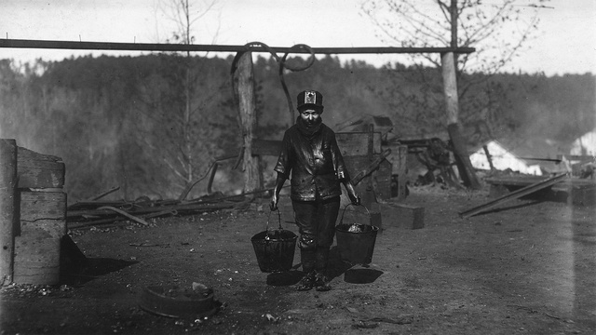
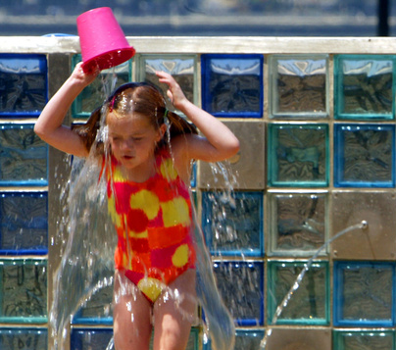
A little boy, his arms and clothes shiny with grease, carries two pails of it to a train. He said at the time that he was 14, but almost definitely looks younger.
A century later, the buckets of grease have been traded for a pail of water, splashed from a fountain in a Manhattan park.

