Slide 1
Life in Meat Packing Factories
Chicago, Illinois

Slide 2
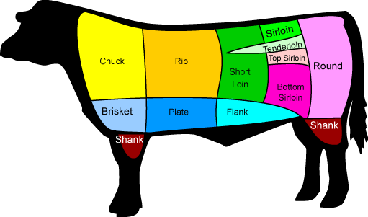
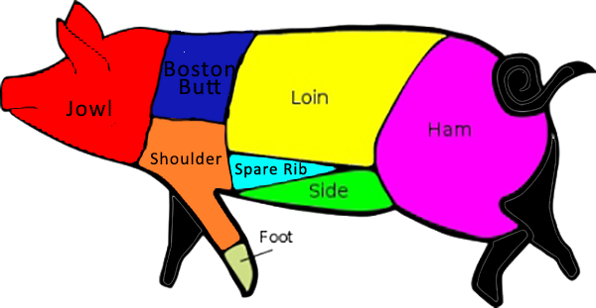

Slide 3
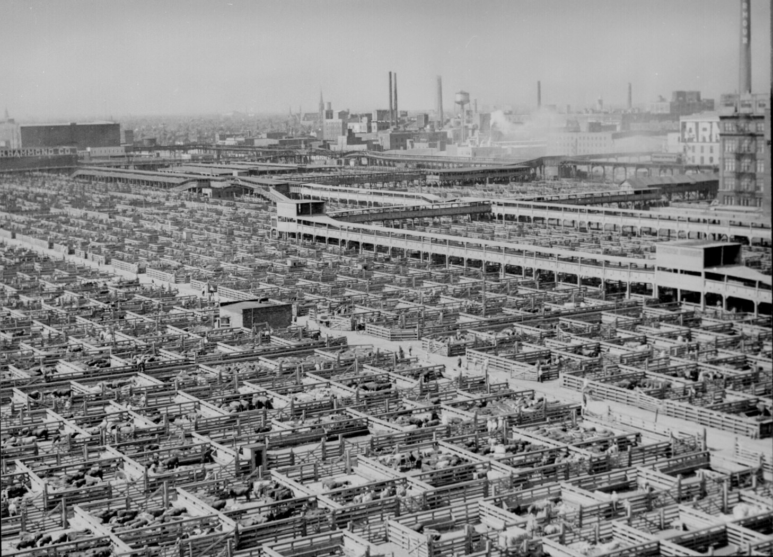
1
What is the purpose of this picture?
What do you learn from this picture?
How does this picture make you feel?
The factory ----------→

Slide 4
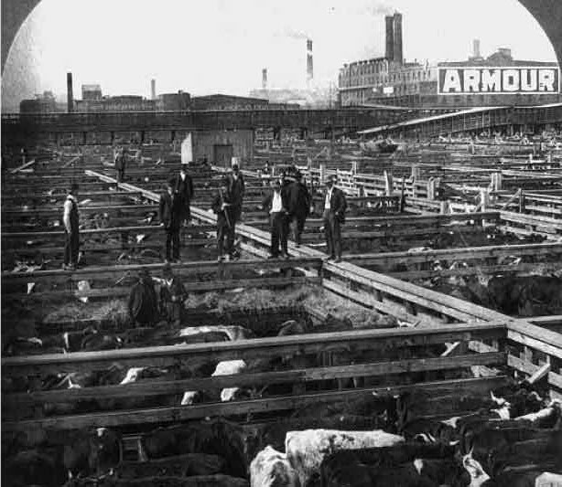
2
Same factory --->
What do you think is happening in this picture?
What do you learn form this picture?
How does this picture make you feel?

Slide 5
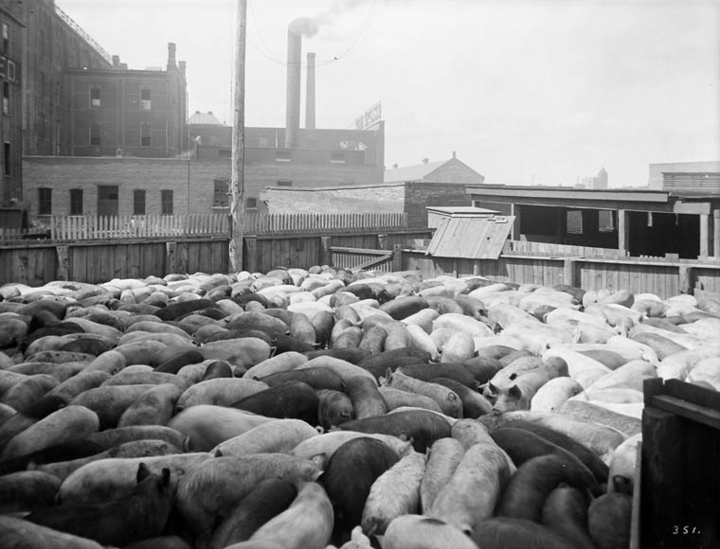
3
What does this picture show?
What do you learn from this picture?
How does this picture make you feel?

Slide 6
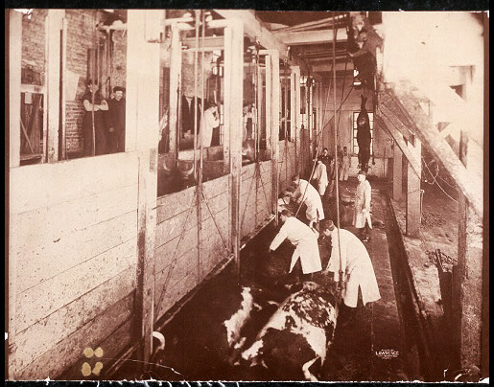
4
What do you think is happening in this picture?
What do you learn from this picture?
How does this picture make you feel?

Slide 7
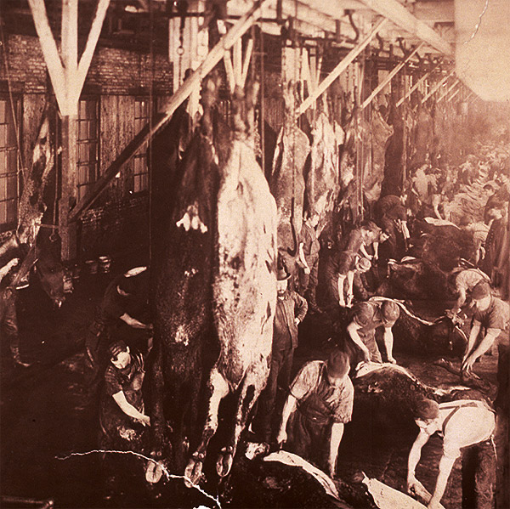

Slide 8
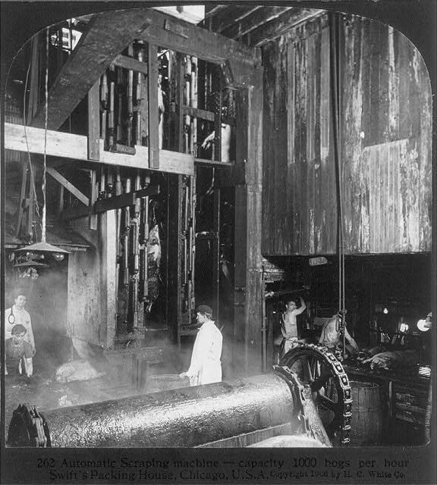

Slide 9
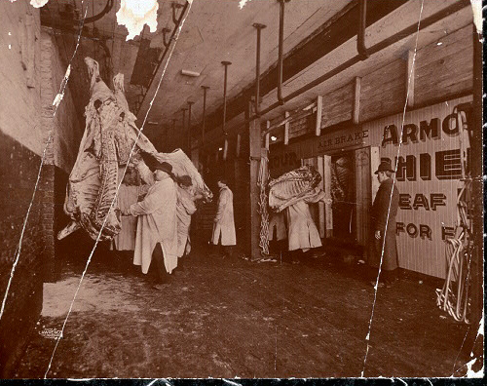

Slide 10
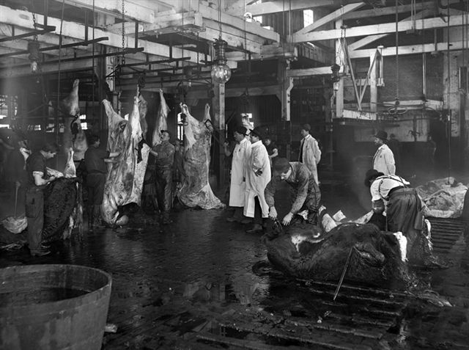

Slide 11
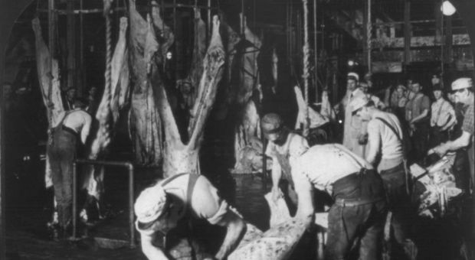

Slide 12
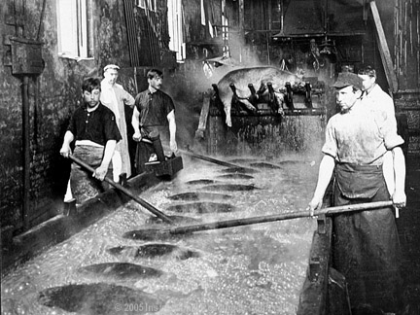
5
What do you think is happening in this picture?
What do you learn from this picture?
How does this picture make you feel?

Slide 13
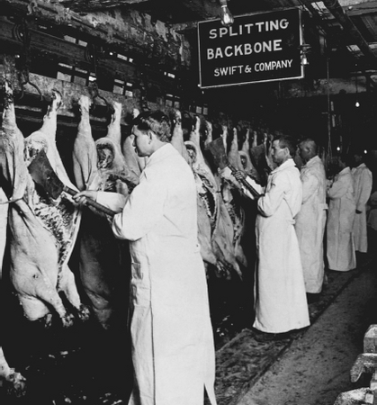
6
What do you think is happening in this picture?
What do you learn from this picture?
How does this picture make you feel?

Slide 14
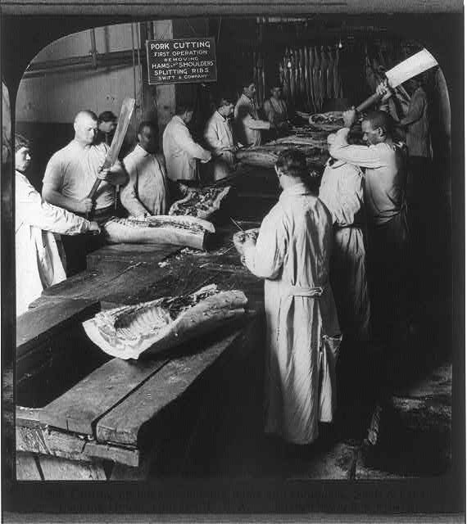

Slide 15
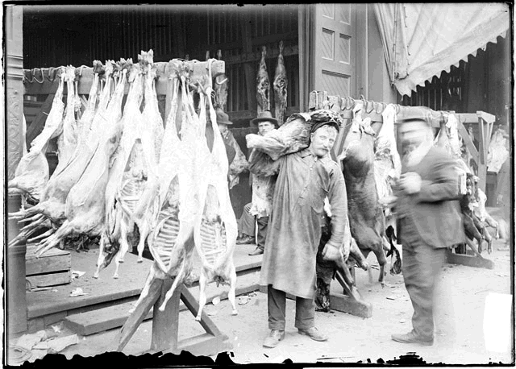
7
What do you think is happening in this picture?
What do you learn from this picture?
How does this picture make you feel?

Slide 16
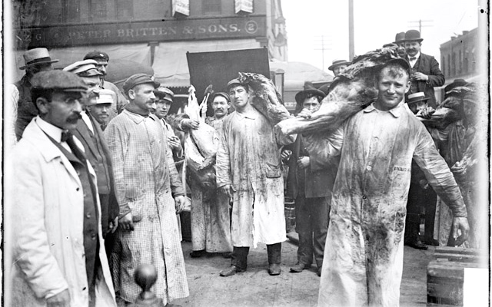

Slide 17
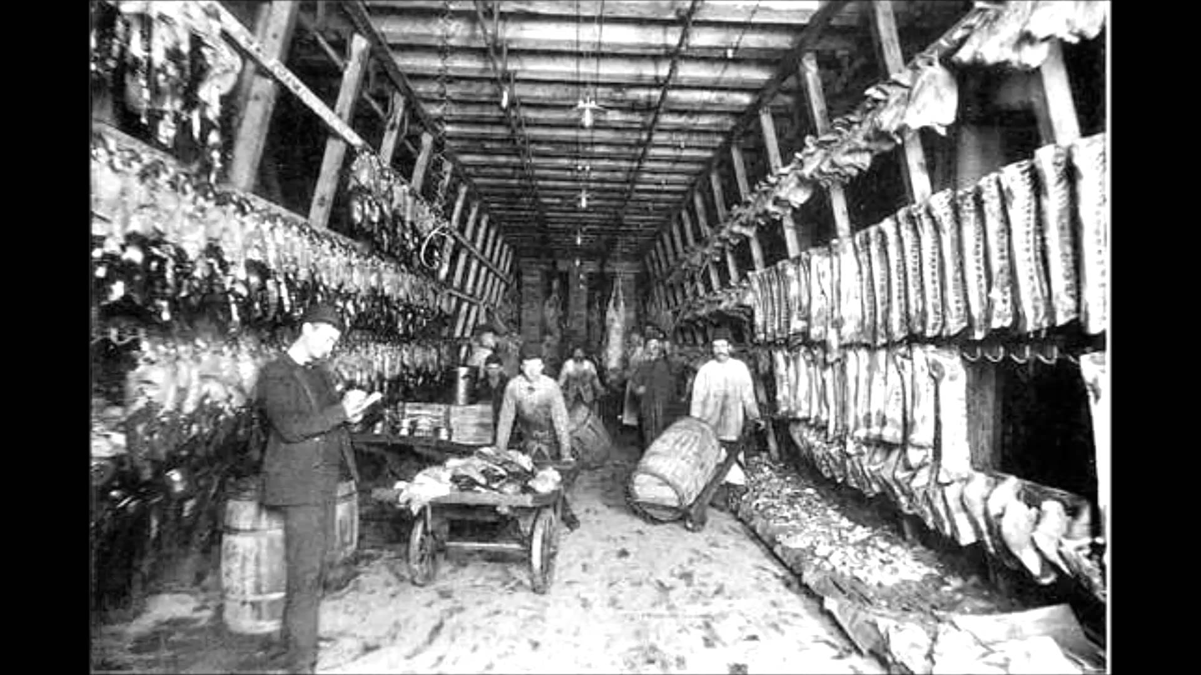

Slide 18
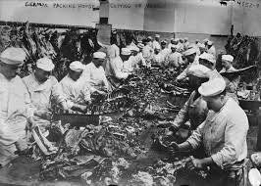
8
What do you think is happening in this picture?
What do you learn from this picture?
How does this picture make you feel?

Slide 19
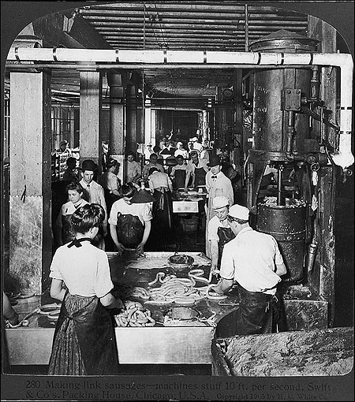

Slide 20
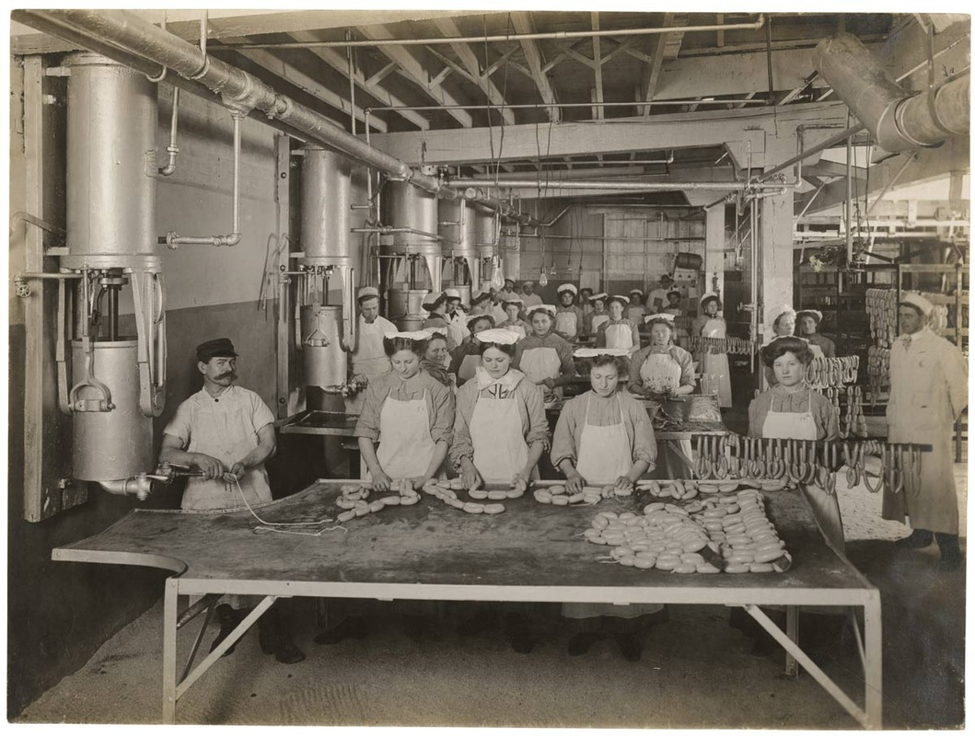
9
What do you think is happening in this picture?
What do you learn from this picture?
How does this picture make you feel?

Slide 21
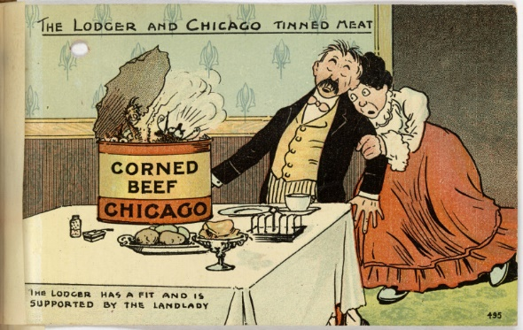
10
What is the message of this cartoon?
What do you learn from this picture?
How does this picture make you feel?

