Slide 1
DO NOW
IDENTIFY 3 CAUSES OF THE GREAT DEPRESSION.
IDENTIFY 4 IMPACTS OF THE GREAT DEPRESSION

Slide 2
The New Deal
Franklin Roosevelt’s response to try and fix the problems of the Great Depression.

Slide 3
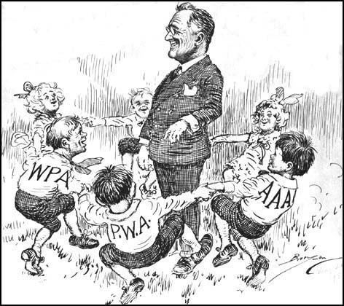
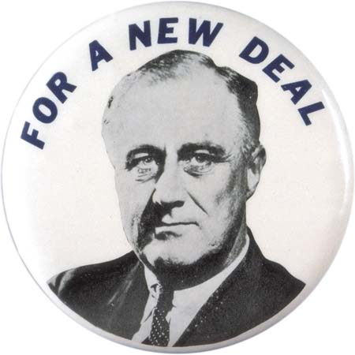
Created government programs to help the nation recover from the Depression.

Slide 4
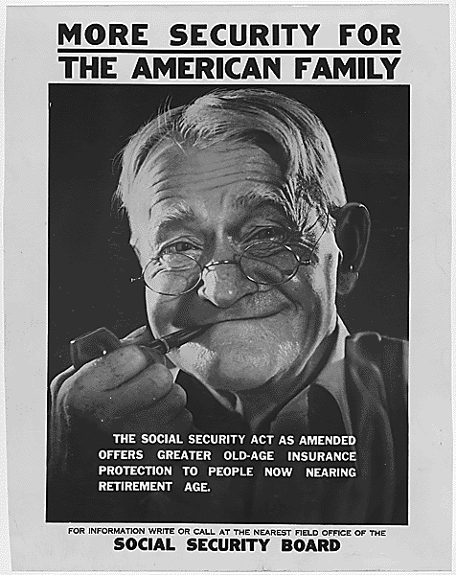
Major Features of the New Deal
1. Social Security
A government program that provides assistance to persons faced with unemployment, disability, or agedness; paid for by employers and employees
A worker was taxed to collect money later in life (Age 65)

Slide 5
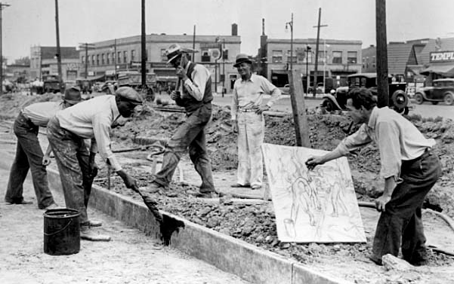
Major Features of the New Deal
2. Federal Works Programs:
Public Works Administration (PWA)- provided jobs on construction projects

Slide 6
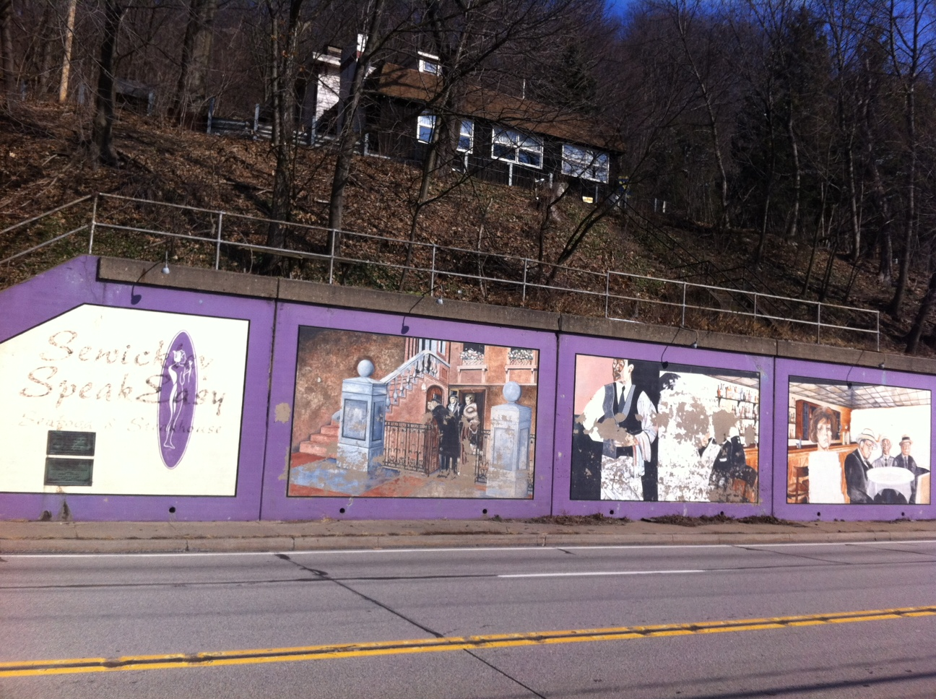

Slide 7
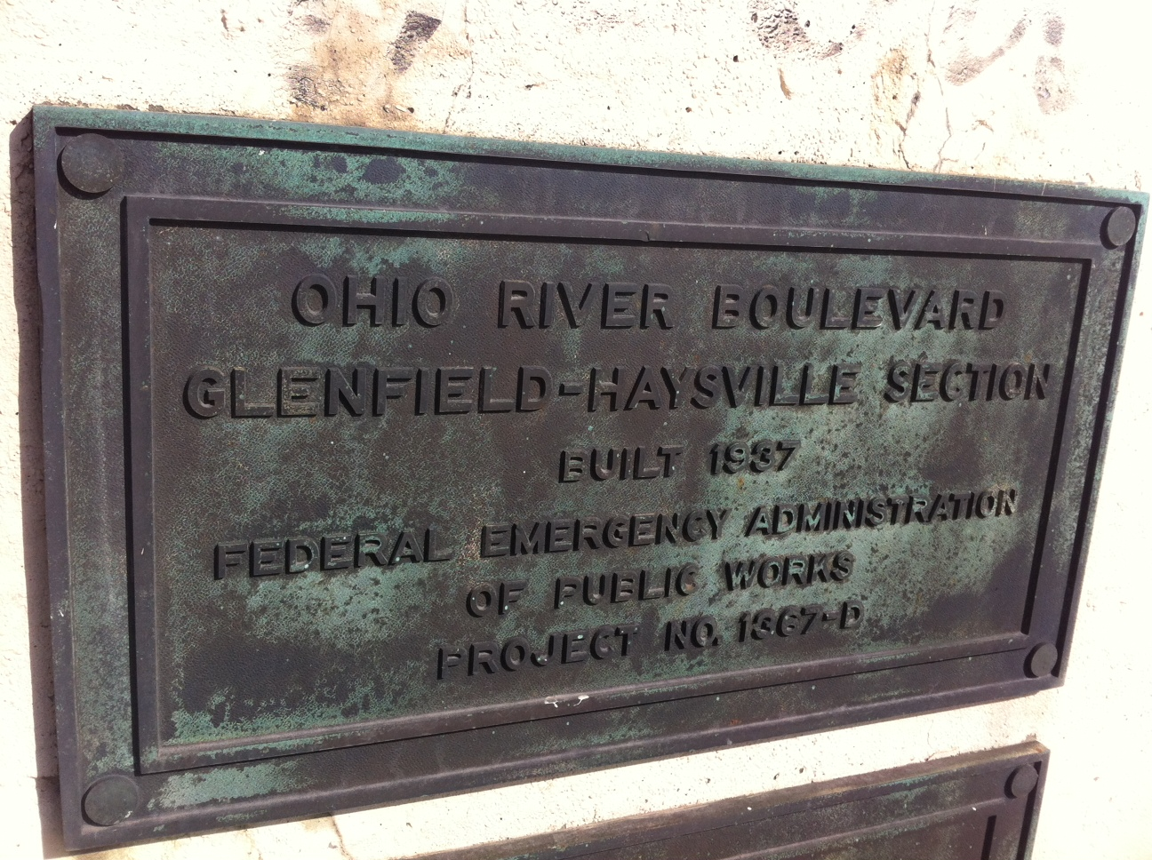

Slide 8
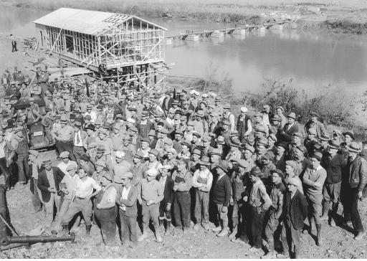
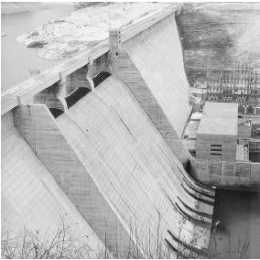
Major Features of the New Deal
3. Environmental Improvement Programs:
Tennessee Valley Authority (TVA)- built dams and power plants
(Hoover Dam)
Civilian Conservation Corps (CCC)- outdoor work, which conserved natural resources, plants, and fought forest fires.

Slide 9
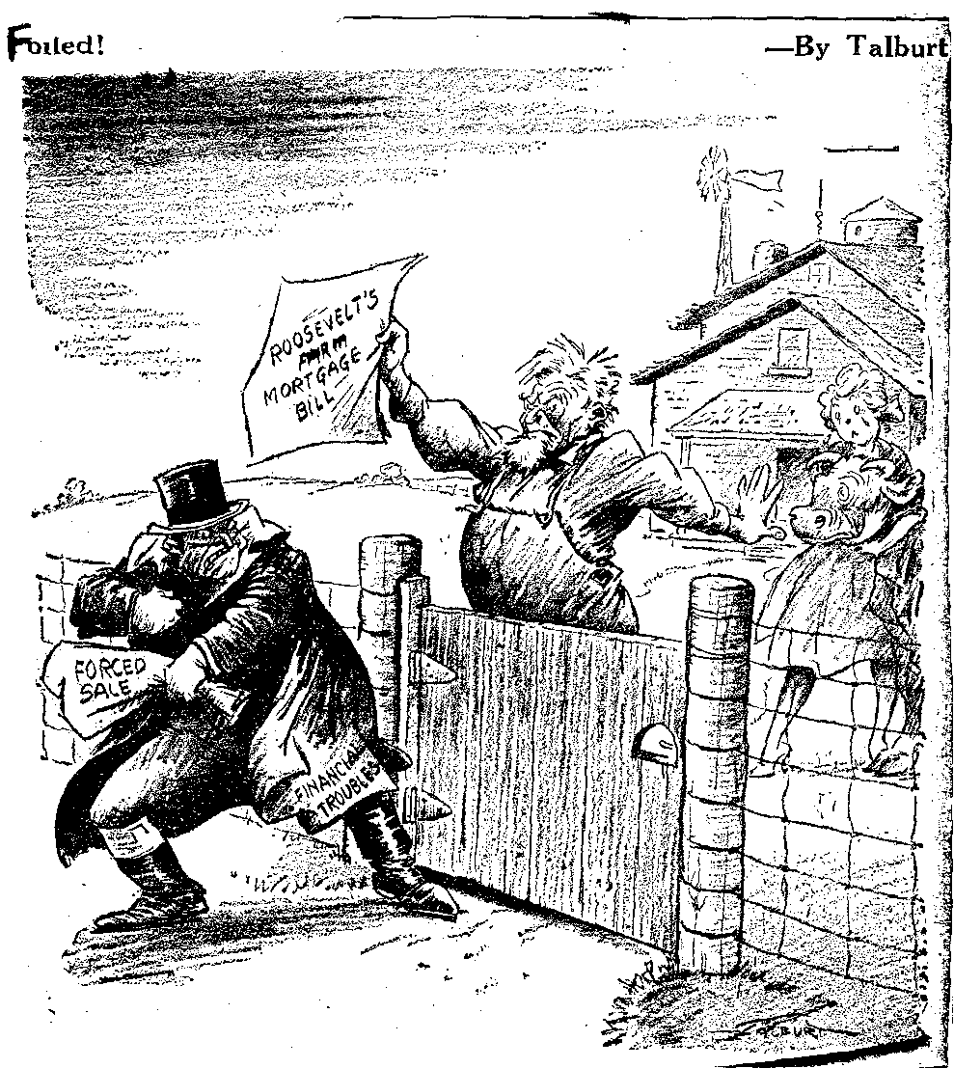
Major Features of the New Deal
4. Farm Assistance Programs
Agricultural Adjustment Association (AAA)-Problem with over-production. So government will pay you NOT to overproduce. Declared unconstitutional later on.

Slide 10
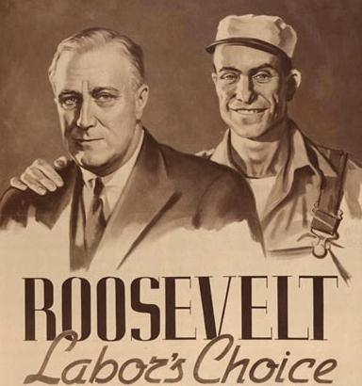
Major Features of the New Deal
5. Increased Rights for Labor
Fair Labor Standards Act
Shorter Hours
Minimum Wage
Unions

