Slide 1
Do now
What were 3 negative effects of Industrialization?
What were 3 reforms of the Progressive Era?
What did Labor Unions do?

Slide 2
DO NOW
What was the 13th amendment?
What was the 14th amendment?
What was the 15th amendment?
What was the 18th amendment?
What was the 19th amendment?
What was the 21st amendment?

Slide 3
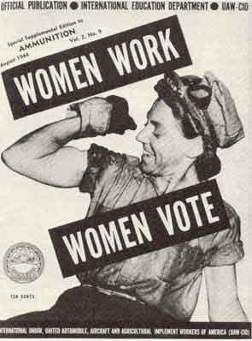
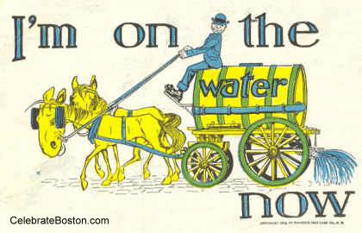
Progressive Movement Continued: Women’s reform Movements

Slide 4
1. Temperance Movement
Composed of groups (mostly women) opposed to the making and consuming of alcohol.

Slide 6
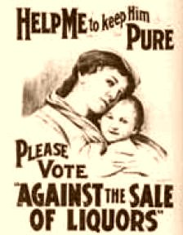
1. Temperance Movement
They Supported the 18th Amendment, which prohibited the manufacture, sale, and transport of alcoholic beverages

Slide 7
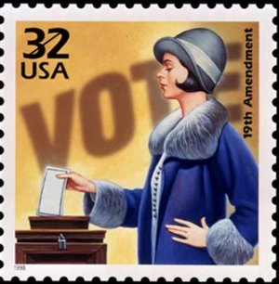
2. Women’s suffrage
(Suffrage – the right to vote)
Increased educational opportunities
Attained voting rights

Slide 8
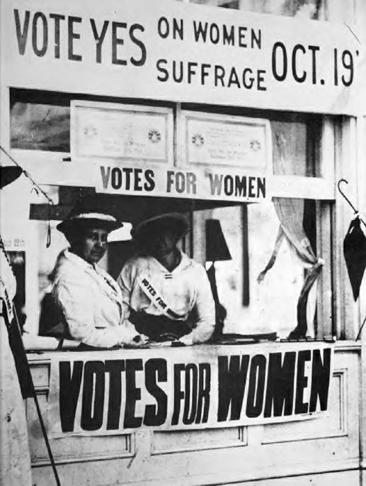
Women’s Suffrage
Women gained the right to vote with the passage of the 19th Amendment to the constitution of the United States. (1920)

Slide 9
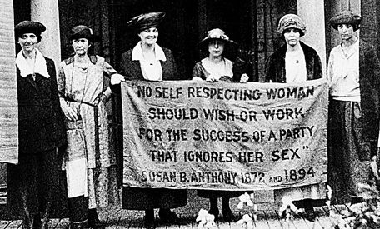
Women’s Suffrage
Susan B. Anthony and Elizabeth Cady Stanton worked for women’s suffrage.

