Slide 1
Name the –ization!
1. What development on farms caused people to leave rural areas for the cities to look for jobs?
2. This shift of population to the cities is known as what?
3. What refers to the growth of factories and in cities?

Slide 2
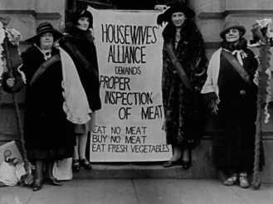
Progressive Movement
1890-1920
A movement where reformers worked to improve the social and political problems that arose from the vast changes brought by industrialization.

Slide 3
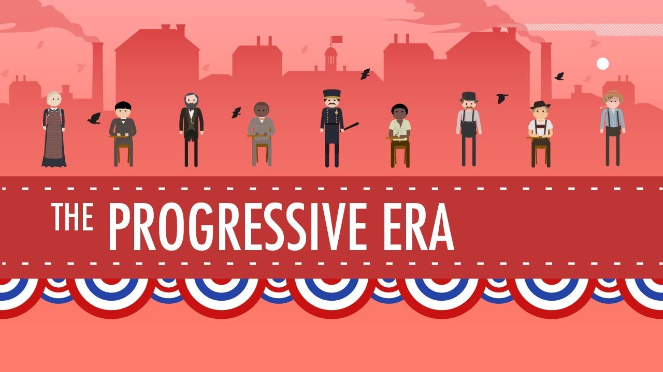
The Negative effects of industrialization led to the rise of organized labor and important workplace reforms.

Slide 4
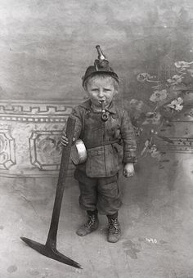
Negative Effects of Industry
___1. Child Labor_ __
As young as 5-6 year olds worked in factories
Did not go to school
Worked as hard as adults
Lower pay

Slide 5
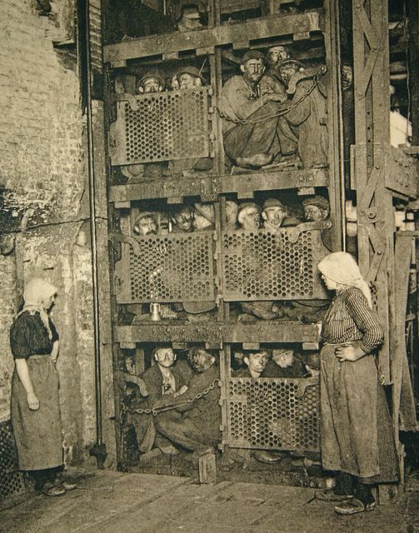
Negative Effects of Industry
2. Unsafe working conditions
Factory air was dirty
High injury rate
Heavy machines used in small spaces

Slide 6
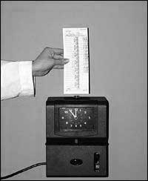
Negative Effects of Industry
3. Long Hours/Low Wages
12-18 hours a day
Average pay was $2 a week

Slide 7
What caused reforms?
1. Organized Labor Unions
Growth of American Federation of Labor (AFL): Brought reform and change.
Ex: Plumbers, Builders,
Carpenters, Miners, etc.
Labor Unions: organizations of wage earners formed for the purpose of serving the members' interests with respect to wages (pay) and working conditions.

Slide 8
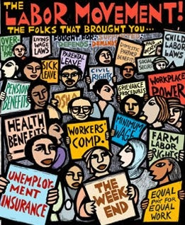

Slide 9
www.history.com/topics/labor/videos/the-fight-to-end-child-labor

Slide 10
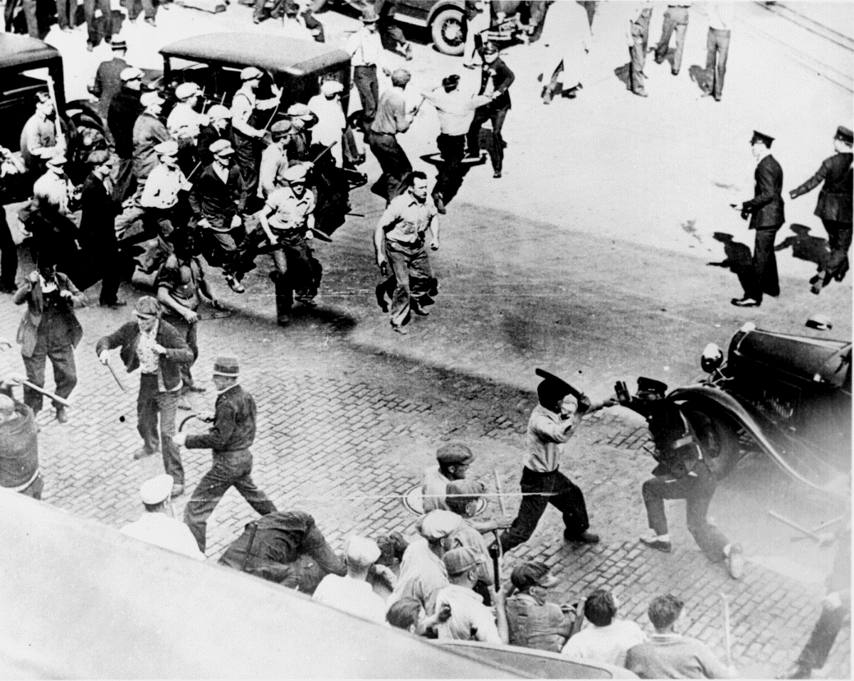
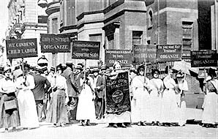
What caused reforms?
2. Worker Strikes: A method of protest used by unions where workers stop working. They may instead protest outside their place of employment to draw attention.

Slide 11
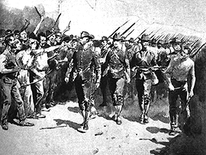
What caused reforms?
Homestead Strike
A failed strike between steel workers and Carnegie in Homestead, Pennsylvania.
9 steel workers were killed any many seriously injured.
American public blamed the union and unions lost a lot of support..

Slide 12
Carnegie and Homestead
The Homestead Strike

Slide 13
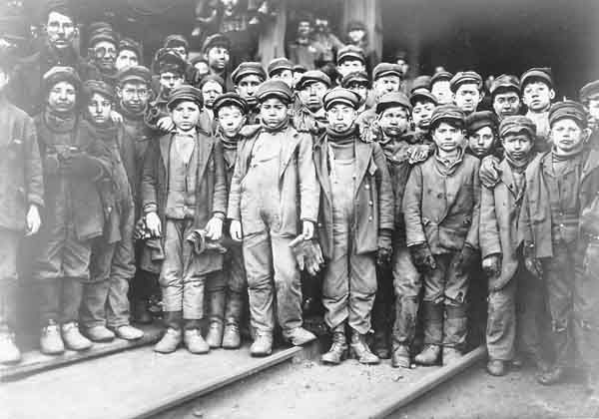
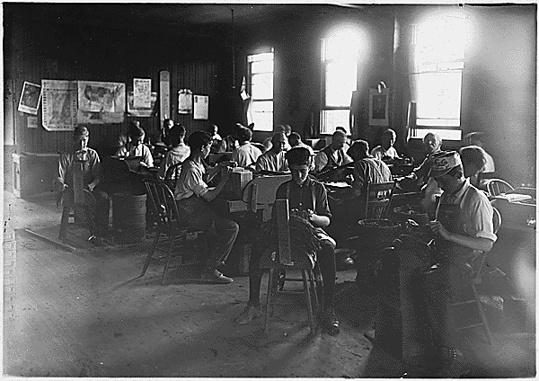
Progressive Era Reform
Coal miners
Child Labor
Cigar factory
1. Placed restrictions on child labor

Slide 14
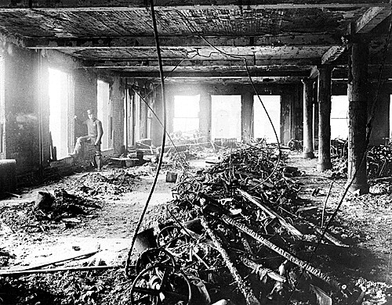
Progressive Era Reform
Unsafe working conditions
2. Improved safety conditions.
New safety regulations

Slide 15
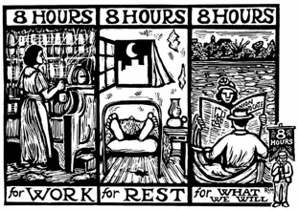
Progressive Era Reform
Long Hours/Low Wages
3. Reduced working hours
Introduced minimum wage.

