Slide 1
DO NOW
What was the temperance movement?
What did the women of the temperance movement want?
What was the 18th Amendment?

Slide 2
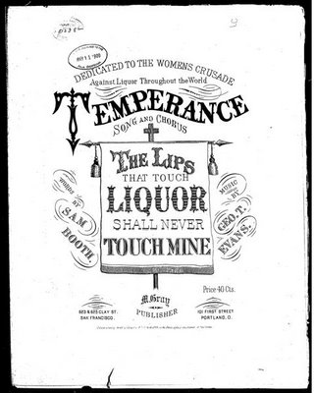
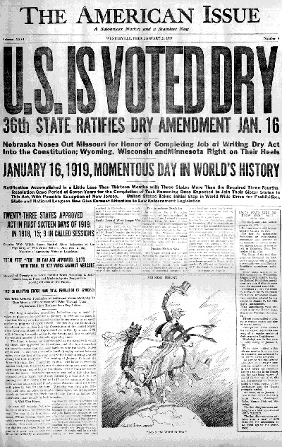
Prohibition was a product of the TEMPERANCE movement and lasted from 1920 to 1933.

Slide 3
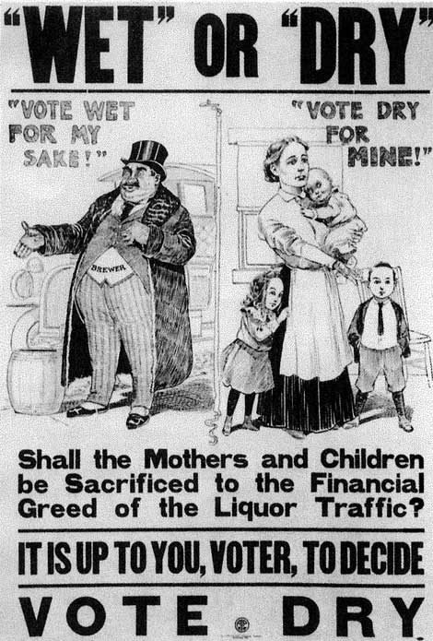
Prohibition was imposed by a constitutional amendment that made it illegal to manufacture, transport, and sell alcoholic beverages. The 18th Amendment

Slide 4
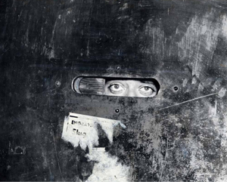
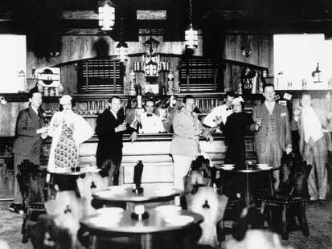
Results of Prohibition
Speakeasies were created as places for people to drink illegal alcoholic beverages.

Slide 5
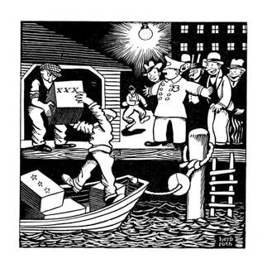
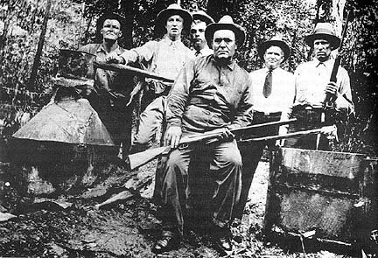
Results of Prohibition
Bootleggers made and smuggled alcohol illegally and promoted organized crime.

Slide 6
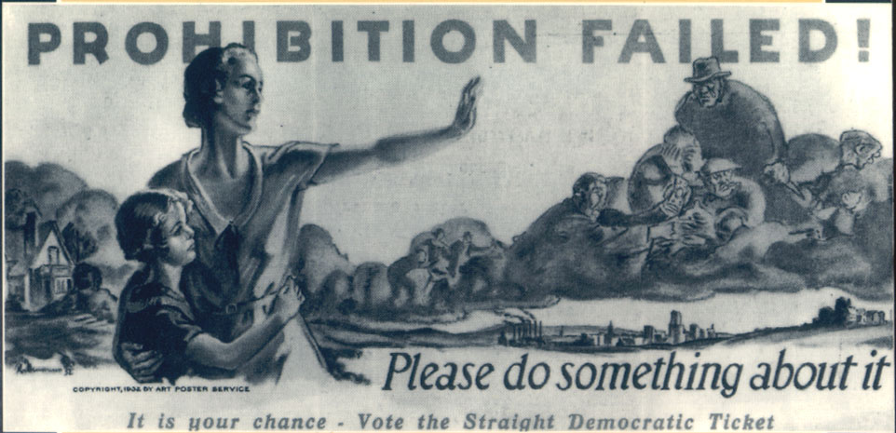
Repealed by the 21st Amendment
Section 1. The eighteenth article of amendment to the Constitution of the United States is hereby repealed.
Section 2. The transportation or importation into any State, Territory, or possession of the United States for delivery or use therein of intoxicating liquors, in violation of the laws thereof, is hereby prohibited.

Slide 7
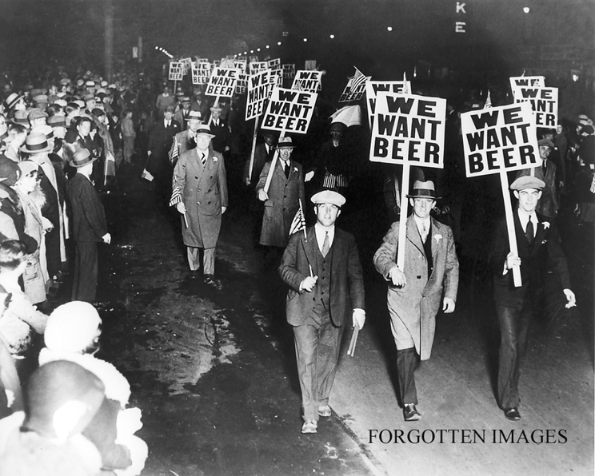
Reforms in the early twentieth century failed to legislate how all people behaved.

