Slide 1
Do Now
What is mechanization?
What is industrialization?
What is urbanization?

Slide 2
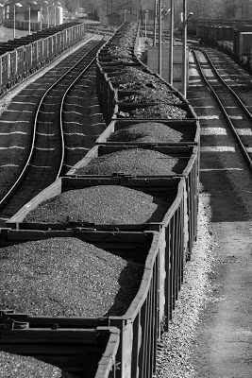
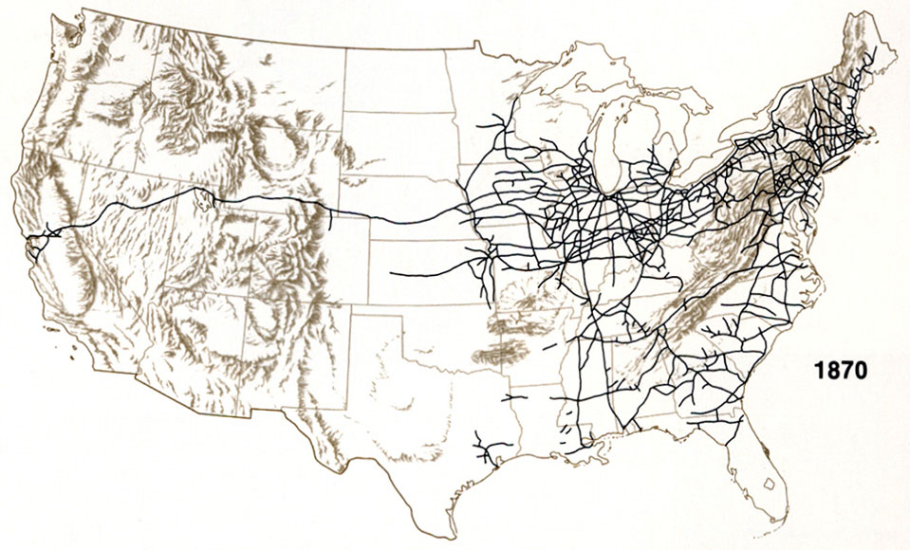
Reasons for prosperity of big business
1. National markets created by transportation advances (Railroads)

Slide 3
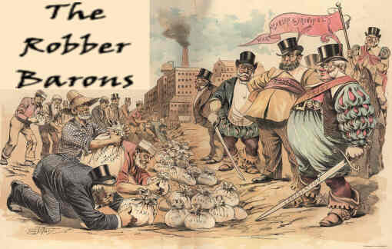
Reasons for prosperity of big business
2. Captains of Industry / Robber Barons

Slide 4
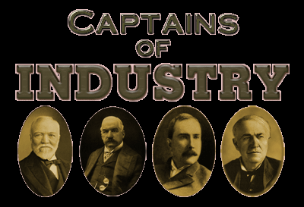
Captains of Industry
An entrepreneur is a person who comes up with a product or service, or a better way to provide them.

Slide 5
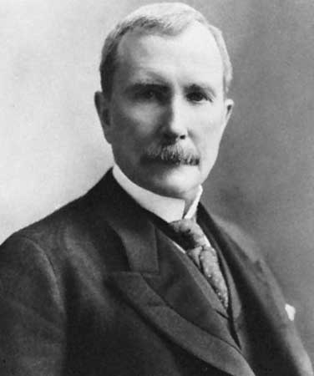
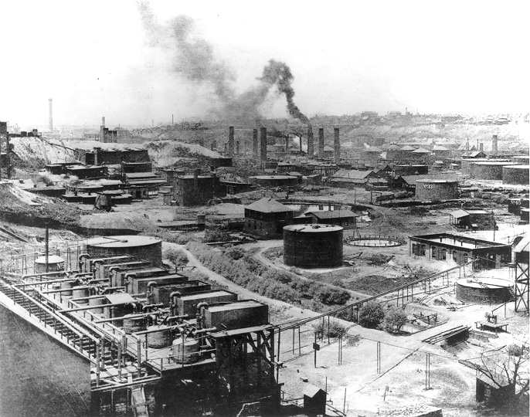
1. John D. Rockefeller
Standard Oil Company
Used to lubricate machine parts
Refined into gasoline for fuel
Refined into kerosene for lighting in mines or heating

Slide 6
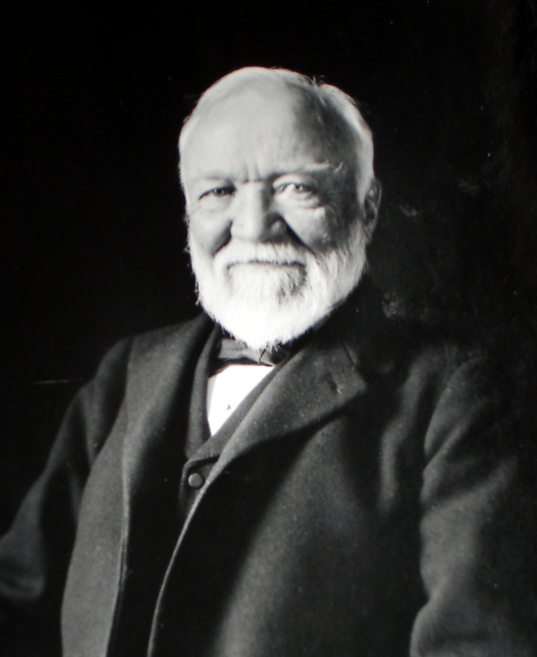
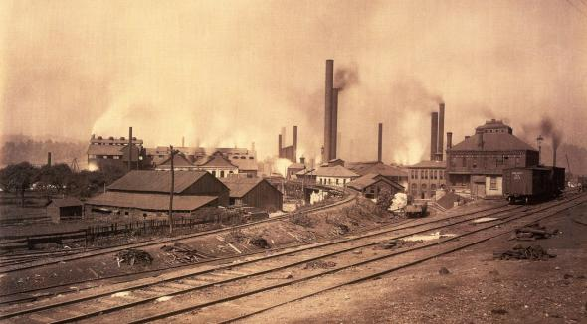
2. Andrew Carnegie
Steel, Pittsburgh Pennsylvania
Lighter, stronger, more flexible than iron
Inexpensive
Used to build bridges, railroads, skyscrapers

Slide 7
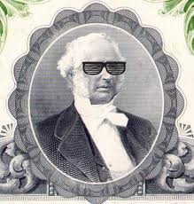
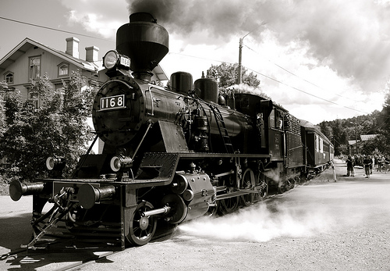
3. Cornelius Vanderbilt
Shipping and Railroad
Moving natural resources to eastern factories
Transporting finished products to national markets

Slide 8
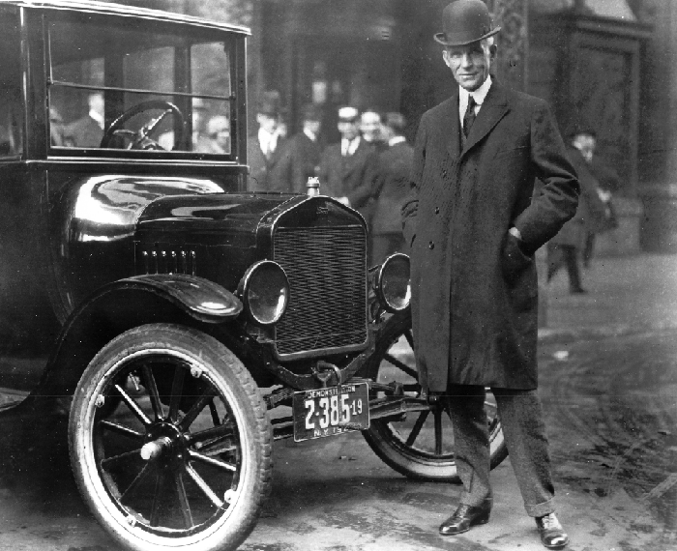
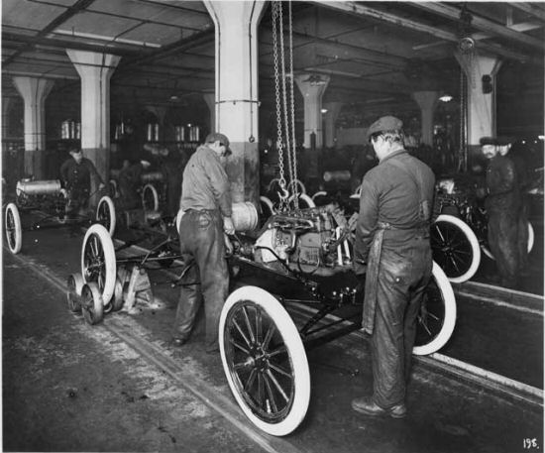
4. Henry Ford Detroit, Michigan
Automobile
Assembly line made cars quickly
and affordably
Paid employees well so they can afford an automobile

Slide 9
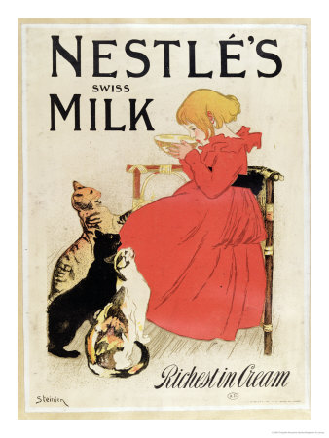
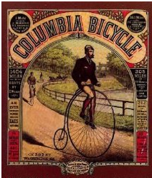
Reasons for prosperity of big business
3. Advertising

Slide 10
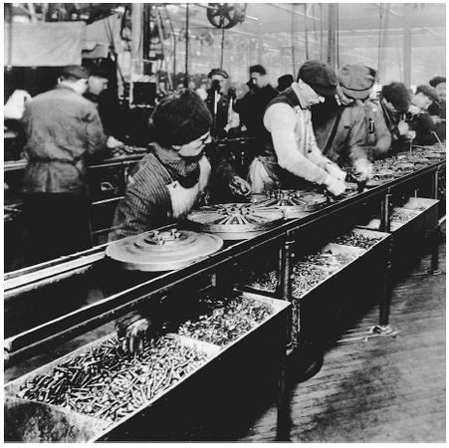
Reasons for prosperity of big business
4. Lower-cost production – (assembly line)
Henry Ford

Slide 11
