Slide 1
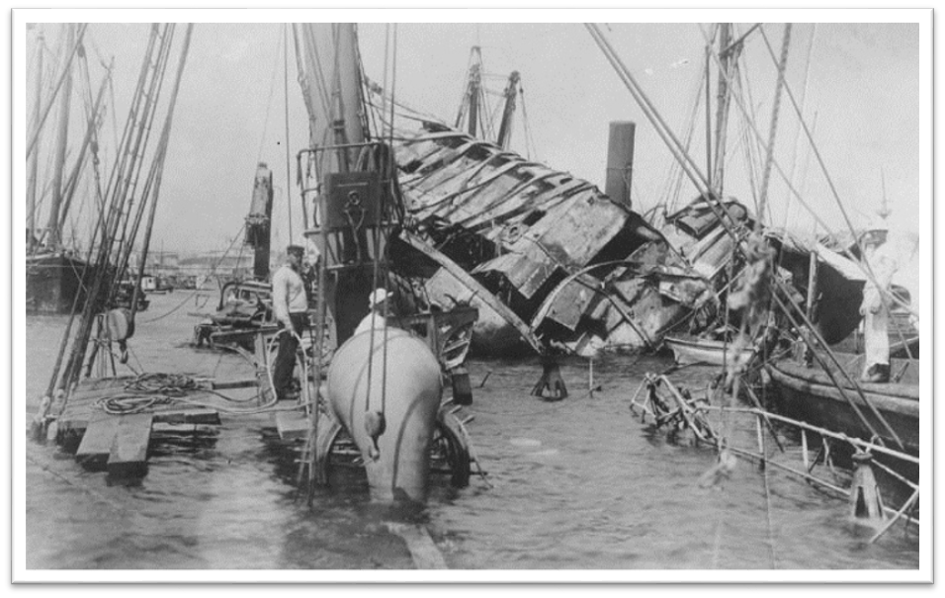
DO NOW
1. Write three questions you have about the picture.
2. Write 2-3 sentences about what you think happened.
2. Why do people in Mexico speak Spanish? IN Cuba?

Slide 2
Map

Slide 3
Cuba, was the world’s wealthiest colony and largest sugar producer by the 1820s. American capitalists began investing millions of dollars in large sugar cane plantations on the island. Gómez avoided confronting Spanish troops, whom he could not hope to defeat. Instead he launched terrorism. Attempting to expel the Spanish economically, he set ablaze millions of sugar cane acres, making the island a virtual torch. More than loan interest was at stake. Sugar seems ordinary today, but long ago its profitability earned the nickname “white gold”.

Slide 4
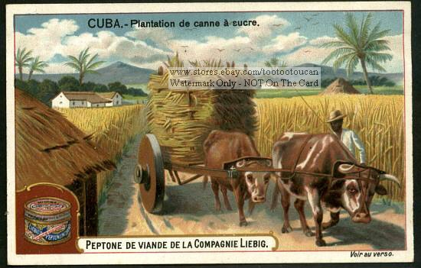
Causes of the Spanish American war
1. Protection of American BUSINESS interests(sugar) in CUBA.

Slide 5
Americans were told Cuba’s rebels were like our Revolutionary War soldiers — men yearning for self-government. The Cuban rebels had formed relationships with small groups of Americans committed to their cause. Many of these Americans supported the filibusters who attempted to run military supplies to the insurrectionists on the island. Cuban emigrés in the United States formed clubs, raised money, and gained support from labor unions and the press.

Slide 6
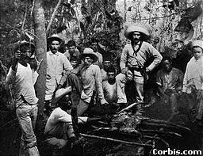
Causes of the Spanish American war
2. American support of Cuban REBELS to gain INDEPENDENCE from Spain

Slide 7
"The explosion put out the street lights and blew down the telephone and telegraph wires throughout the city.“Now it seemed the extraordinary public reaction to the sinking of the Maine was forcing the president to consider making new demands of the Spanish government. Historian David Trask says that no one in the Administration would have entertained the possibility of war, had it not been for the ungovernable uproar throughout the country that followed the destruction of the Maine.

Slide 8
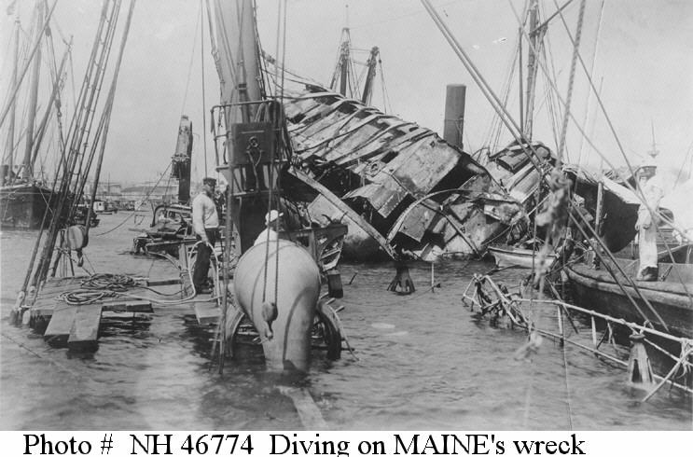
Causes of the Spanish American war
3. Rising tensions as a result of sinking the U.S.S. MAINE in Havana Harbor.

Slide 9
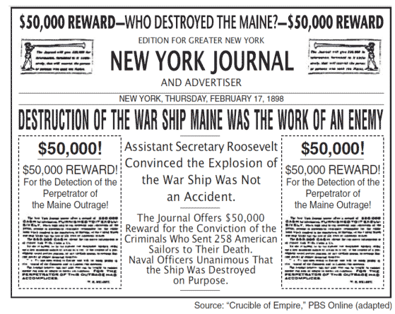
Causes of the Spanish American war
4. YELLOW JOURNALISM exaggerated news reports of events

Slide 10
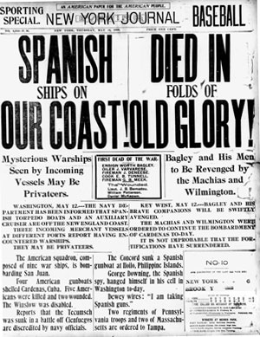
Yellow Journalism
Yellow Journalism is news that is exaggerated. News that is sensationalized. (blown things out of proportion.) Authors want people to buy magazines/newspapers.
During the Spanish American War, the authors wrote a lot of articles that were blown out of proportion.
What was this called?
Yellow Journalism

Slide 11
The New York Journal and the New York World printed exaggerated accounts of Valeriano Weyler's (Spanish general and governor of Cuba and the Phillipines) brutality. Stories of poisoned wells and children being thrown to the sharks deepened American sympathy for the rebels. "Weyler throws nuns into prison. Butcher wages brutal warfare on helpless women." They claimed the Spanish had blown up the Maine. The Journal's headline read "The Warship Maine was Split in Two by an Enemy's secret Infernal Machine". Hearst's paper offered a reward of $50,000 for the capture of the Spaniards who supposedly committed the outrage.

Slide 12
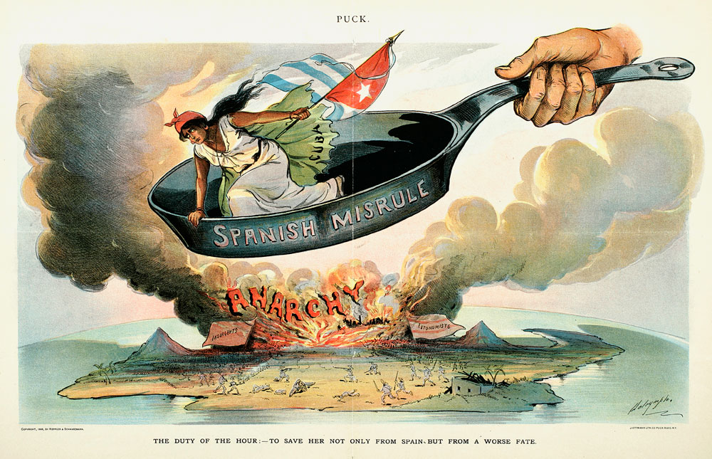
Results of the Spanish American war
1. CUBA gained INDEPENDENCE from Spain.

Slide 13
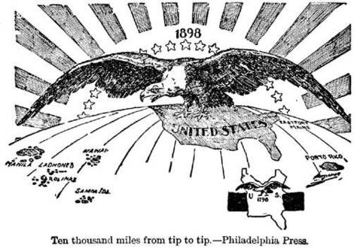
Results of the Spanish American war
2. The United States gained possession of:
PHILLIPINES
PUERTO RICO
GUAM

Slide 14
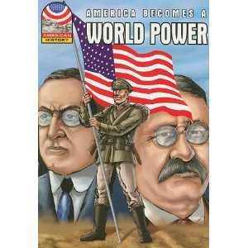
Results of the Spanish American war
3. The United States emerged as a WORLD POWER.

Slide 15
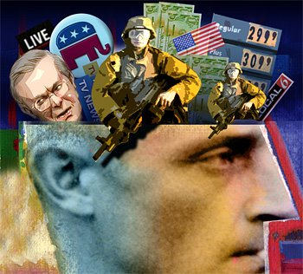
Economic interests and public opinion often influence United States involvement in international affairs.

Slide 16
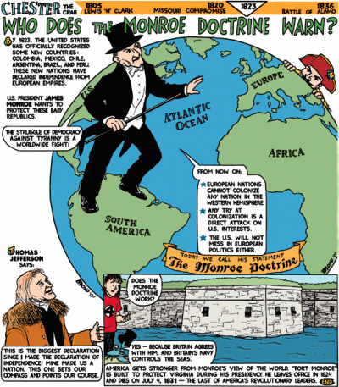

Slide 17
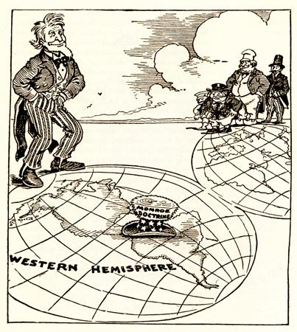
WRITE 5 QUESTIONS ABOUT THE CARTOON.
Write a story about the cartoon.

Slide 18
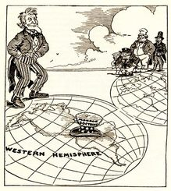
The Monroe Doctrine is a policy of the United States introduced on December 2, 1823. It stated that further efforts by European nations to colonize land or interfere with countries in North or South America would be viewed as acts of aggression, requiring U.S. intervention.

Slide 19
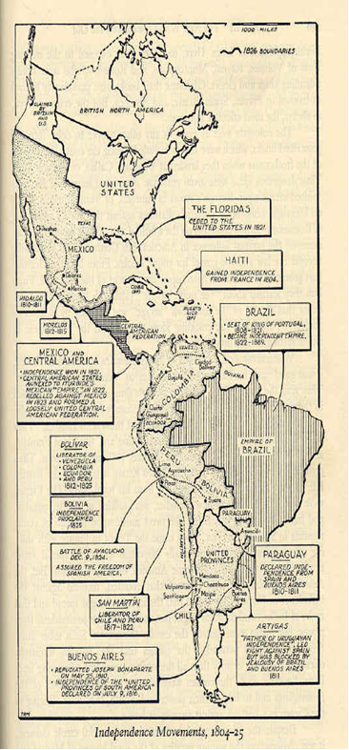
Roosevelt Corollary
1. Asserted the United States’ right to
interfere in the economic matters of
other nations in the Americas.

Slide 20
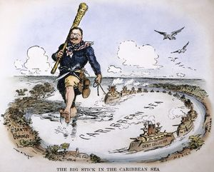
Roosevelt Corollary
Claimed the United States had the right to exercise international POLICE POWER

Slide 21
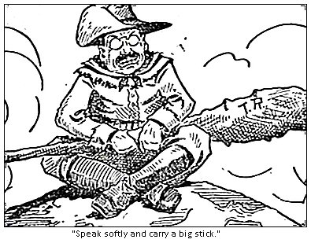
BIG STICK DIPLOMACY
Advocated Big Stick Diplomacy
(building the Panama Canal)
“BIG STICK Diplomacy”. Roosevelt said that the United States would try to work things out peacefully, but if necessary he would use the military and economic POWER of the United States to get what we WANTED.

Slide 22
“Speak softly and carry a big stick, and you will go far.” – Theodore Roosevelt

