Slide 1
DO NOW
Who was Henry Ford?
What were the benefits of the assembly line?
What other things needed to be created along with automobile?

Slide 2
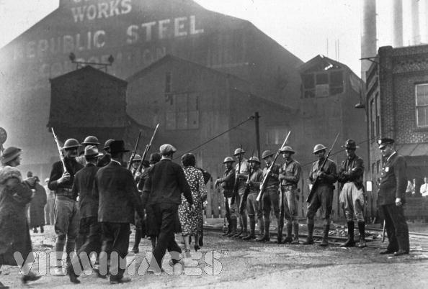
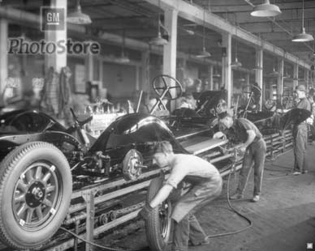
1. Growth of transportation related industries Road construction Oil Steel Automobile
Results of Improved Transportation Due to the Automobile

Slide 3
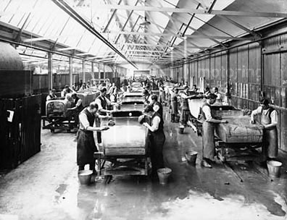
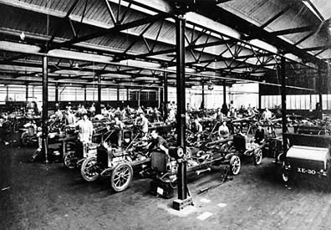
Results of improved transportation
2. Creation of jobs - more people were needed to work in factories and transportation-related industries.

Slide 4
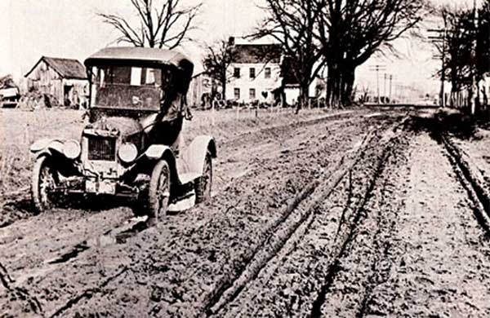
Results of improved transportation
3. Greater mobility-it was easier for people to travel from place to place.

Slide 5
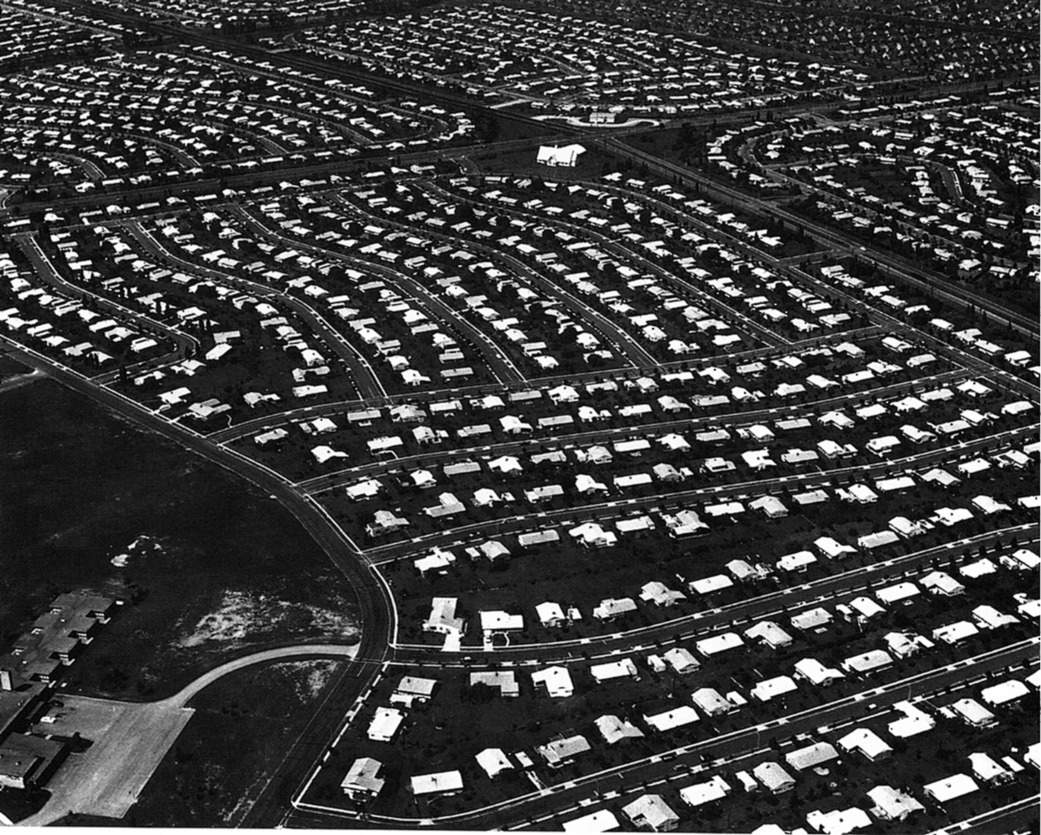
Results of improved transportation
4. Movement to suburban areas. (Outside of the cities)

Slide 6
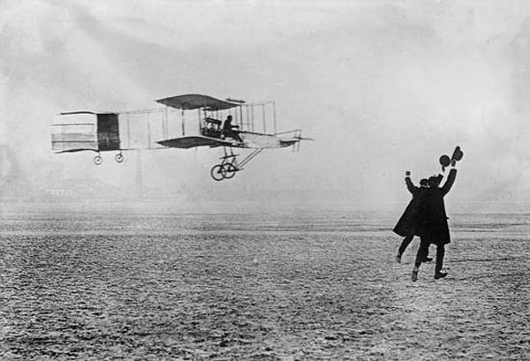
The Wright Brothers invented the first airplane.

Slide 7
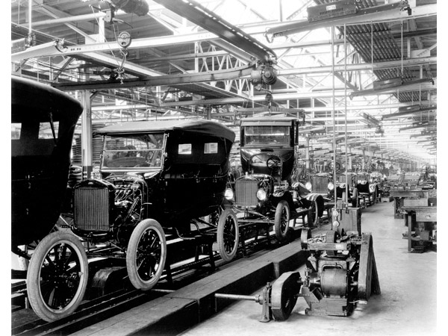
Henry Ford - use of the assembly line made automobiles more affordable through factory production.

Slide 8
Communication Changes

Slide 9
Do Now
1. Who said “Speak softly and carry a big stick”?
Theodore Roosevelt
2. What was the Progressive Movement?
An era of social activism aimed at fixing problems caused by industrialization, urbanization, immigration, and corruption in government.
Who said “I will fight no more forever”?
Chief Joseph

Slide 10
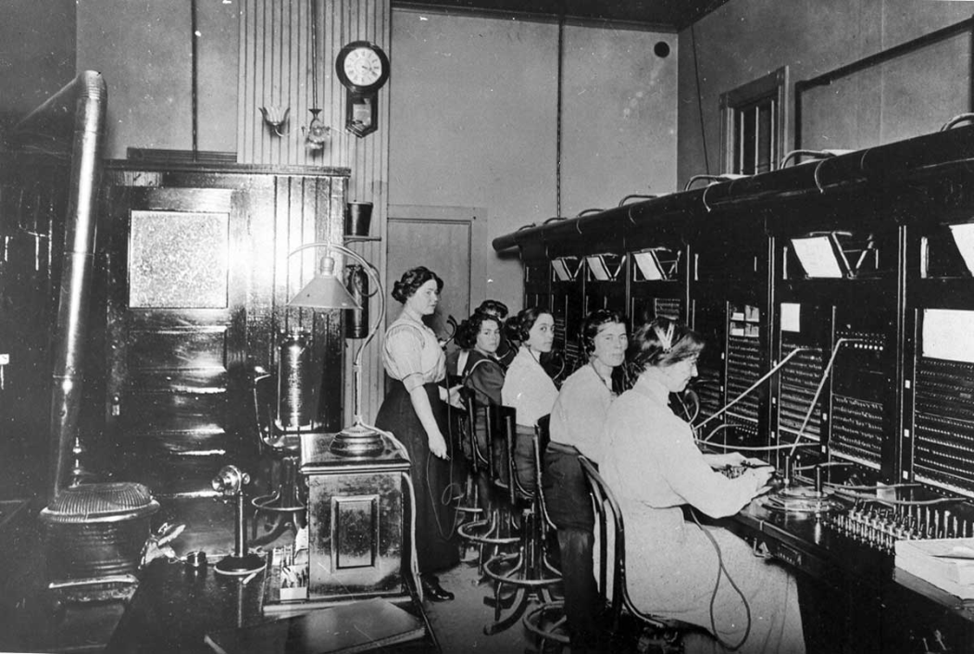
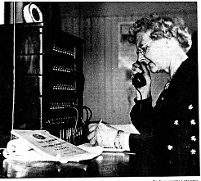
Communication Changes
1. Increased availability of telephones

Slide 11
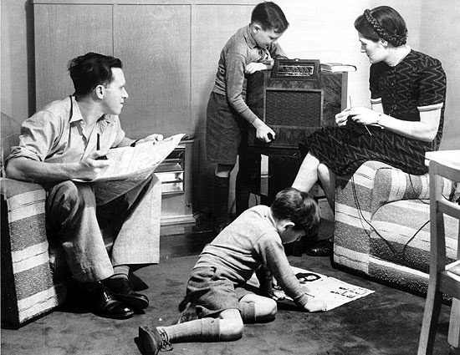
Communication Changes
2. Development of the radio

Slide 12
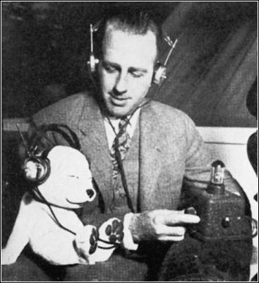
Communication Changes
3. Development of the Broadcast industry

Slide 13
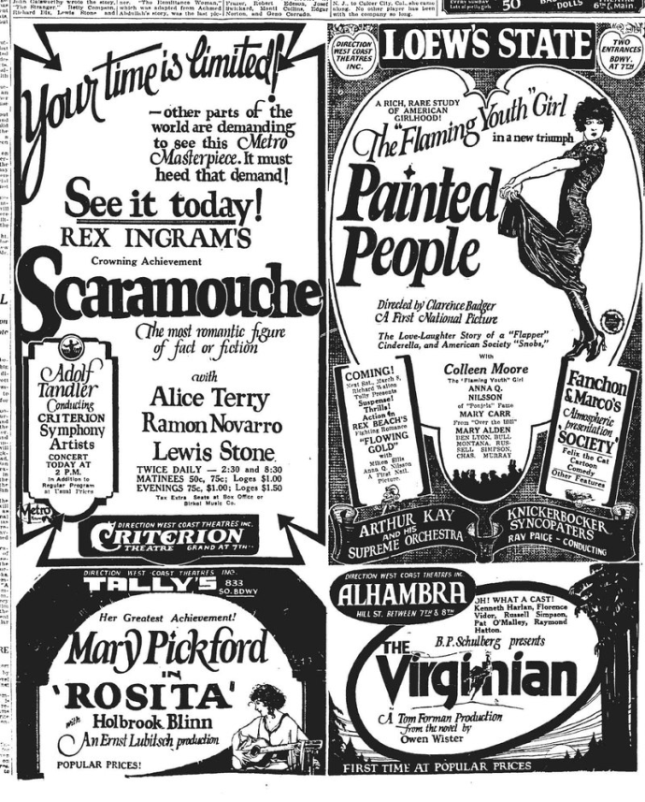
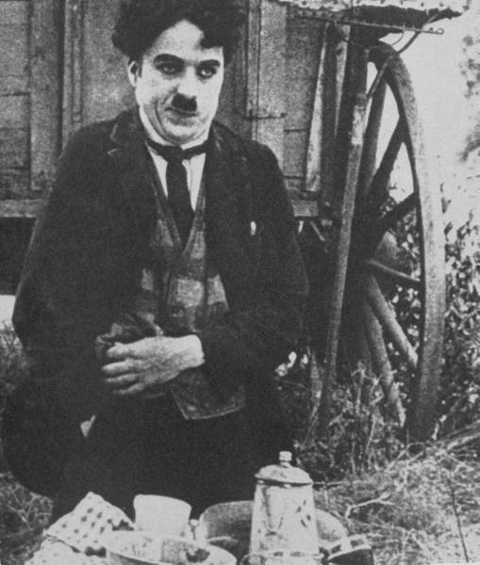
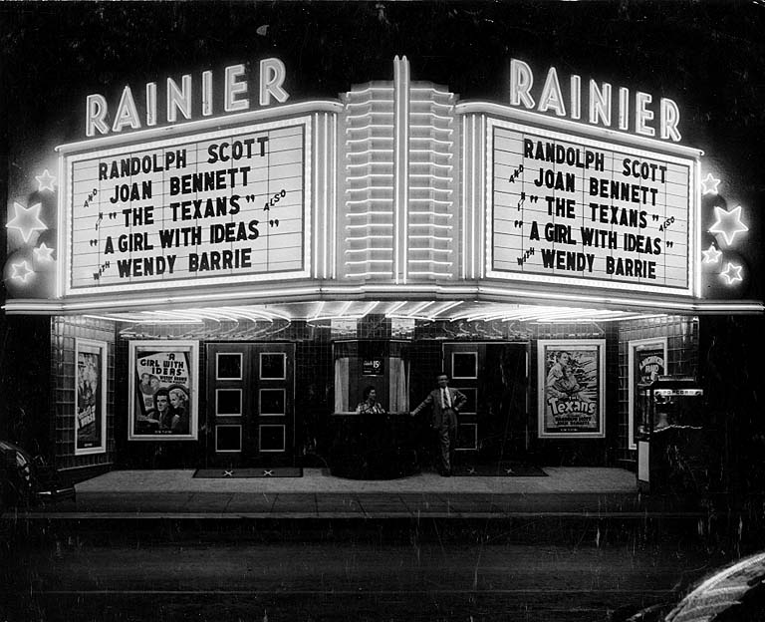
Communication Changes
4. Development of the movies

Slide 14
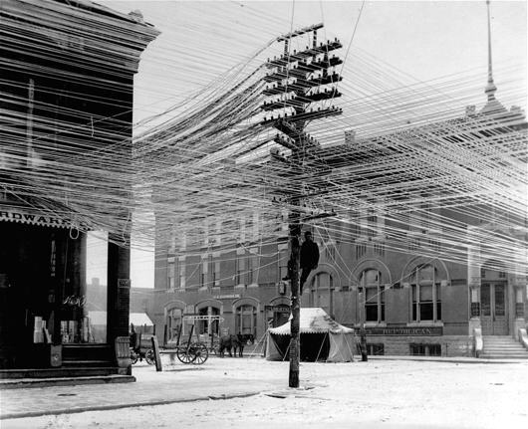
Definition of Electrification
- the use of Electricity to make things work.

Slide 15
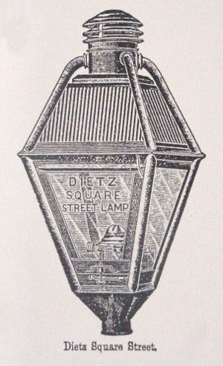
Ways electrification changed American life
1. Electric lighting- allowed people to have a longer day and work at night.

Slide 16
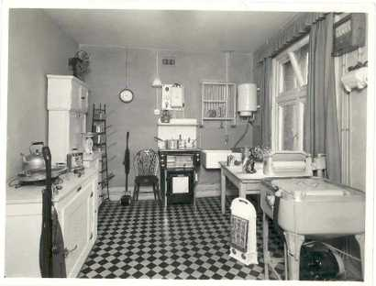
Ways electrification changed American life
2. Labor-saving products (e.g., washing machines, electric stoves, water pumps) -allowed people to do housework faster and have more leisure time.

Slide 17
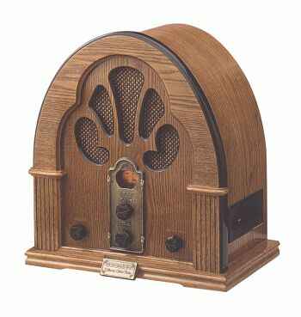
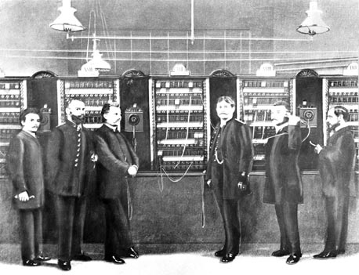
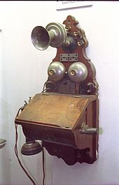
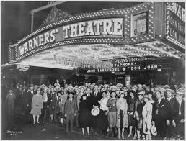
Ways electrification changed American life
3. Improved Communications

Slide 18
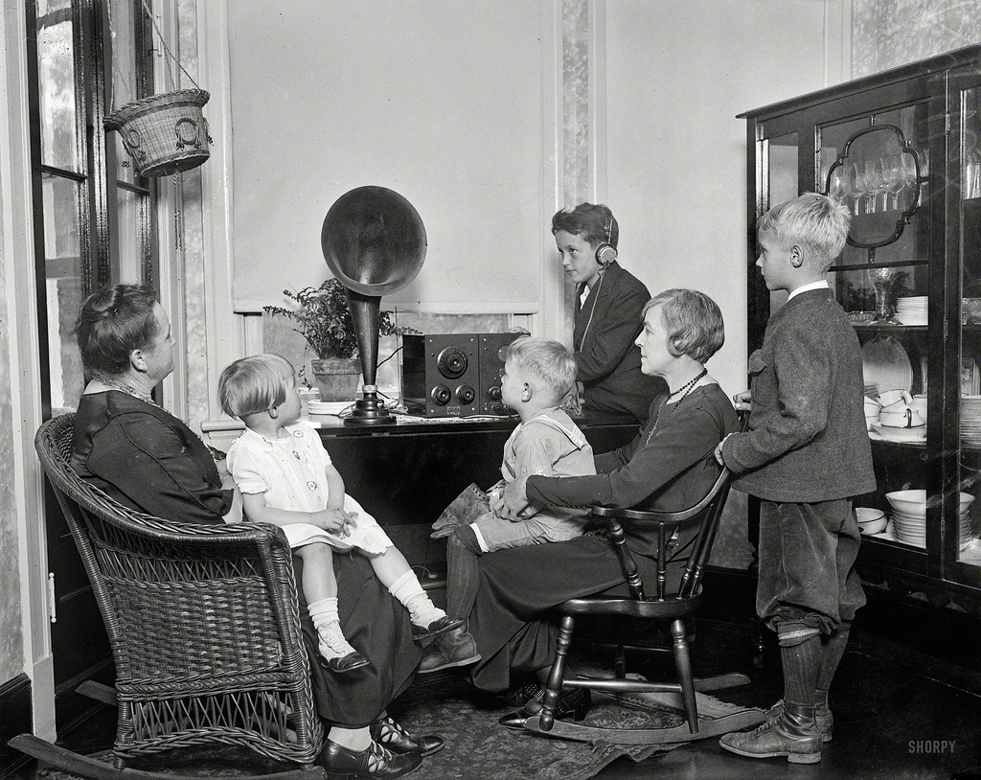
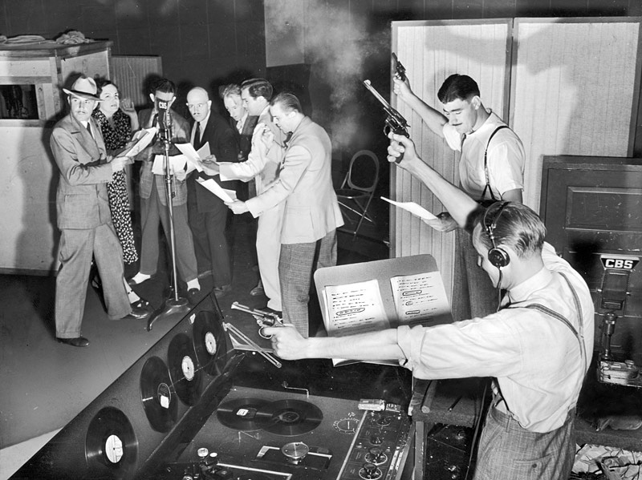
Ways electrification changed American life
4. Entertainment (e.g., radio and movies)- allowed people to enjoy life and spend their money.

Slide 19
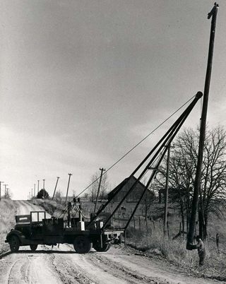
Technology extended progress into all areas of American life, including neglected rural areas.

