Slide 1
Do NOW
What event ignited WW I?
The assassination of Archduke Franz Ferdinand.
2. This led which country to declare war on which country?
Austria-Hungary declared war on Serbia.
3. Which countries made up the Allies?
Serbia, Russia, France, England, Belgium, and the U.S.
Which countries made up the Central Powers?
Austria Hungary, Germany, Bulgaria, and the Ottoman Empire

Slide 2
Why did the United States get involved in WW I?

Slide 3
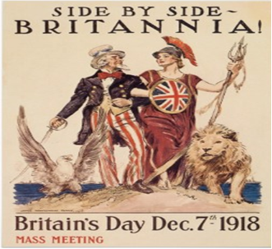
1. The U.S. had strong economic and political ties to Great Britain.

Slide 4
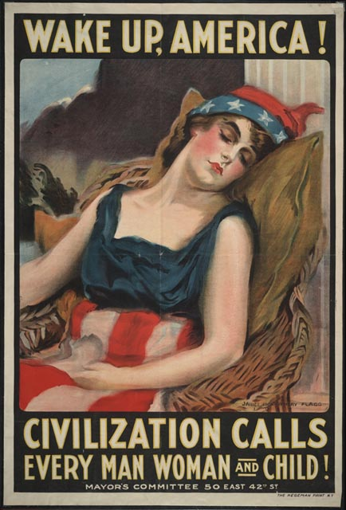
2. Inability to remain NEUTRAL (not interfere).

Slide 5
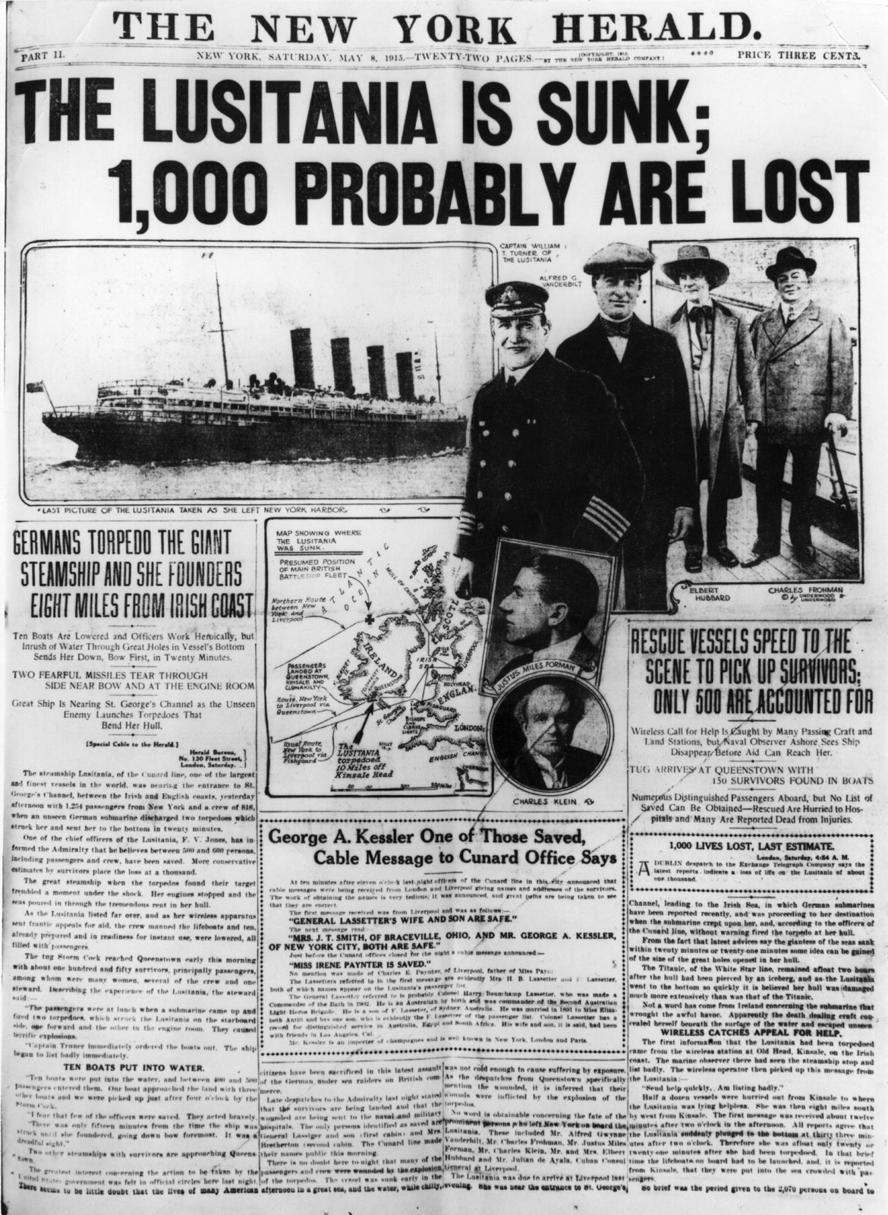
3. German unrestricted SUBMARINE WARFARE (sinking of the LUSITANIA and other ships)

Slide 6
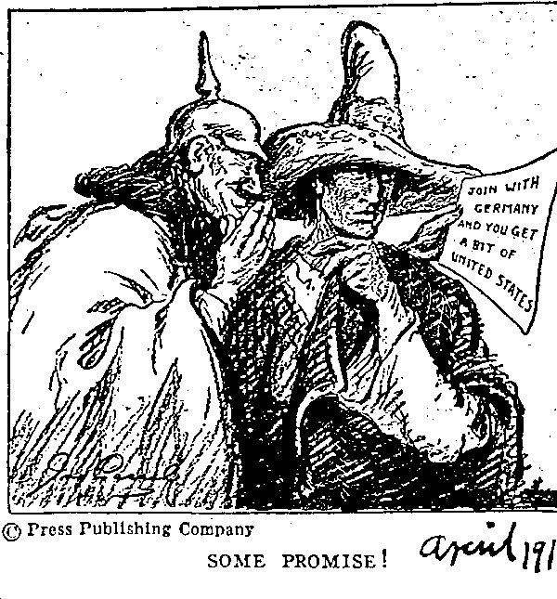
4. Zimmermann Telegram
Germany asked Mexico to join the Central Powers and attack the United States.
Offered them Texas, New Mexico, and Arizona.
Threatened U.S. National interests and forced President Wilson into action.

Slide 7
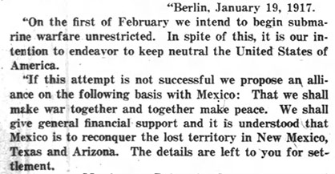
4. Zimmermann Telegram

Slide 8
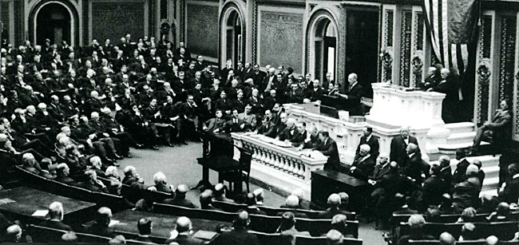
President Wilson asked Congress for permission to go to war. congress declared war on April 6, 1917 ‘’ President Wilson, "an act of high principle and idealism... ...a crusade to make the world safe for democracy."

Slide 9
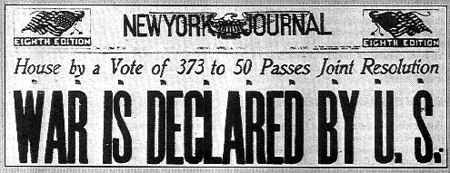
The United States’ involvement in World War I ended a long tradition of avoiding involvement (isolationism) in European conflicts and set the stage for the United States to emerge as a global superpower.

Slide 10
Warfare saw many changes in WW I Due to New Technologies

Slide 12
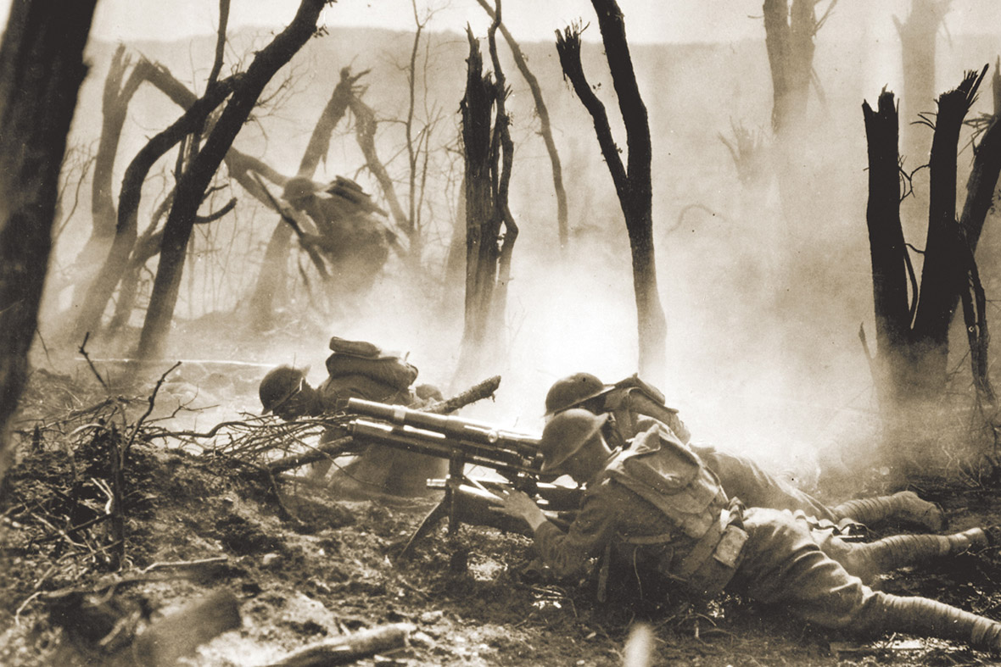
The 37-mm gun section of the 2nd Division is seen in combat against German forces in an undated World War One photo. Machine guns were regularly employed for the first time, forever altering the battlefield. Reuters

Slide 13
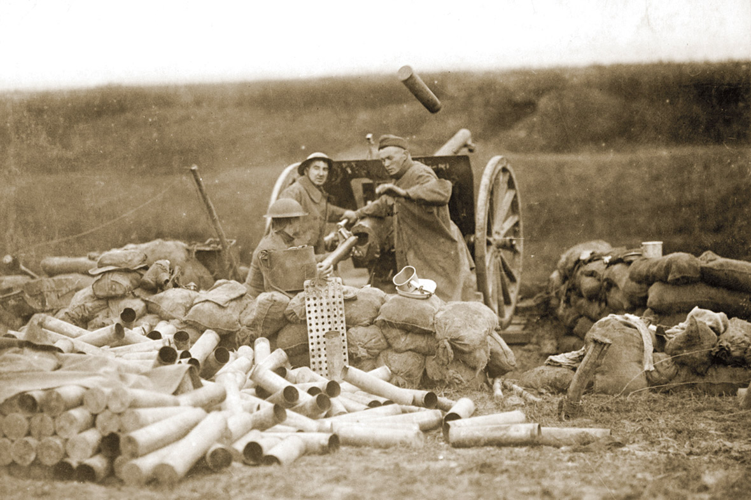
US artillerymen fire a 75mm gun toward Montsec from a position near Beaumont, France on September 12, 1918. World War One was the first major war where a majority of casualties were inflicted by long range artillery. Reuters

Slide 14
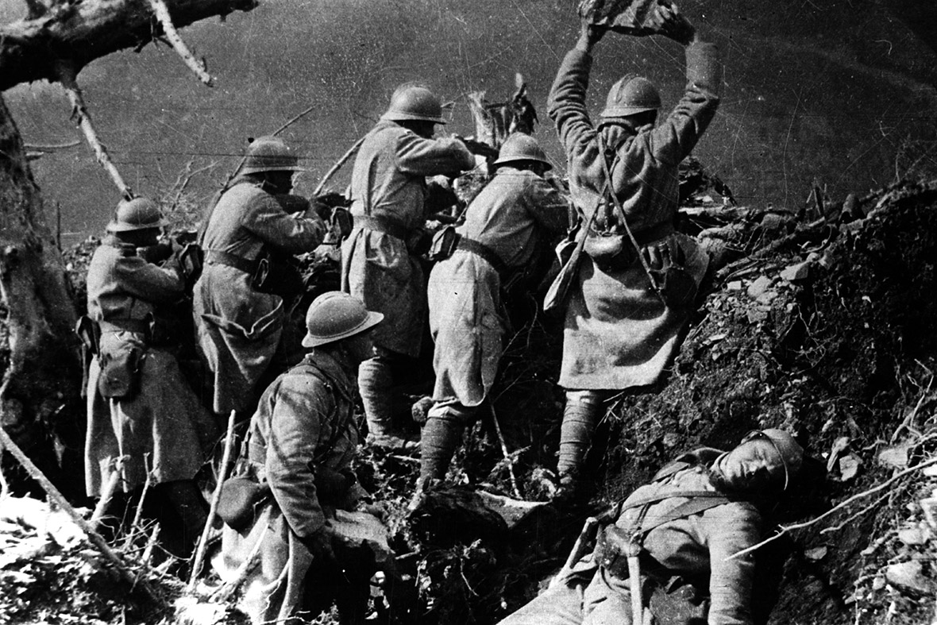
French soldiers fire rifles and throw rocks in an attempt to dislodge German soldiers from hillside trenches. Steel helmets were used for the first time in World War One as protective headgear for soldiers. Getty

Slide 15
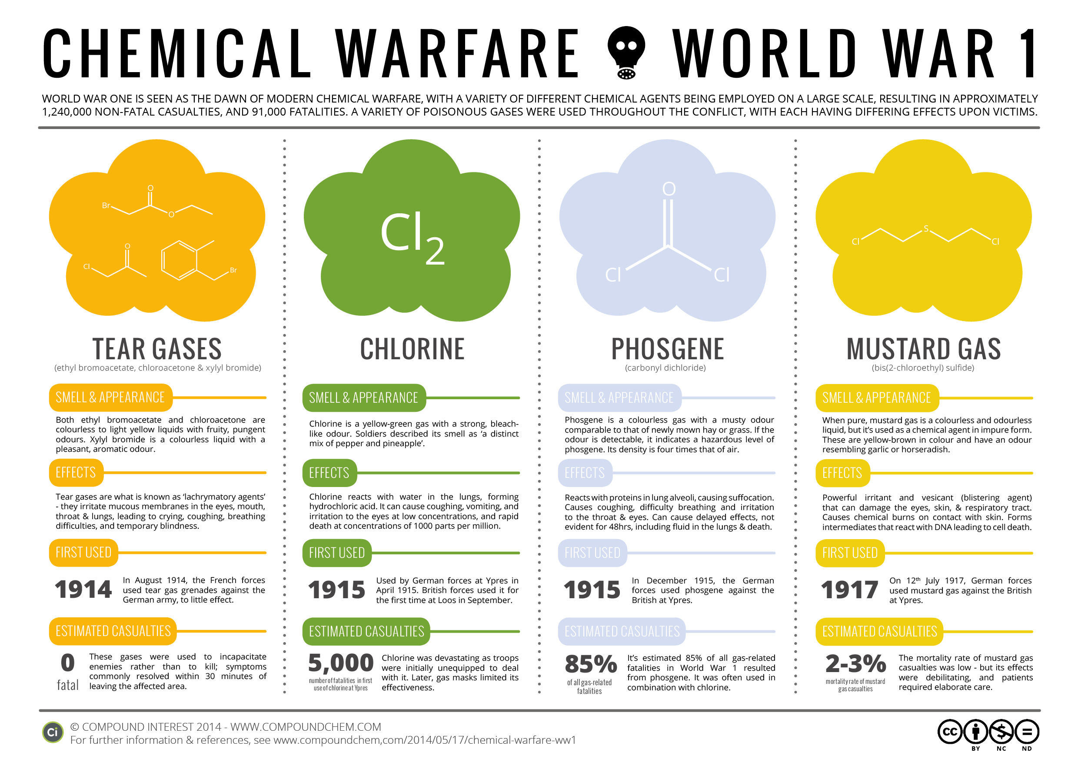

Slide 16
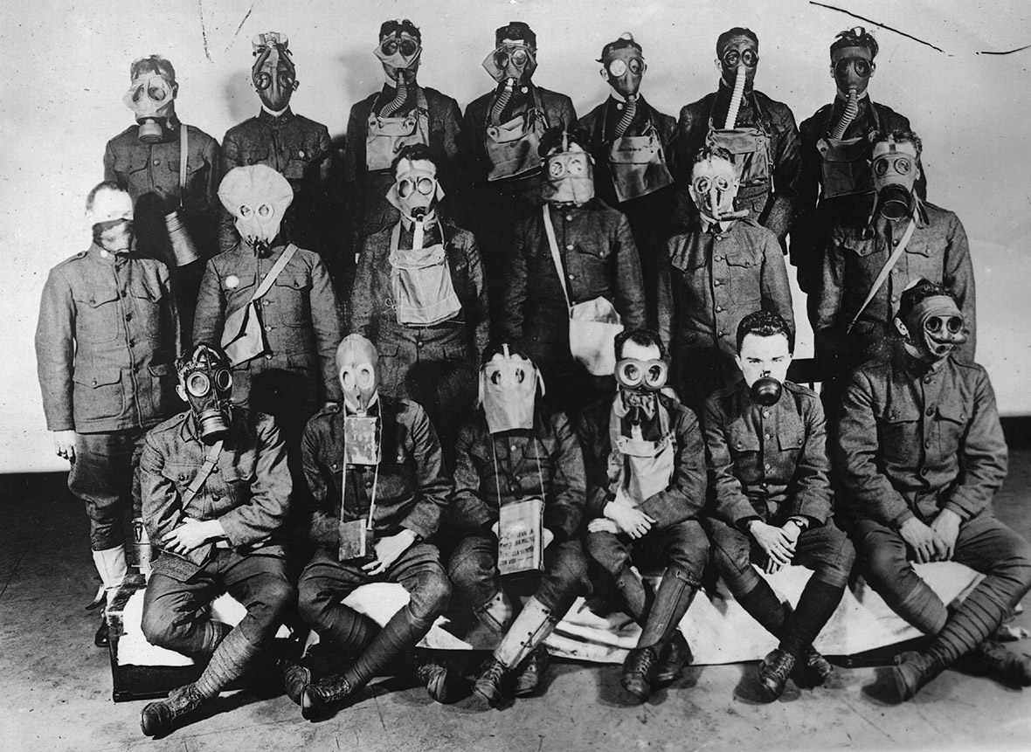
Circa 1917: US soldiers demonstrate the different styles of gas masks used by Allied and German forces during the First World War. Chemical weapons in the form of deadly poison gases were used for the first time, leading quickly to the development of the first gas masks. Getty

Slide 17
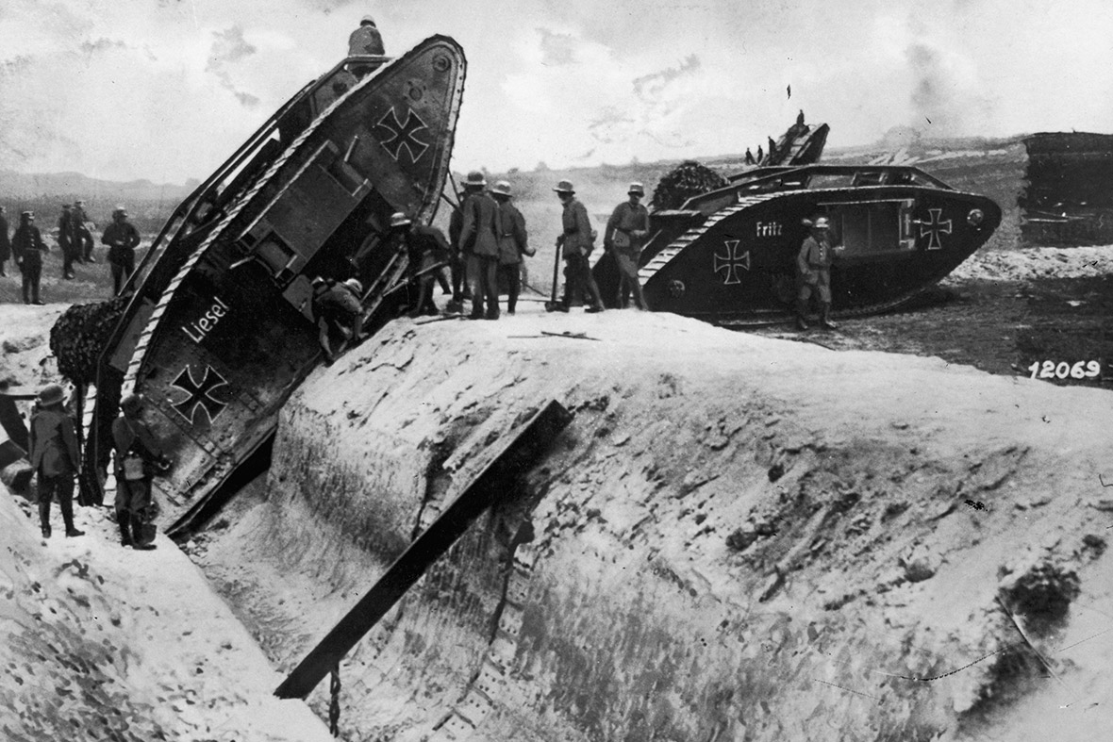
Circa 1917: Germans test the climbing powers of captured British tanks, redecorated in German colors. Tanks were invented as a means of breaking the trench warfare stalemate. Getty

Slide 18
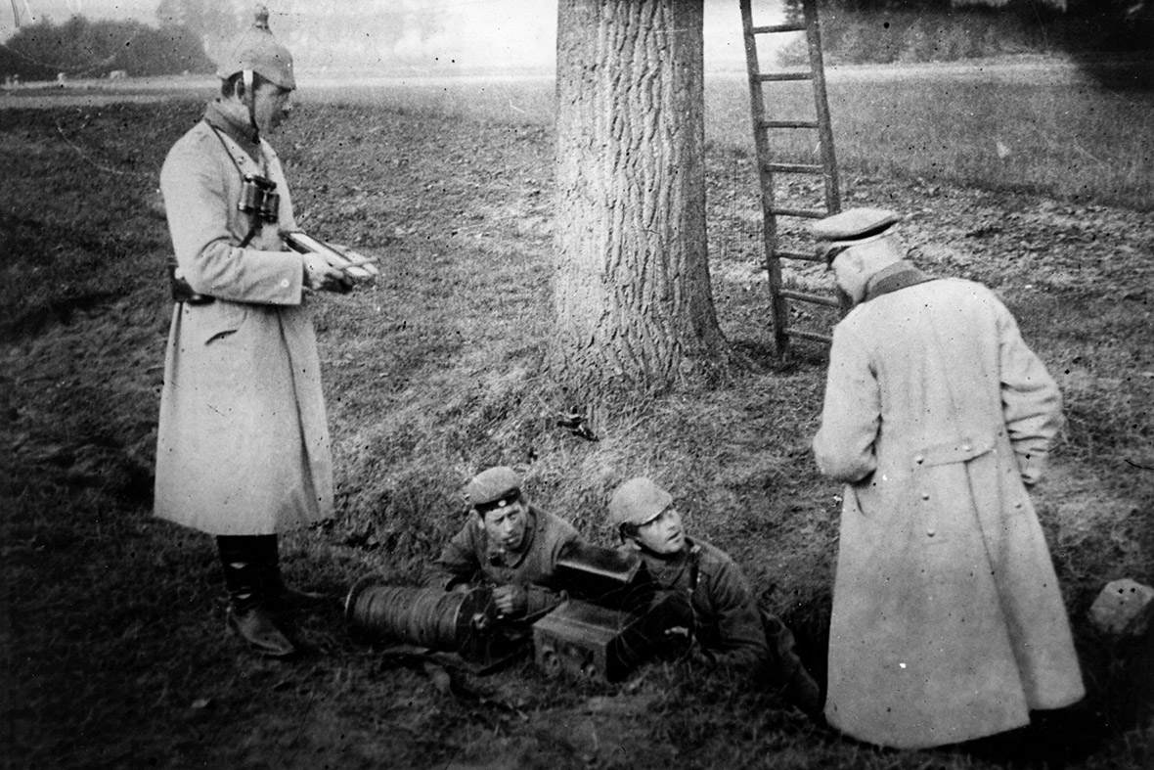
A group of German soldiers prepare to make contact using a field telephone. Wireless communications and field telephones were regularly used for the first time to coordinate military movements. Getty

Slide 19
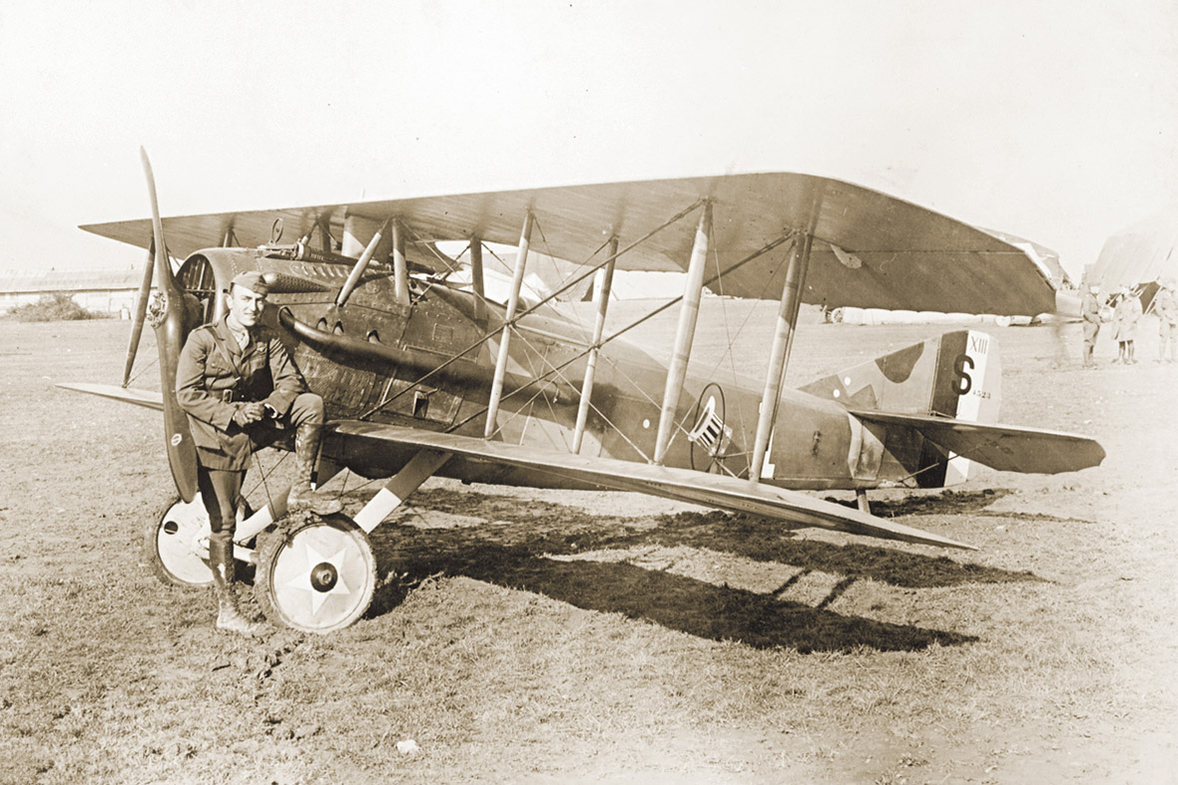
1st Lt. Eddie Rickenbacker, America's most successful World War One fighter ace, poses with a biplane. Aircraft were deployed in war en masse for the first time, for both air-to-air combat and reconnaissance. Reuters

Slide 20
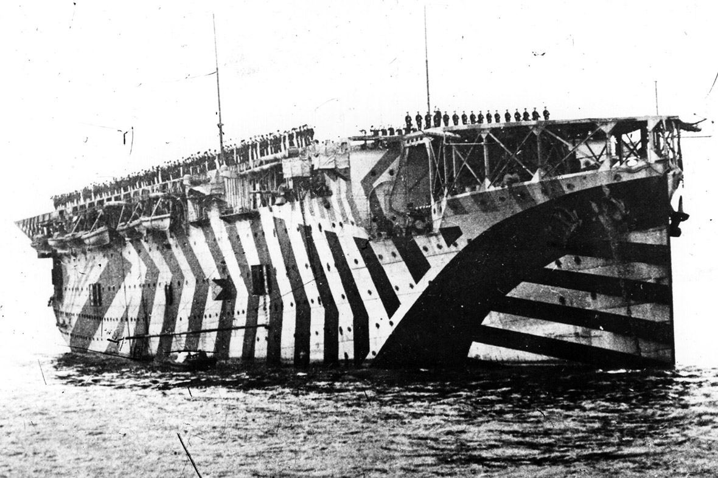
Aircraft carriers were used for the first time, with the HMS Argus setting the template for future carriers capable of allowing planes to both take off and land on ships. Dazzle camouflage was designed by Norman Wilkinson to confuse enemies. The camouflage was intended to make it difficult to pinpoint the direction in which a ship was travelling. Getty

Slide 21
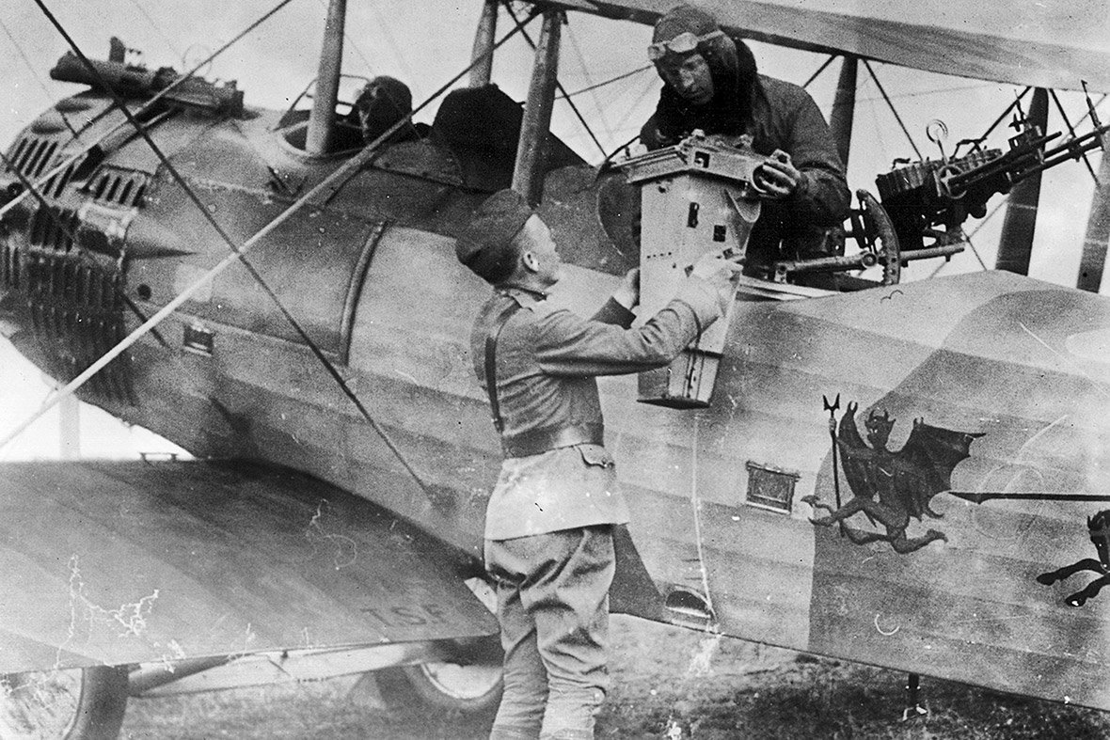
An officer receives a camera and its film for processing in the field. Reuters

Slide 22
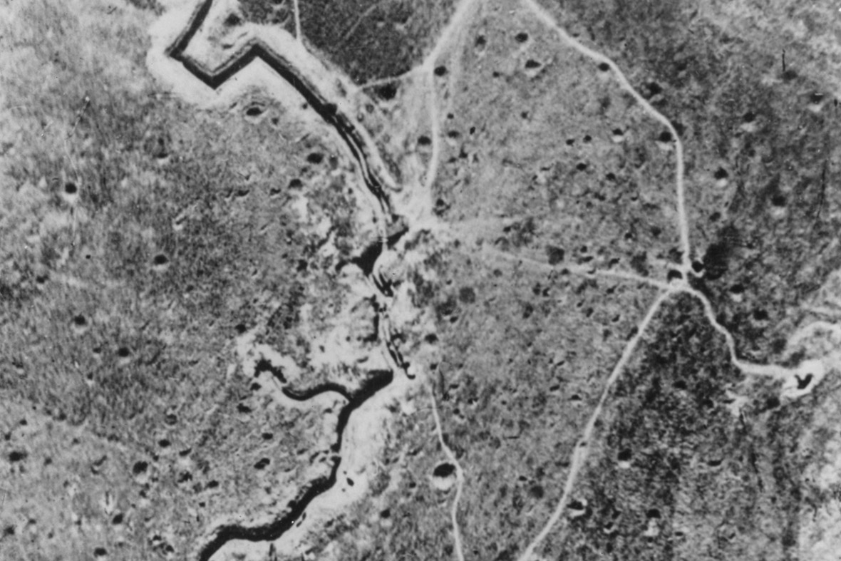
An early aerial reconnaissance photograph taken at 8,000 ft shows deep trenches, mine craters and shell strikes on an important sector of the Hindenburg Line. Getty

Slide 23
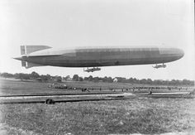
German Zeppelin – used to attack London

Slide 24
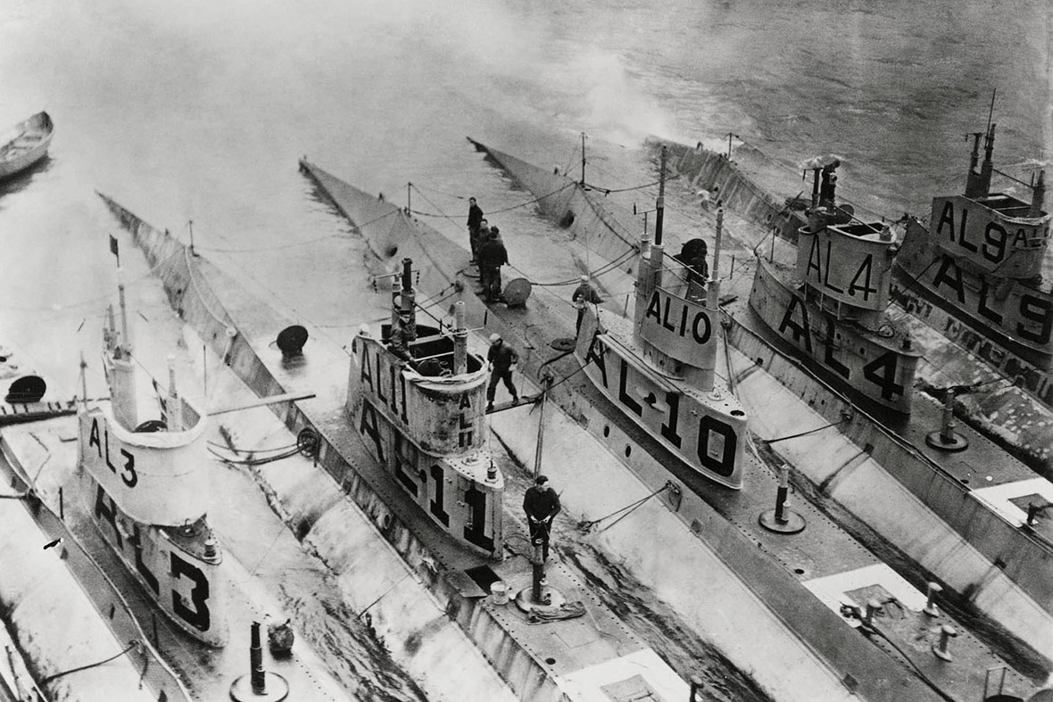
United States L class submarines are seen stationed in the Azores during World War One. Submarines were used in mass numbers for the first time in naval warfare. Reuters

Slide 25
Trench Warfare

Slide 26
