Slide 1
Do NOW
What event helped the USA become a world power?
The Spanish American War helped the US become a world power.
2.What said that the USA should have international police power?
The Roosevelt Corollary to the Monroe Doctrine declared the US had international police power.
3.What is an alliance?
An alliance is a formal agreement or treaty between two or more nations or people to help each other for specific purposes.
4. Where did World War I take place?
World War I took place mostly in Europe.

Slide 2
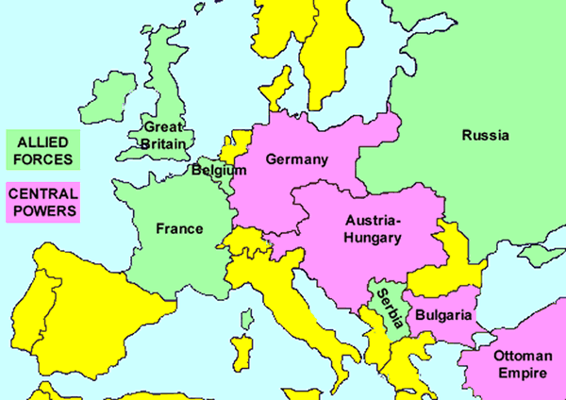
Europe before WW I

Slide 3
What started World War I ?

Slide 4
Bosnia was a territory in the very south-east corner of the Austrian empire.

Slide 5
Some people there wanted to be independent from Austria and set up their own state which could run itself.

Slide 6
Serbia had ethnic (family) ties to Bosnia and many Serbians wanted Bosnia to be free.

Slide 7
What started World War I ?

Slide 8
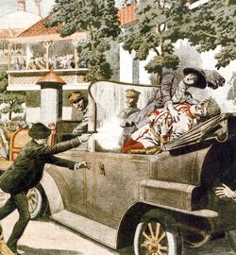
What started World War I ?
On June 28, 1914 Archduke Franz Ferdinand, the heir to the Austrian throne, was assassinated by a Serbian organization known as the Black Hand Gang.

Slide 9
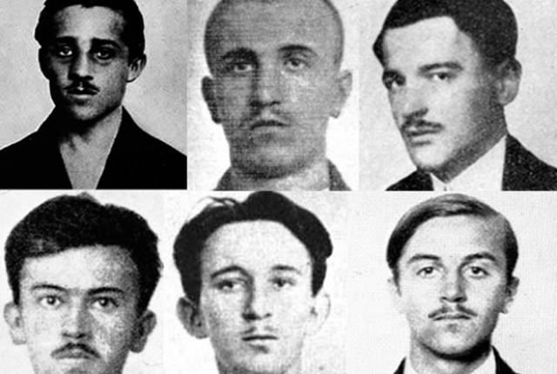
← Archduke Franz Ferdinand
← Gavrilo Princip
Black Hand Gang →

Slide 10
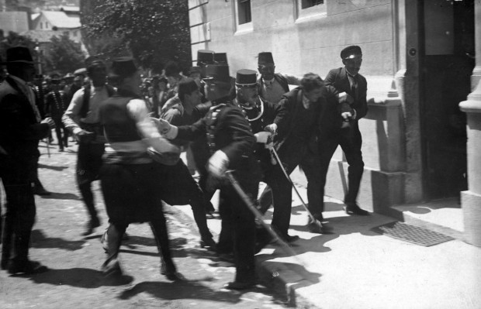
The arrest of Gavrilo Princip

Slide 11
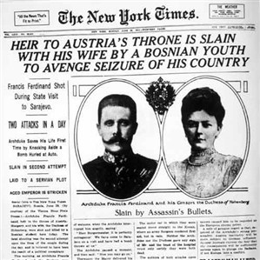

Slide 12
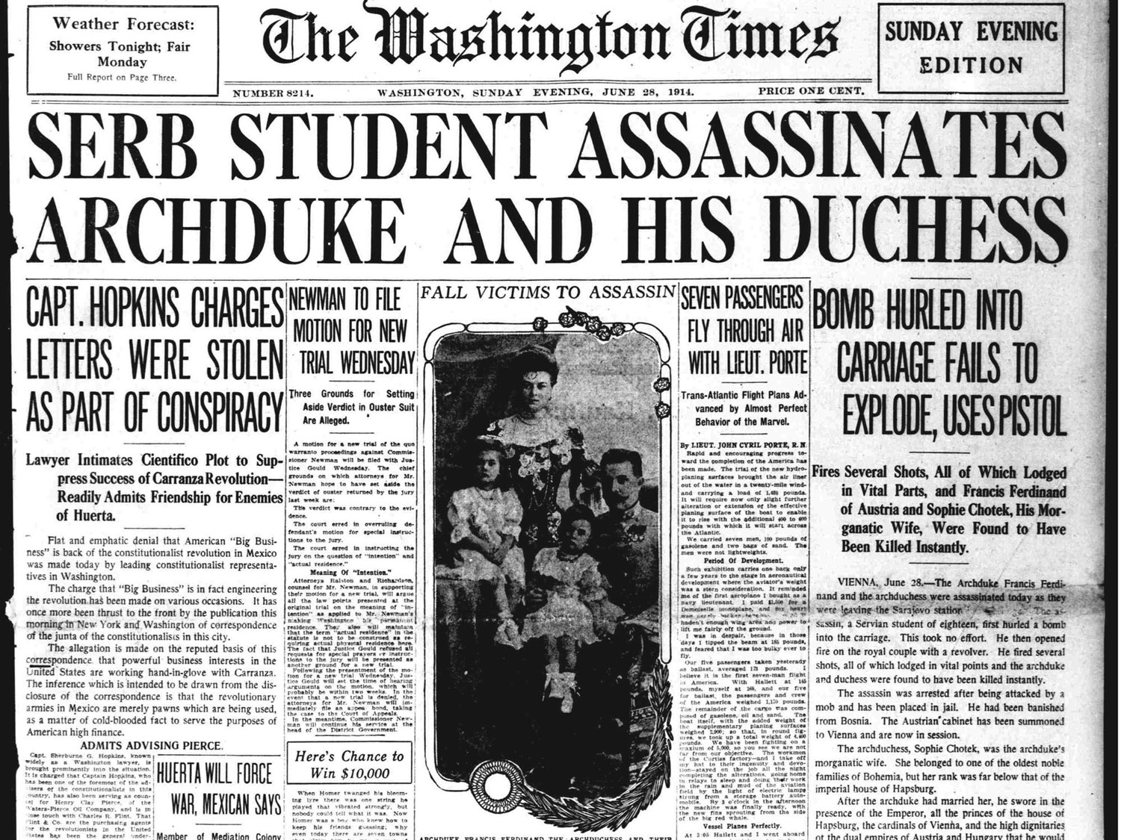

Slide 13
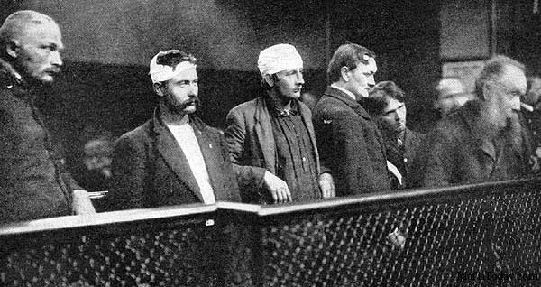
The Trial
In total eight men were charged with treason and Franz Ferdinand's murder. However under Austro-Hungarian law capital punishment could not be applied to anyone under the age of 20 when the crime was committed. Gavrilo Princip, whose precise date of birth could not be firmly established at his trial, was therefore imprisoned for the maximum duration, twenty years. He died however of tuberculosis on 28 April 1918.

Slide 14
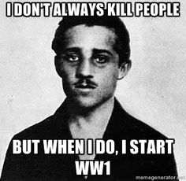
Gavrilo Princip

Slide 15
Austria-Hungary blames Serbia for the murder of their Archduke and…

Slide 16
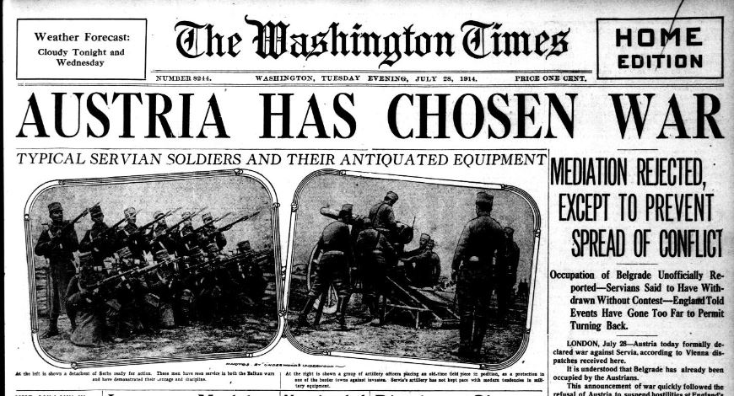
Austria-hungary declares war against Serbia

Slide 17
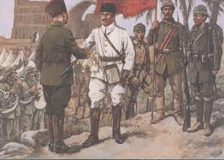
Russia, Serbia's traditional ally, joins them against Austria-hungary.

Slide 18
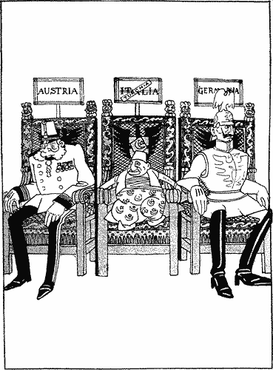
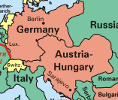
Germany, bound by the Triple Alliance treaty to Austria, joined the war.

Slide 19
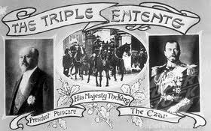
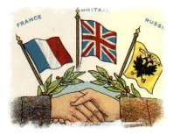
France and Britain, bound by alliance with Russia known as the Triple Entente, joined the war.

Slide 20
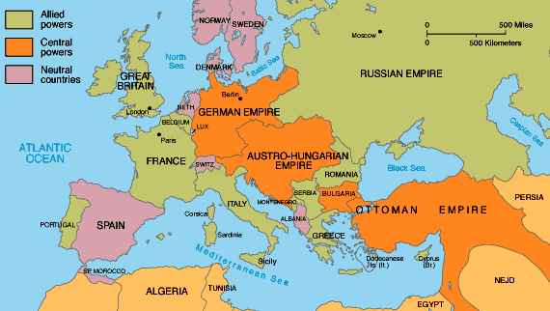
Italy remained neutral until 23 May 1915, when it entered the war on the side of the Allies.

Slide 21
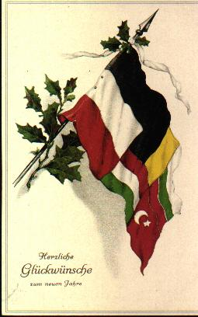
Central powers
Germany
*Austria-Hungary
Bulgaria
Ottoman Empire (Turkey)

Slide 22
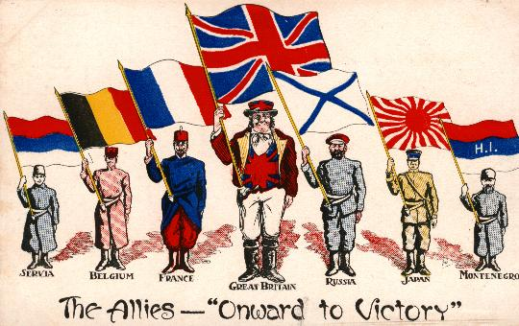
Allies
Great Britain
France
Russia
Belgium
*Serbia
USA

Slide 23
