Slide 1
Do now
Why did Russia Join WWI?
They were an ally of Serbia and Austria-Hungary declared war on Serbia
2. Why did Germany Join WWI?
They were an ally of Austria-Hungary
Why did France and Great Britain Join WWI?
They were allies with Russia.
Why did the USA Join WWI?
They joined because they has strong ties with England, they were unable to stay neutral, German unrestricted submarine warfare and the Zimmermann telegram.

Slide 2
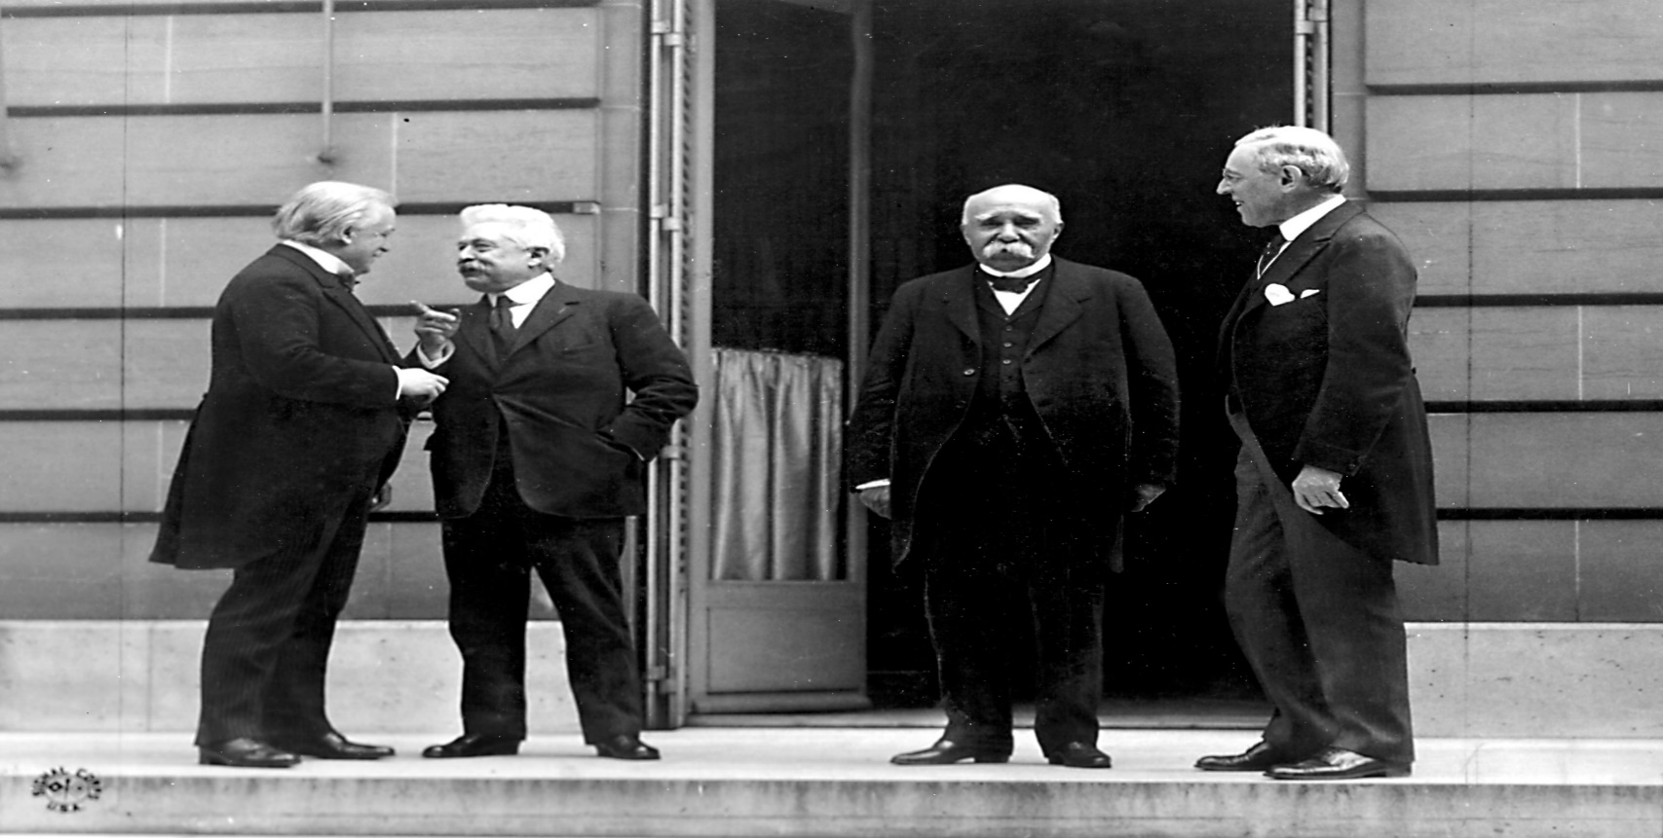
Post WW I The United States provided international leadership at the conclusion of ww i.
The BIG FOUR – Italy, England, France and the United States

Slide 3
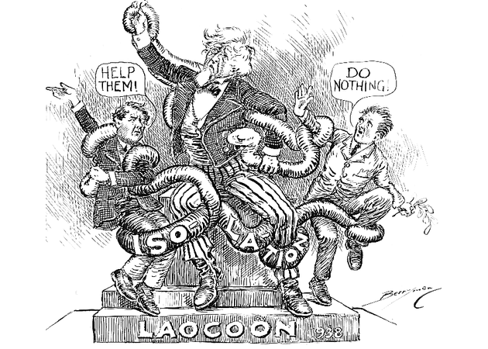
After WWI there were disagreements about the extent to which the United States should participate in world affairs.

Slide 4
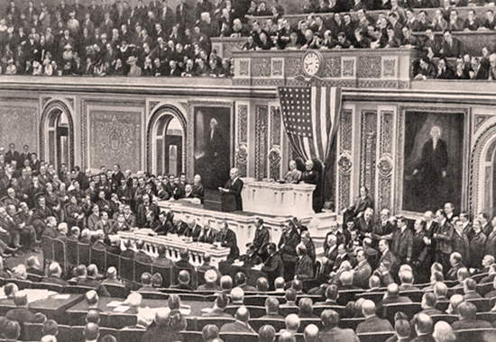
President Woodrow Wilson had a peace plan after WWI. (14 points speech)

Slide 5
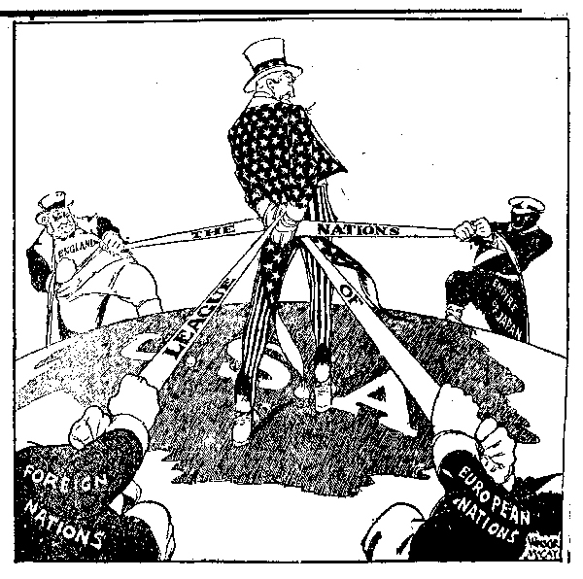
The plan called for the formation of a peacekeeping organization called the league of nations.

Slide 6
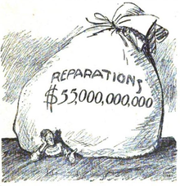
Treaty of Versailles (Agreement with Germany) -caused Germany to lose land -to accept total blame for the war -pay for all the damages -No navy or air force -Army limited to 100,000 men

Slide 8
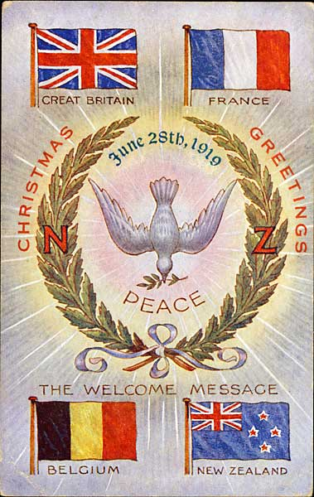
In Europe, Germany suffers greatly for their involvement in WWI, largely due to the Treaty of Versailles

Slide 9
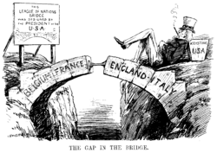
•The United States decided not to join the League of Nations because the United States Senate failed to ratify the Treaty of Versailles.

Slide 10
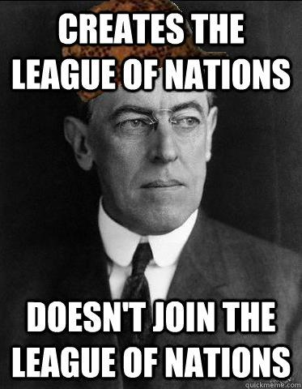

Slide 11
